Slide 1

Subcommittees´ meeting
10/11/2021

Slide 2
Agenda
Quick news from the secretariat
SDP feedback
Comp 1 feedback
Fun and games
AOB

Slide 3

Governing board
PSC motions
- Reports
- ToR
- FIPP: Ms. Prachi Pandey

Slide 4
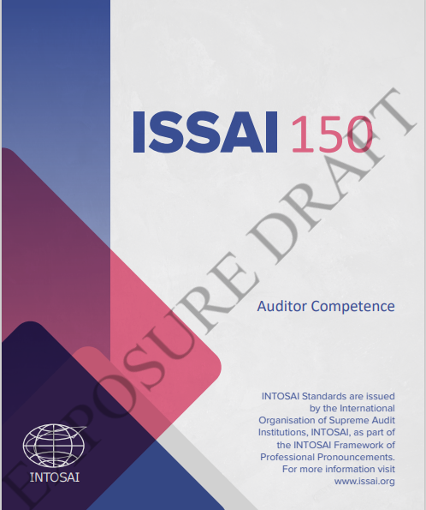
Auditor competence pronouncement
EXPOSURE PERIOD
31/12/2021
https://www.issai.org/projects/developing-pronouncements-on-auditor-competence/

Slide 5
SDP process – messages from the SC
Continue the discussion together of the SDP together with the comp 1 review
Criteria for inclusion and not inclusion – formal communication
Goal the delivery of excellent project over time: quality, relevance, timing, need
Increase awareness – better communication
Roles and responsibilities for each player
More broad-based participation in the process
Start with gap analysis: new and revision of pronouncements
Duplication/conflict issues
In the IFPP/ outside the IFPP: Subject matter specific guidance
Transparent process with technical assessment of the suggestions
More resources to FIPP and the TSF
All INTOSAI projects to SDP – possibility of adjustments

Slide 6
Comp 1 review – principles-based framework
Define the concept: principles - what to achieve vs rules – how to achieve
What ISSAI implementation means in a principles-based approach?
For PA principles-based is not enough
Standards need guidance and/or proceduresn
IFPP already too broad – difficult to navigate
Guidance material outside the IFPP?
Possibility of web solutions
Limit numbers of principles, max 20

Slide 7
Comp 1 review – aspirational framework
Define the concept: what is an aspirational framework
Framework must be relatable and realistic to SAIs
General standards that are applicable in different contexts
SAIs struggle to mee the INTOSAI requirements
Issai compliance is not understood – aspirational would be difficult
Bar too high – might leave some SAIs behind
Non-aspirational framework a reputational risk for INTOSAI

Slide 8
Comp 1 review – elective guidance
Define the concept: what is elective guidance
Guidance should explain the Issais – others outside the IFPP
Clarify what should be in the framework and the criteria
Now there are standards, practices, manuals – some temporary, some general, some not helpfull
Improve accessibility
GUIDs in the IFPP have a higher status – more flexible due process
How to deal with guidance that do not meet the IFPP criteria?
KSC portal not easy to use – all material should be in one place

Slide 9
Comp 1 review – non-audit guidance
INTOSAI is a huge community, common ground difficult to develop
Limited resources should not be used to benefit a small number of SAIs
Current mandate already a lot of work
Problem of conflicting authorities
Credible space outside the IFPP for non-audit guidance
Survey: guidance for forensic audit
Already a lot of non-audit material in the IFPP
Crucial non-audit engagements should also be covered by INTOSAI pronouncements
The scope of the FIPP should be clearly defined
Modifications to the current scope should be carefully evaluated from a public interest perspective

Slide 10
Comp 1 review – Innovative IT platform
Wikipedia concept
Lot of repetition in the IFPP – identify differences and eliminate duplication
New practical tools:
IT tool to put everything together to clean up the content
Reliability issues
Simple language
Almost dialogue
Accessible language&translations
tools for users and authors
support for various language versions
printout option
A more dynamic and interactive solution will require continuous monitoring.

Slide 11
Time for fun and games

Slide 12

Next meeting 2022

