Slide 1


Review of the IFPP (Component 1)
Preliminary survey results

Slide 2
Response rate
 | responses | %
Total responses | 125
INTOSAI | 117 | 60 %
EUROSAI | 42 | 82 %
ASOSAI | 27 | 57 %
AFROSAI | 29 | 54 %
ARABOSAI | 10 | 45 %
OLACEFS | 19 | 39 %
PASAI | 10 | 37 %
CAROSAI | 5 | 22 %
non-INTOSAI responses | 8

Slide 3
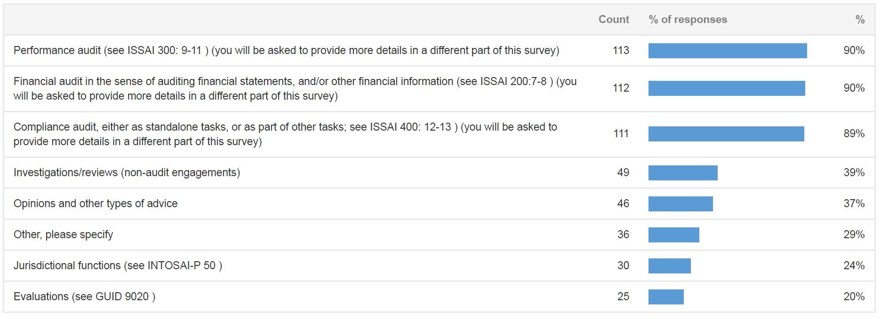
The work SAIs do

Slide 4
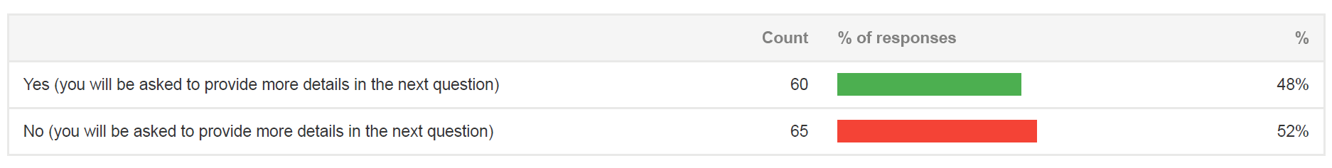
Should the IFPP cover more engagement types?

Slide 5
How the IFPP is used

Slide 6
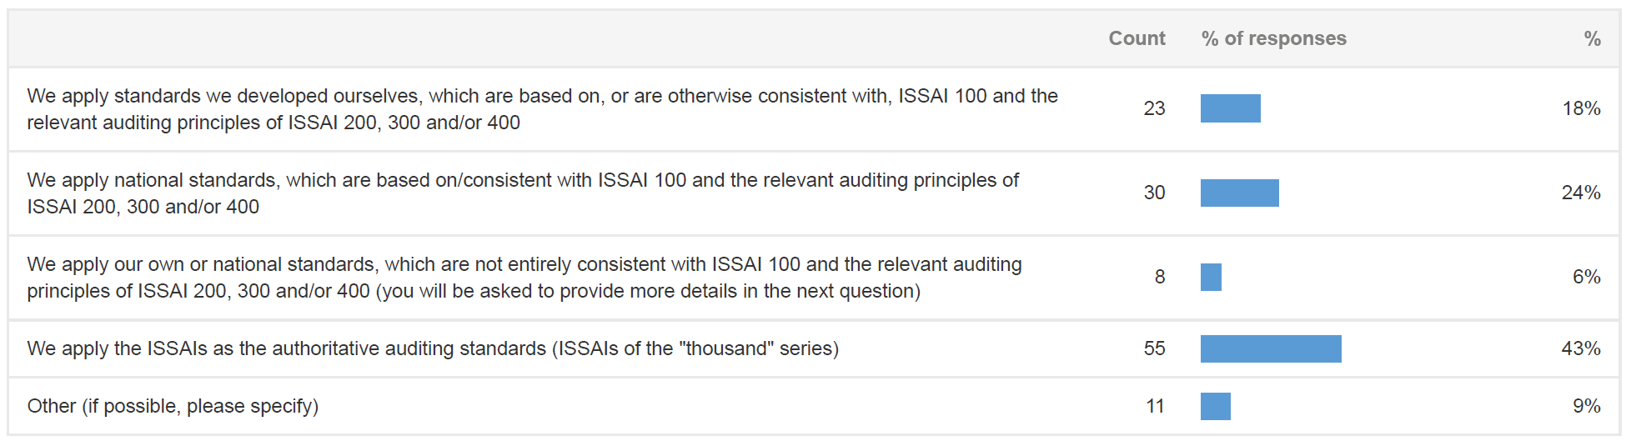
What standards SAIs apply

Slide 7
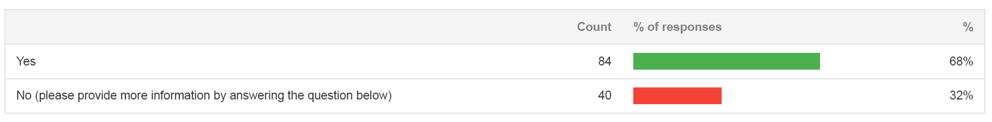
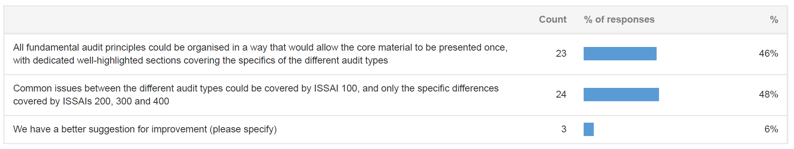
Should audit type ISSAI principles be presented separately of ISSAI 100?

Slide 8
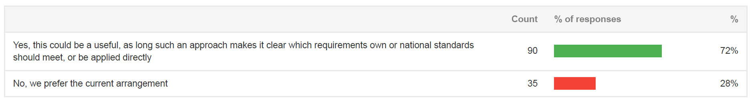
Should audit type material (principles and standards) be presented in one place?

Slide 9
Combining audit objectives in one engagement

Slide 10
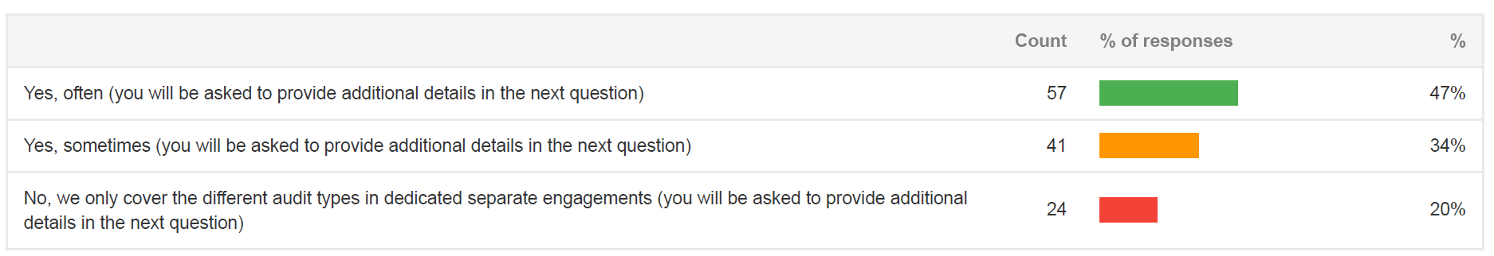
Combining audit objectives in one engagement

Slide 11
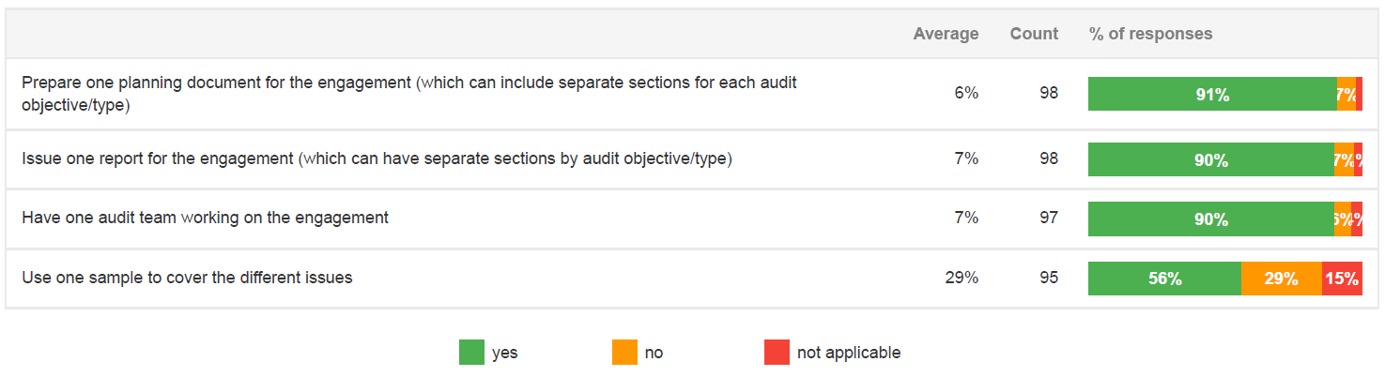
Practice for combining audit objectives in one engagement

Slide 12
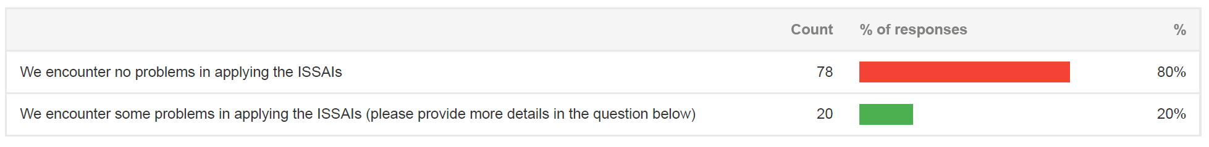
Is it clear which ISSAIs to use in applying a ʻcombined auditʼ approach?

Slide 13
The status of guidance

Slide 14
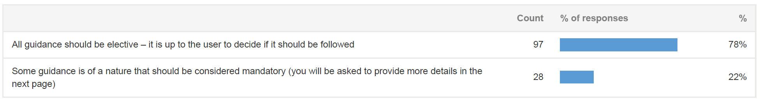
Should guidance be elective or mandatory?

Slide 15
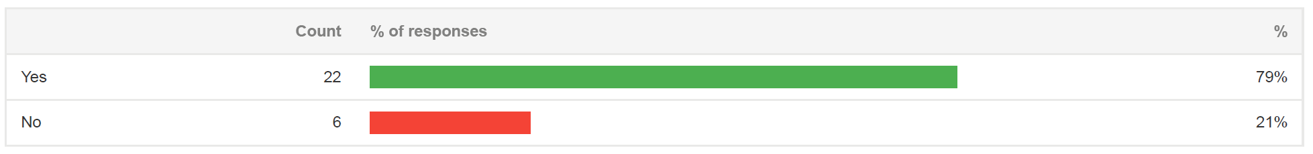
Should mandatory guidance be renamed?

Slide 16
Making the IFPP more accessible

Slide 17
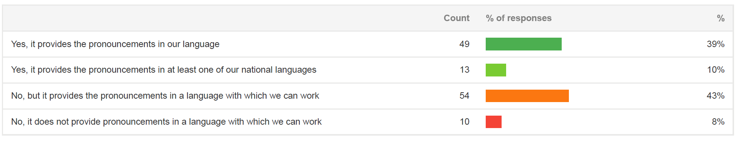
Is IFPP available in the SAI language

Slide 18
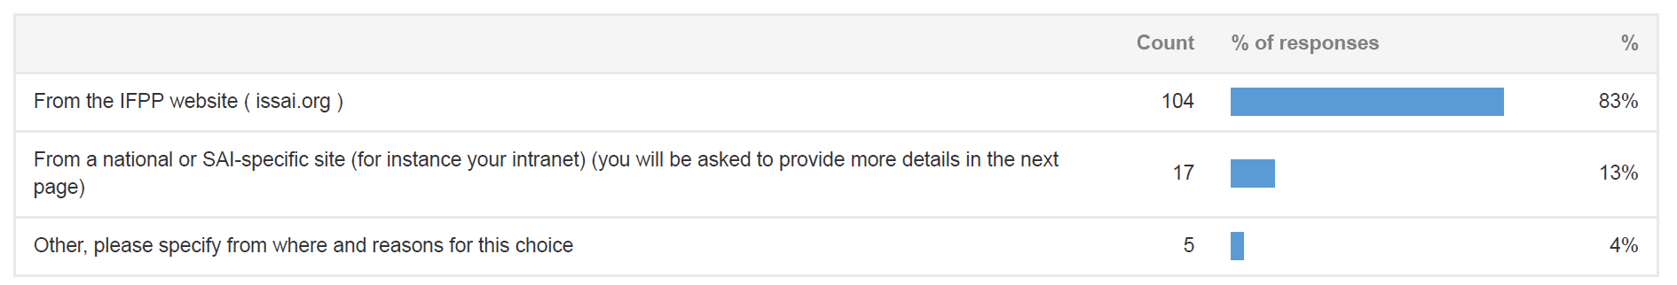
How SAIs access IFPP?

Slide 19
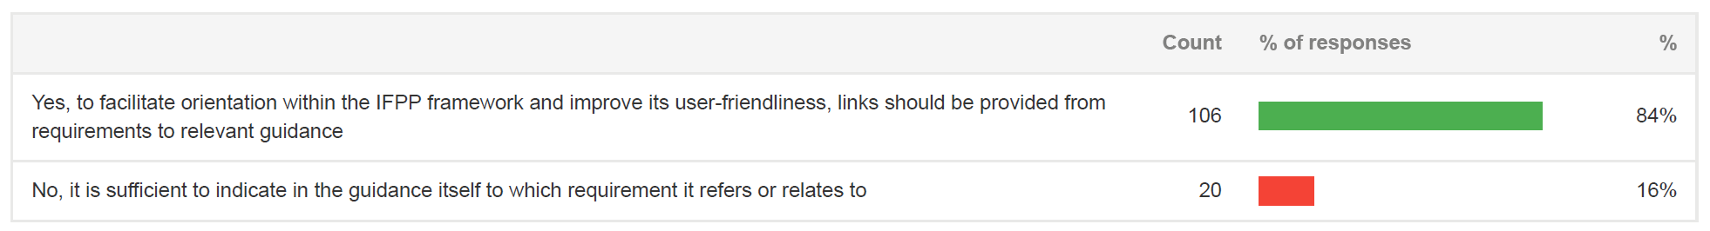
Facilitating navigation across IFPP

Slide 20
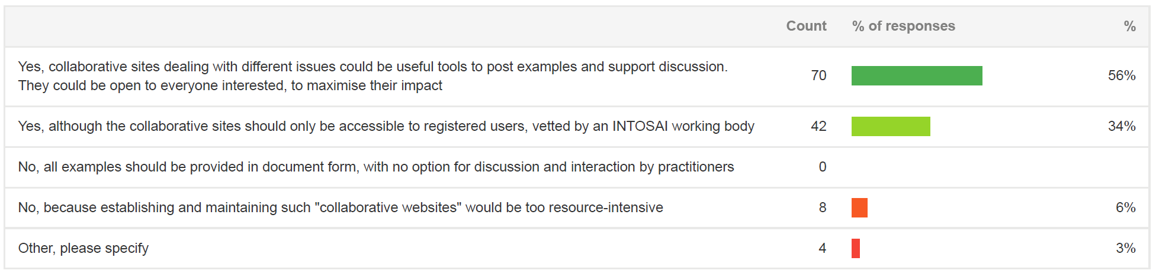
Presenting material in a flexible way – using collaborative sites

Slide 21
Other (unsorted)

Slide 22
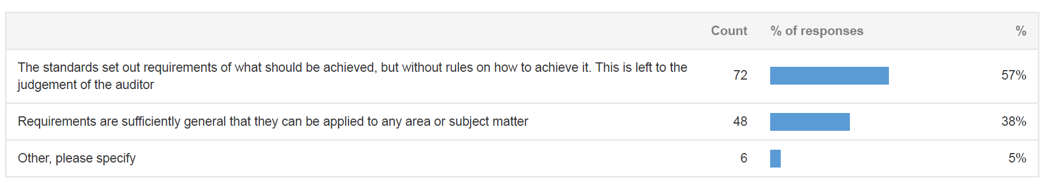
The meaning of principles based standards

Slide 23
Introducing changes to the IFPP

Slide 24
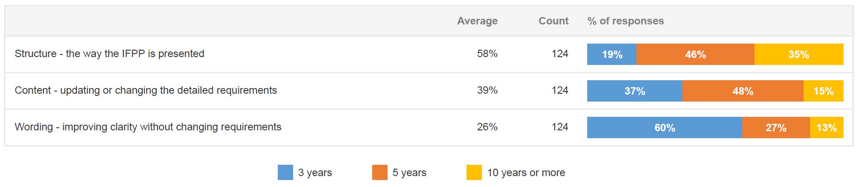
Optimal frequency for reviewing and changing the IFPP

