Slide 1
Standards for Internal Control in the Government
Standards for Internal Control in the Federal Government
Going Green

Slide 2
Session Objective
To discuss GAO’s revision to the Standards for Internal Control in the Federal Government (Green Book)

Slide 3
Green Book Through the Years
1983
Present

Slide 4
What’s in Green Book for Federal, State and Local Government?
Reflects federal internal control standards
May be an acceptable framework for internal control at the state and local government level
Written for government
Leverages the COSO Framework
Uses government terms

Slide 5
Revision to the Green Book
What is not changing
What is changing
Core definition of internal control
Three categories of objectives and five components of internal control
Each of the five components of internal control are required for effective internal control
Important role of judgment in designing, implementing and operating an internal control system and evaluating its effectiveness
Changes in operating environments considered
Operations and reporting objectives expanded
Fundamental concepts underlying five components articulated as principles
Additional consideration given to operations, compliance, and non-financial reporting objectives

Slide 6
Green Book Revision Proposed Timeline
Outreach to User Community
Ongoing
First GBAC meeting
5/20/2013
Public Exposure
9/3/2013-2/18/2014
Finalize Green Book
Summer 2014

Slide 7
Green Book Advisory Council
Representation from:
Federal agency management
Inspector General
State and local government
Academia
COSO
Independent public accounting firms
At large

Slide 8
Green Book Revision Process
Retained five original COSO components
Adapted COSO Framework’s language to make it appropriate for a federal government standard
Adapted the concepts for a government environment where appropriate
Considered clarity drafting conventions
Considered INTOSAI internal control guidance

Slide 9
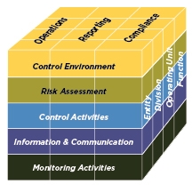
The COSO Framework
Relationship of Objectives and Components
Direct relationship between objectives (which are what an entity strives to achieve) and the components (which represent what is needed to achieve the objectives)
COSO depicts the relationship
in the form of a cube:
The three objectives are represented
by the columns
The five components are represented
by the rows
The entity’s organization structure is
represented by the third dimension
Source: COSO

Slide 10
From COSO to Green Book: Harmonization
COSO
Green Book

Slide 11
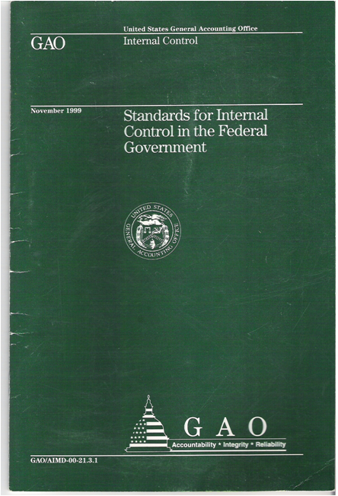
Revised Green Book: Standards for Internal Control in the Federal Government
Overview
Standards

Slide 12
Development of Highlights Page

Slide 13
Revised Green Book: Overview
Overview
Explains fundamental concepts of internal control
Addresses how components, principles, and attributes relate to an entity’s objectives
Discusses management evaluation of internal control
Standards

Slide 14
Overview: Components, Principles, and Attributes
Overview
Achieve Objectives
Principles
Attributes
Components
Standards

Slide 15
Revised Green Book: Principles

Slide 16
Revised Green Book: Principles

Slide 17
Component, Principle, Attribute

Slide 18
Overview: Additional Considerations
Overview
Overview
The impact of service organizations on an entity’s internal control system
Discussion of documentation requirements in the Green Book
Applicability to non-federal entities
Cost/Benefit and Large/Small Entity Considerations
Standards
Standards

Slide 19
Revised Green Book: Standards
Overview
Explains principles for each component
Includes application material for each attribute
Standards

Slide 20
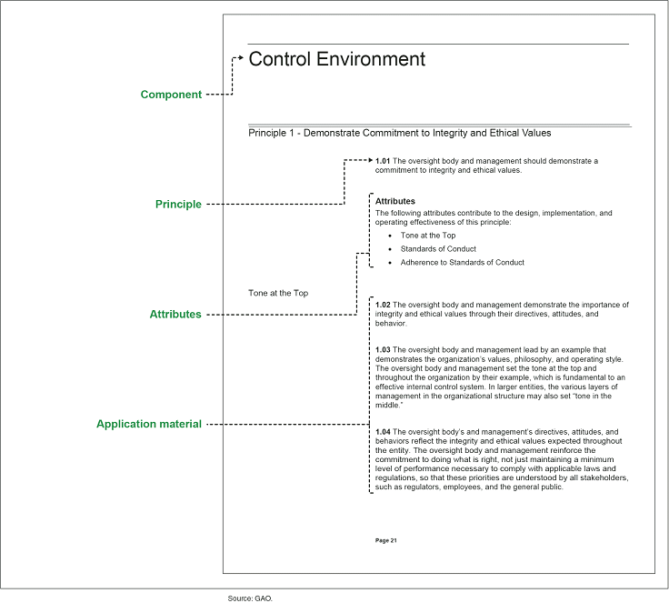
Example Page Layout

Slide 21
Where to Find the Green Book
The Green Book is on GAO’s website at: www.gao.gov/greenbook
For technical assistance, contact us at: greenbook@gao.gov
Notes:
21

Slide 22
Thank You
Questions?

