Slide 1
Harmonisation of ISSAIs – Revision of the Fundamental Auditing Principles

Slide 2


Slide 3


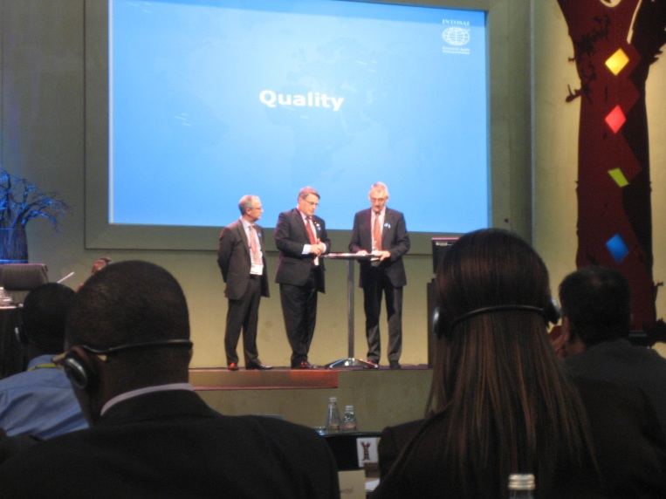

Slide 4
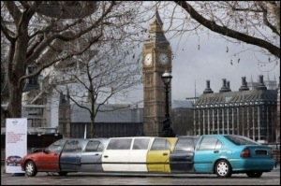

Slide 5
Fundamental Auditing Principles

Slide 6
- a credible set of standards

Slide 7
ISSAI 100 Fundamental Principles of Public Sector Auditing
ISSAI 200 Fundamental Principles of Financial Auditing
ISSAI 300 Fundamental Principles of Performance Auditing
ISSAI 400 Fundamental Principles of Compliance Auditing

Slide 8
The International Standards of Supreme Audit Institutions (ISSAI)
Founding Principles
ISSAI 1 The Lima Declaration
Prerequisites for the functioning of SAIs
ISSAI 10 The Mexico Declaration on SAI Independence
ISSAI 20 Principles of Transparency and Accountability
ISSAI 30 Code of Ethics
ISSAI 40 Quality Control for SAIs
Fundamental Auditing Principles

ISSAI 100 Basic Principles
ISSAI 200 General Standards
ISSAI 300 Field Standards
ISSAI 400 Reporting Standards
Auditing guidelines
General auditing guidelines:
ISSAI 1000-2999 Financial Auditing Guidelines
ISSAI 3000-3900 Performance Audit Guidelines
ISSAI 4000-4999 Compliance Audit Guidelines
Specific guidelines:
ISSAI 5000-5099 International Institutions
ISSAI 5100-5199 Environmental Audit
ISSAI 5200-5299 Privatisation
ISSAI 5300-5399 IT-audit
ISSAI 5400-5499 Audit of Public Debt
ISSAI 5500-5599 Guidelines on Audit of Disaster-related Aid
ISSAI 5600-5699 Guidelines on Peer Reviews

Slide 9
A new flagship for INTOSAI

Slide 10
A new foundation for the ISSAIs

Slide 11
A common language for the profession

Slide 12
How ISSAIs can be refered to

Slide 13
A new flagship for INTOSAI
A new foundation for the ISSAIs
A common language for all
How ISSAIs can be refered to

Slide 14
INTOSAI
IFAC
Regional
IIA
The SAI
EU
National privat
sector auditing
Other Countries
National boards

Slide 15
unite INTOSAI….

Slide 16
1216

Slide 17
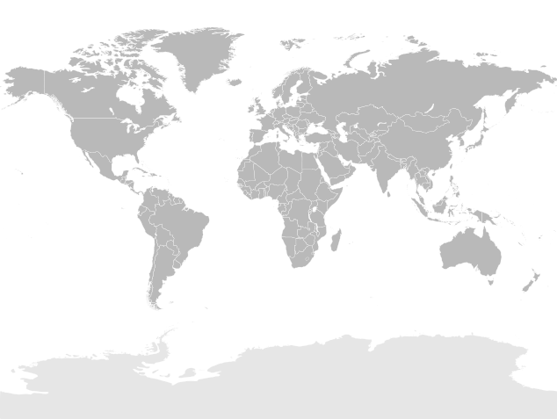
Norway
Sweden
Denmark
UK
Austria
ECA
Slovakia
USA
Mexico
China
Brazil
India
South Africa

Slide 18
Improvement of the
full set of ISSAIs

Slide 19


Slide 20
Overview
Proposals from the project group
Approval of the Endorsement Versions (EV):
EV ISSAI 100
EV ISSAIs 200, 300 and 400
Proposal on Drafting conventions for auditing guidelines
Further issues
The maintenance frequency
ISSAI 100
ISSAIs 200, 300 and 400
A ‘transition period’ for SAIs that wish to refer to the old ‘INTOSAI Auditing Standards’ after 2013
Consequences for the Introduction to the ISSAI Framework
Dissolving the project group

Slide 21
Overview
Proposals from the project group
Approval of the Endorsement Versions (EV):
EV ISSAI 100
EV ISSAIs 200, 300 and 400
Proposal on Drafting conventions for auditing guidelines
Further issues
The maintenance frequency
ISSAI 100
ISSAIs 200, 300 and 400
A ‘transition period’ for SAIs that wish to refer to the old ‘INTOSAI Auditing Standards’ after 2013
Consequences for the Introduction to the ISSAI Framework
Dissolving the project group
☞

Slide 22
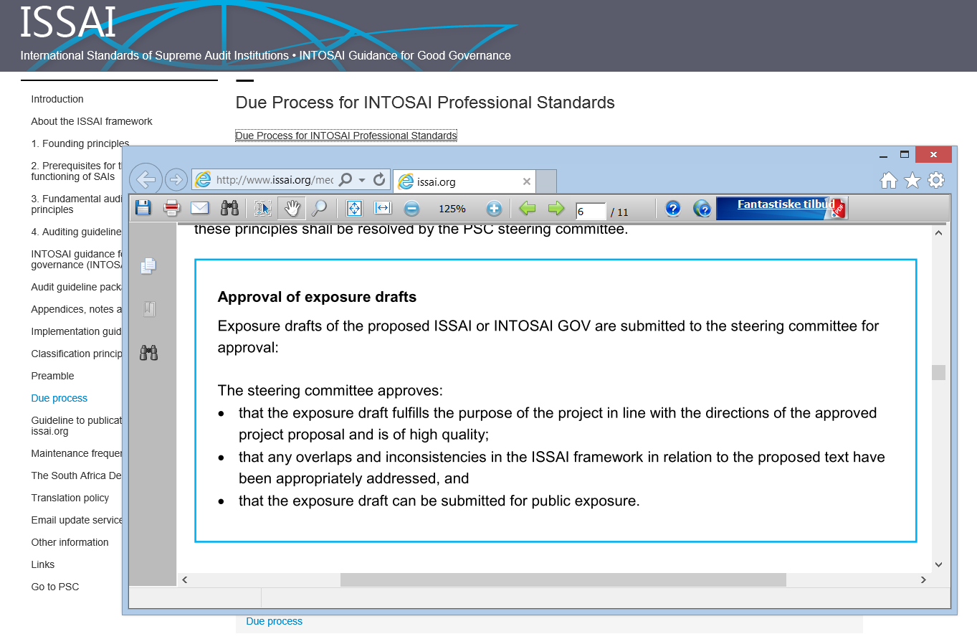

Slide 23
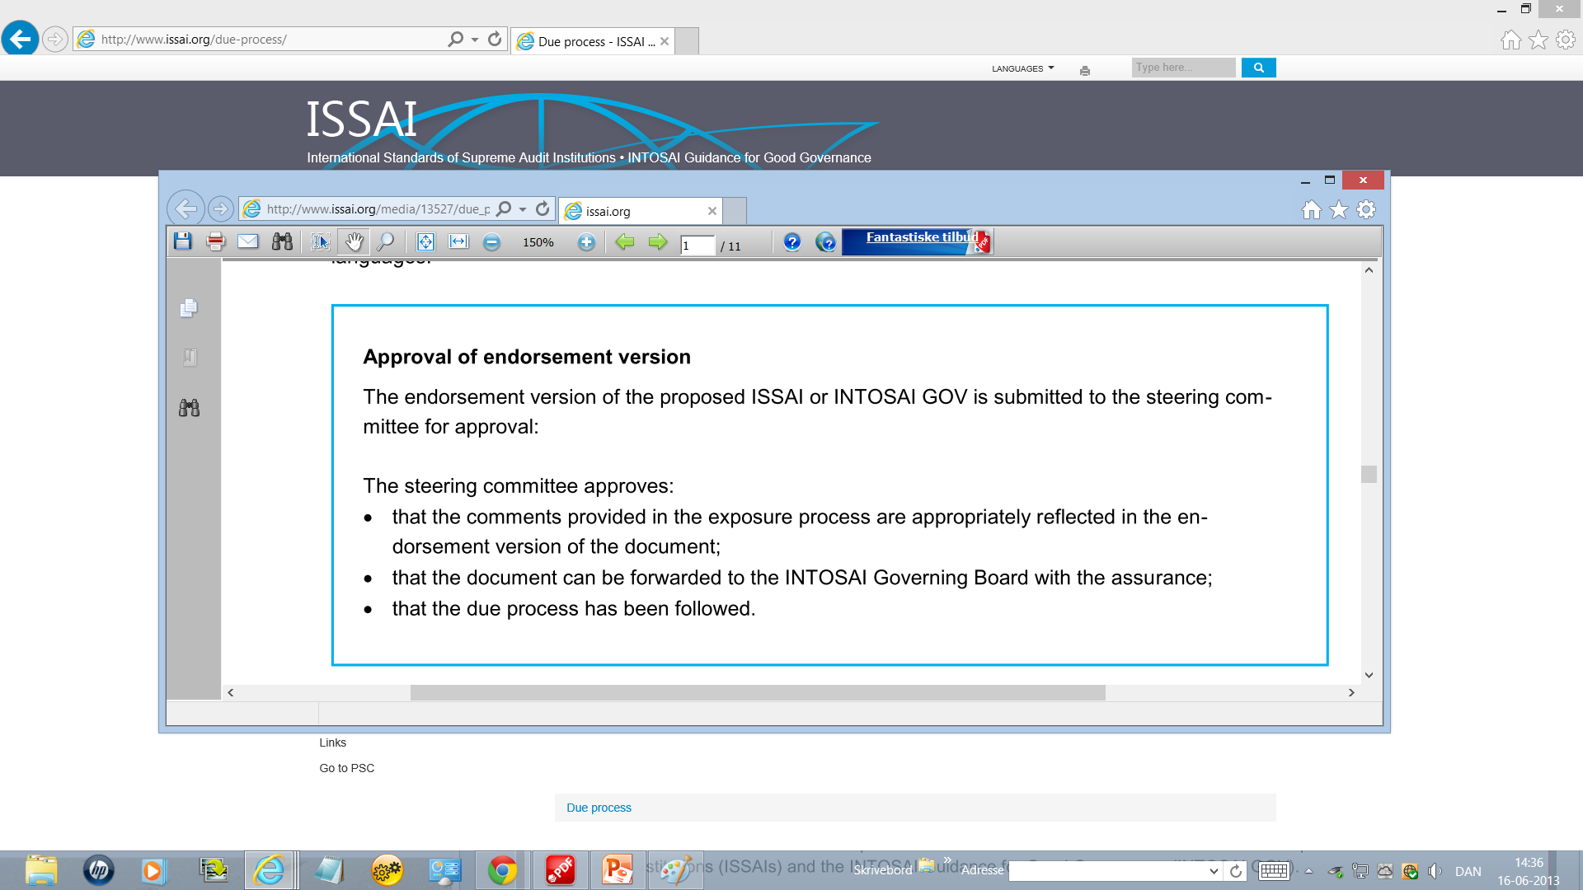

Slide 24
EV ISSAI 100

Slide 25
EV ISSAI 200
EV ISSAI 300
EV ISSAI 400

Slide 26
Overview
Proposals from the project group
Approval of the Endorsement Versions (EV):
EV ISSAI 100
EV ISSAIs 200, 300 and 400
Proposal on Drafting conventions for auditing guidelines
Further issues
The maintenance frequency
ISSAI 100
ISSAIs 200, 300 and 400
A ‘transition period’ for SAIs that wish to refer to the old ‘INTOSAI Auditing Standards’ after 2013
Consequences for the Introduction to the ISSAI Framework
Dissolving the project group
☞

Slide 27
Overview
Proposals from the project group
Approval of the Endorsement Versions (EV):
EV ISSAI 100
EV ISSAIs 200, 300 and 400
Proposal on Drafting conventions for auditing guidelines
Further issues
The maintenance frequency
ISSAI 100
ISSAIs 200, 300 and 400
A ‘transition period’ for SAIs that wish to refer to the old ‘INTOSAI Auditing Standards’ after 2013
Consequences for the Introduction to the ISSAI Framework
Dissolving the project group
☞

Slide 28
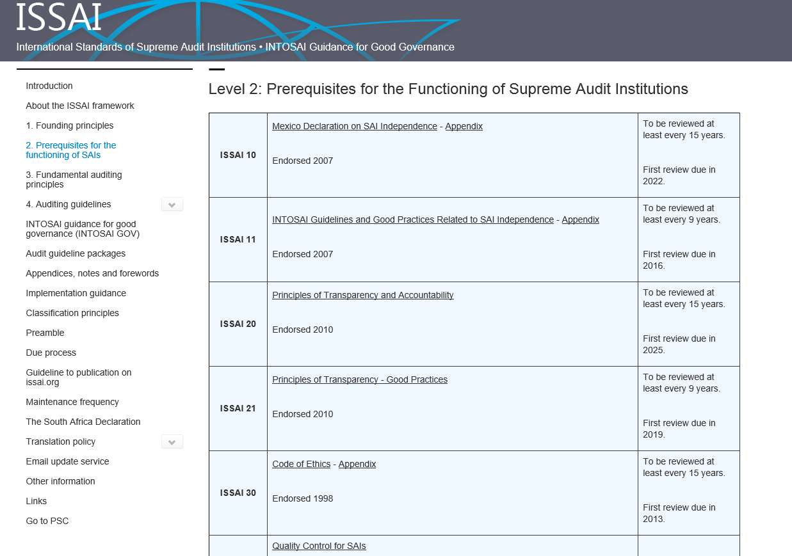

Slide 29
No maintenance
ISSAI 1 – The Lima Declaration
15 years:
ISSAI 10 - Mexico Declaration on SAI Independence
ISSAI 20 - Principles of Transparency and Accountability
ISSAI 30 – Code of Ethics
9 years:
ISSAI 40 - Quality Control for SAIs
ISSAI 11 - INTOSAI Guidelines and Good Practices Related to SAI Independence
ISSAI 21 - Principles of Transparency - Good Practices
5 years:
ISSAIs 1000-5999 Auditing Guidelines

Slide 30
2013 – ISSAI 30 Code of Ethics
12 guidelines in the ISSAI 5000-5999 series
2014 – ISSAIs 1000-1999 Financial audit guidelines
ISSAIs 3000, 3100 Performance audit guidelines 8 guidelines in the ISSAI 5000-5999 series
2016 – ISSAIs 4000, 4100, 4200 Compliance audit guidelines
ISSAI 11 Good Practices related to SAI Independence
2018 – A number of guidelines in the ISSAI 5000-5999 series
2019 – ISSAI 40 Quality Control for SAIs
ISSAI 21Principles of Transparency - Good Practices
(Financial audit guidelines)
(Performance audit guidelines)
A number of guidelines in the ISSAI 5000-5999 series
2021 – (Compliance audit guidelines)
2022 – ISSAI 10 The Mexico Declaration on SAI Independence

Slide 31
Overview
Proposals from the project group
Approval of the Endorsement Versions (EV):
EV ISSAI 100
EV ISSAIs 200, 300 and 400
Proposal on Drafting conventions for auditing guidelines
Further issues
The maintenance frequency
ISSAI 100
ISSAIs 200, 300 and 400
A ‘transition period’ for SAIs that wish to refer to the old ‘INTOSAI Auditing Standards’ after 2013
Consequences for the Introduction to the ISSAI Framework
Dissolving the project group
☞

Slide 32
Overview
Proposals from the project group
Approval of the Endorsement Versions (EV):
EV ISSAI 100
EV ISSAIs 200, 300 and 400
Proposal on Drafting conventions for auditing guidelines
Further issues
The maintenance frequency
ISSAI 100
ISSAIs 200, 300 and 400
A ‘transition period’ for SAIs that wish to refer to the old ‘INTOSAI Auditing Standards’ after 2013
Consequences for the Introduction to the ISSAI Framework
Dissolving the project group
☞

Slide 33
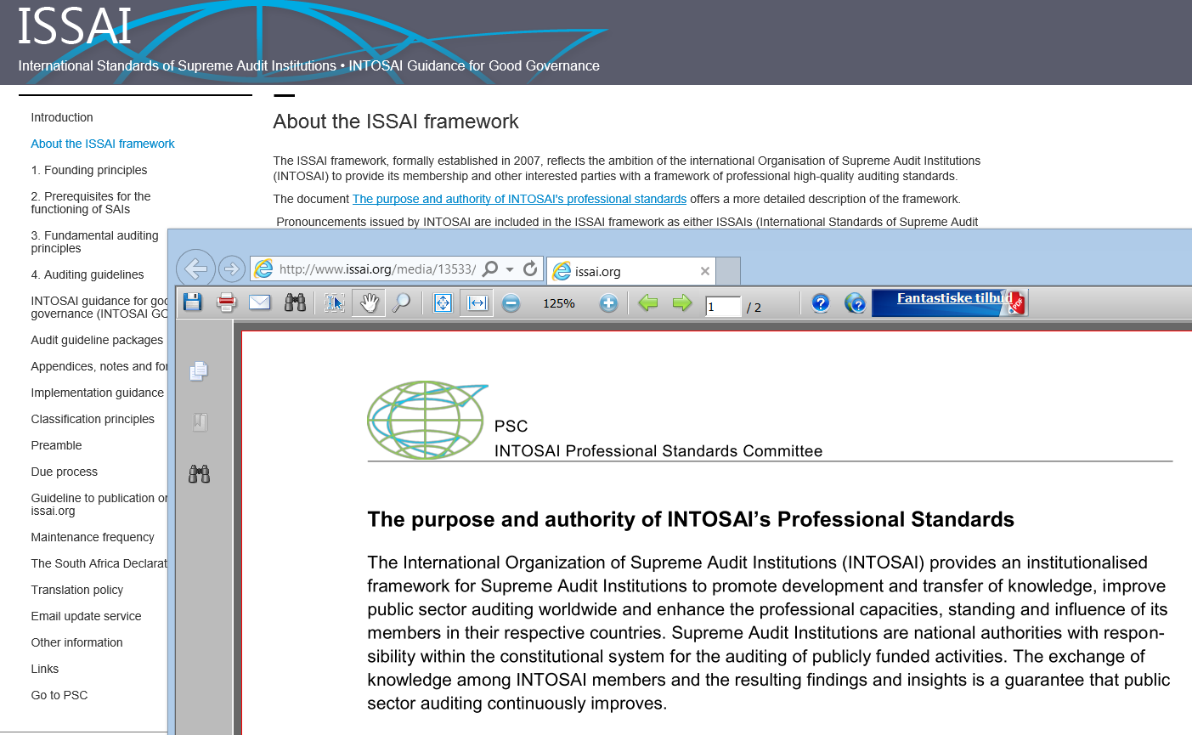

Slide 34
Overview
Proposals from the project group
Approval of the Endorsement Versions (EV):
EV ISSAI 100
EV ISSAIs 200, 300 and 400
Proposal on Drafting conventions for auditing guidelines
Further issues
The maintenance frequency
ISSAI 100
ISSAIs 200, 300 and 400
A ‘transition period’ for SAIs that wish to refer to the old ‘INTOSAI Auditing Standards’ after 2013
Consequences for the Introduction to the ISSAI Framework
Dissolving the project group
☞

