Slide 1

Governance initiatives at SAI Brazil
Federal Court of Accounts - Brazil
Meeting of the ICS Subcommittee
27-28 May 2014, Vilnius/Lithuania
Maria Lúcia Lima
luciafl@tcu.gov.br
Notes:
Good morning, ladies and gentlemen,
My name is Maria Lúcia, I work in Brazil, at the Federal Court of Accounts.
1) Today I will talk about Governance initiatives in my SAI.

Slide 2
Overview
Context
Governance Framework for public organizations
Governance Framework for public policies and programs
Recent works
Notes:
First, I will talk quickly about the context to work with governance in Brazil. Then, I will present two governance frameworks that we are developing in my SAI. And I will present some recent works in Brazil using governance.

Slide 3
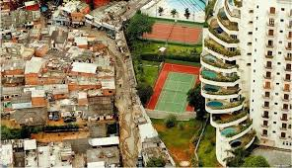
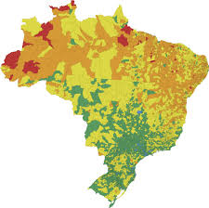
Context
Inequalities in Brazil
Economic growth x quality of life
Notes:
Brazil is a country with many inequalities. The south and the southeast are much more developed than the north and the northeast.
Brazil faces a number of challenges to promote its much-desired development, combining economic growth with quality of life for its population.
It is necessary to invest a lot of money to improve the public services. In order to have effective results, it is important to have good management and good governance.
Improving public governance is key to overcoming many of these challenges.
Considering this, TCU has been striving to act in a increasingly selective and systemic way, emphasizing structural themes of the public administration. We are developing many works to verify how is the governance in the public administration.

Slide 4
What is governance?
Governance has several meanings, a range of elements and sectorial contexts, and a variety of dimensions and formats (The Australian National University, 2012)
Notes:
We know that governance is a concept hard to define and hard to understand. And it has different meanings and dimensions, depending on the context and the environment. I don´t intend to bring a final definition of governance. I will present the frameworks that we are developing in Brazil.

Slide 5
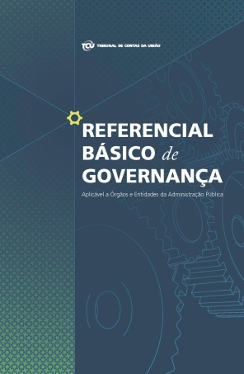
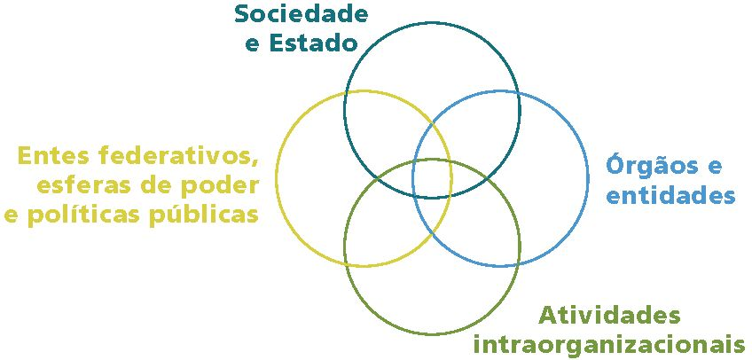
Perspectives of public governance
Society and Public Administration
National and subnational government levels and public policies
Organizations and entities
Intraorganizational activities (IT, HR, Risk management etc.)
Levantamentos
(TI, RH, Aquisições, Riscos etc.)
Notes:
Governance also has different perspectives of observation. We started working with the perspective of the activities among organizations. For example: IT, HR, Risk management. I brought for you some handouts about those works.
After, we started the project with OECD, very well presented by Mrs. Ishat Reza. In this project, the perspective are the public policies.
And we also have a governance framework for public organizations.

Slide 6
TCU´s governance framework for public organizations
Governance in the public sector is a set of mechanisms of leadership, strategy and control used to evaluate, direct and monitor the management in order to conduct the public policies and deliver services of interest to society.
Notes:
For organizations, we have been using that definition.

Slide 7
TCU´s components of mechanisms of governance
Governance at organizations and entities of public administration
Scope
Leadership
People and skills
Principles and behaviors
Control
Risk management and internal control
Internal audit
Accountability and transparency
Relationship with stakeholders
Organizational strategy
Transorganizational alignment
Organizational leadership
Governance system
Strategy
Mechanisms
Components
Notes:
And, for this scope, we have three mechanisms: leadership, strategy and control. Each mechanism has some components, for example, under control we have: risk management and internal control, internal audit, accountability and transparency.

Slide 8
TCU´s governance framework for public policy and programs
This framework intends to analyze the public governance when it is related to public policies.
Public policy governance, for this framework, can be defined as the context and way in which policies are formulated, implemented and evaluated for the benefit of society.
Notes:
For public policy and programs, the definition is about how the governance is inserted in the public policy cycle.

Slide 9
TCU´s framework components
1. Institutionalization
8. Accountability
2. Plans and objectives
3. Participation
4. Organization capacity and resources
5. Coordination and communication
6. Monitoring and evaluation
7. Risk management and internal control
Notes:
This framework has those eight components. I´m not going through the eight, but I want to show you what are them. It´s important to say that they are related with the phases of the policy cycle (formulation, implementation and evaluation).

Slide 10
Audit on governance of the National Programme of Regional Development
Main findings
Vague goals
Formulation does not address main problems
Financial Resources are not aligned to the objectives
Lack of structure to implement and supervise the programme
Intragovernamental coordination does not work
Intergovernmental coordination is not effective
No monitoring system so far
Flawed control system
Insufficient disclosure of results
Notes:
As I said, Brazil has to deal with great social differences. Therefore, the government has many programs that aim to decrease those differences. One of this programmes is the National Programme of Regional Development. We have audited this programme using the governance framework. Those are the main findings.
We found problems in the three phases of the policy cycle. About formulation, we found that it does not address the main problem, which is the social inequality.
We found many problems in the implementation. For example: lack of structure and of coordination. We also found that the monitor and control systems could improve. So, in general, we can see that there this programme can improve it´s governance a lot.

Slide 11
Recent works on specific areas
Survey on the IT governance profile in the Federal Public Administration
Survey of Human Resources governance and management in the Federal Public Service
Notes:
Recently, we have developed some works in specific government areas. I will present some information about the survey on the Information Technology governance in the federal public administration. I also brought handouts for you about some of those works.

Slide 12
Objectives
  To gather information about IT Governance situation in the Federal Public Administration (FPA), aiming at supporting audit plan
  To verify more critical situation in IT Governance
  To identify the main systems and databases of the FPA
  To identify the areas in which the Federal Court of Accounts of Brazil (TCU) can act to enhance IT Governance
Notes:
The work had four main goals: to gather information about IT governance situation, to verify where the situation was more critical, to identify the main systems and databases and to identify areas for future work of TCU (it´s the acronym in Portuguese for the name of brazilian SAI).

Slide 13
Survey Structure – 2012
Governance
-
Leadership
Management (controls)
-
Strategy and planning
-
Knowledge and information
-
People
-
Processes
Management results (output)
Efficacy
Law compliance
Efficcency
legitimacy
Governance results (outcome)
Economy
-
for the citizen
Effectiveness
-
for society
Notes:
The structure of the survey has two main dimensions: governance and management. In governance, the main component is leadership. The management dealt with four components: strategy and planning, knowledge and information, people and processes.
338 entities answered the survey.

Slide 14
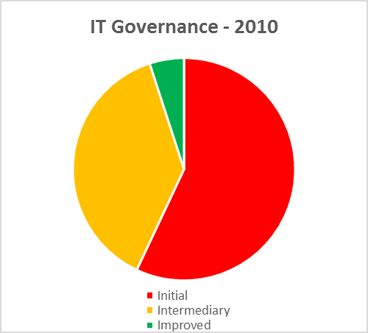
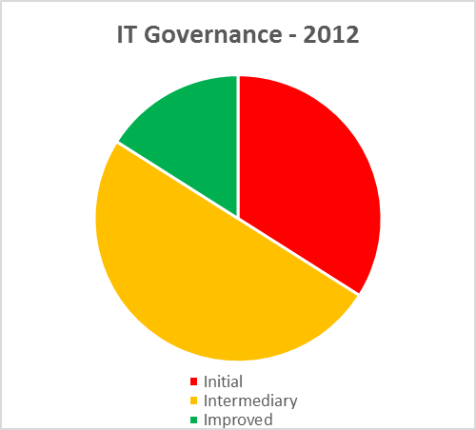
Result
5%
16%
34%
38%
57%
50%
Notes:
The survey was done in 2010 and 2012 and here we have some results showing the improvements. We classified the organizations in three categories, regarding the level of governance: initial, intermediary and improved. In 2010, 57% were at the initial level and only 5% were at the improved level. In 2012 the situation was better. The initial level decreased to 34% and the improved level increased to 16%. The idea is to repeat the survey every other year.
Initial – 0 to 39%; Intermediate – 40 to 59%; Improved – 60 to 100%.

Slide 15
Get.IT Project
Governance Evaluation Techniques for IT
Participating SAIs: India, Kiribati, Kuwait, Lithuania, Malaysia, South Africa, USA, Brazil (project leader)
Scope: Collaborative development of a guide on IT Governance
Notes:
Another initiative that we have in Brazil is the Get.IT Project. Brazil is the project leader and of the SAI participant is our host, Lithuania.

Slide 16
Recent works on finalistic themes
Maturity assessment in risk management in indirect public administration
Maturity of monitoring and evaluation systems of the Brazilian public administration
Notes:
Besides developing works in specific areas, we are also studying finalistic themes. Those are the some works done and I will talk a little bit about the maturity assessment in risk management in indirect public administration.

Slide 17
Objectives
To assess the maturity of risks management in 65 agencies of the Brazilian indirect federal public administration.
To identify the aspects of risks management that need to be improved by the organizations and gather relevant information for the planning of future oversight activities of the SAI.
Notes:
This work aimed to assess the maturity of risks management in 65 brazilian agencies and to identify areas for future works (the same that we did in the IT survey). This survey was performed last year and now we are conducting and audit in 9 entities, to gather more details, to confirm the answers provided by the questionnaires and to develop working papers for future audits in this area.

Slide 18
Evaluative dimensions
Risk management environment
Leadership
Policies and strategies
Processes
Identification and evaluation of risks
Response to risks
People
Monitoring and communication
Partnerships
Results
Notes:
The survey evaluated the agencies considering four dimensions: the risk management environment (with 3 components), the processes (with 3 components), partnerships and results (without components).

Slide 19
Result
Entities according to the maturity levels in risks management
Notes:
The result of the survey was that most of the 65 organizations are at the basic level in risks management. (0 to20, 21 to 40, 41 to 60, 61 to 80, 81 to 100).

Slide 20
Conclusion
Notes:
To conclude, I would like to say that in SAI Brazil we understand that governance is a key aspect in the context of public administration. I tried to give an overview of some initiatives that we have in Brazil to assess governance. We believe that good governance can lead to more efficiency and effectiveness on public administration and on the use of public resources.

Slide 21
Any questions?

Slide 22
Thank you for your attention!
Ačiū už dėmesį
Muito obrigada pela atenção!
Notes:
That´s what I had to tell you. Thank you very much for your attention. I wrote this is lithuan as well, but I don´t know how to pronounce. And I also have it in Portuguese: Muito obrigada!

