Slide 1

Good Governance in the Public Sector
INTOSAI Subcommittee on Internal Control Standards
May 27-28, 2014
Vilnius, Lithuania
Vincent Tophoff
Senior Technical Manager, IFAC

Slide 2

Agenda
Good Governance in the Public Sector
Framework purpose and development
Key definitions
Overall structure
Guidance on implementing the principles
Framework supplement
Looking ahead

Slide 3
Why an IFAC/CIPFA Framework?
Good Governance in the Public Sector
Importance of public sector
Role and economic significance
Effective governance drives:
better decisions
use of resources
accountability

Slide 4
Why an IFAC/CIPFA Framework?
Good Governance in the Public Sector
Previous work by both IFAC and CIPFA
Update needed to reflect guidance from others
Reference point for national & sector standard setters/regulators

Slide 5
Public Sector Characteristics
Good Governance in the Public Sector
Leadership and coordination
Range of functions
service provision, regulator
Resource redistribution
Taxation funding
Primary objective: service delivery not profit generation
Non-exchange transactions
Budget, accountability are key
Broader accountability: outputs, outcomes & value for money

Slide 6
Analyzing the Environment
Good Governance in the Public Sector
What are the main challenges for good governance in public sector organizations?
Sovereign debt crisis
Shortage of funding / rationalization
Short-termism
Internationalization, technology, complexity
Corruption

Slide 7
Analyzing the Environment
Good Governance in the Public Sector
What can a governance framework accomplish?
Establish a benchmark for good governance
Serve as a reference point for those developing or reviewing national codes
Help public sector organizations continually improve governance systems
Where no code/guidance exists, provide:
A shared understanding of what constitutes good governance
A powerful stimulus for positive action

Slide 8
Analyzing the Environment
Good Governance in the Public Sector
What are the critical differences for public v. private sector that impact governance?
Objectives
For the public welfare
Politically motivated agendas
Profit not the main priority
Funding mechanism
Often tax payers
Broader stakeholder accountability

Slide 9
Analyzing the Environment
Good Governance in the Public Sector
How can the framework bridge regional and cultural differences?
Based on study of relevant national and international codes
Develop globally, implement locally
International promotion, distribution of framework

Slide 10
Analyzing the Environment
Good Governance in the Public Sector
Governance materials reviewed
Good Governance Standard for Public Services, OMP/CIPFA
Governance in Public Sector: A Governing Body Perspective, IFAC
OECD Governance Guidelines of State-Owned Enterprises
Actionable Governance Indicators, World Bank
Code of Practices on Fiscal Transparency, IMF
Public Internal Financial Control, EC
Developing Corporate Governance Codes of Best Practice, Global Corporate Governance Forum
Local codes and guides

Slide 11
Analyzing the environment
Good Governance in the Public Sector
Identify how to overcome resistance to implementing a framework
Sponsorship
Demonstration of the benefits
Apply or explain

Slide 12
Framework Development Timeline
Good Governance in the Public Sector
Initial consultation
Analysis of responses
Governance literature review
Initial development
International Reference Group reviews
IFAC Professional Accountants in Business Committee informal consultation
Revisions
Consultation draft: June 2013
Framework release: July 2014

Slide 13
International Reference Group
Good Governance in the Public Sector
Yoseph Asmelash United National Conference on Trade & Development (UNCTAD)
Ian Ball Formerly IFAC
Andreas Bergmann International Public Sector Accounting Standards Board (IPSASB)
Jón Blöndal Organisation for Economic Co-operation & Development (OECD)
Carlo Cottarelli International Monetary Fund (IMF)
Robert Dacey US Government Accountability Office (GAO)
Steve Freer Formerly CIPFA
Gert Jönsson International Organization of Supreme Audit Institutions (INTOSAI)
Mervyn King King Committee on Corporate Governance
Ian McPhee Australian National Audit Office
Maurice McTigue George Mason University (USA)
Roger Tabor Professional Accountants in Business Committee, IFAC

Slide 14
Framework Layout
Good Governance in the Public Sector
Framework:
Foreword by Mervyn King, Chair, IIRC, and King Report, South Africa
Definitions
Principles-based to maximize relevance, applicability
Sub-principles and supporting guidance to provide explanation
Supplement:
Examples
Provide practical experience and aid understanding
Evaluation questions to consider
Further reading

Slide 15
Key Definitions: Governance
Good Governance in the Public Sector
The arrangements put in place to ensure that the intended outcomes for stakeholders are defined and achieved
Arrangements include:
Political
Economic
Social/environmental
Administrative
Legal

Slide 16
Key Definitions: Governing Body
Good Governance in the Public Sector
The person(s) or group with primary responsibility for overseeing an entity’s strategic direction, operations, and accountability
Applicable to different structures:
Separate legislature and executive branches
Different executive and non-executive structures
All levels – use of term “entity”

Slide 17
Good Governance in Public Sector
Good Governance in the Public Sector
The fundamental function of good governance in the public sector is to ensure that entities achieve their intended outcomes while acting in the public interest at all times.
Good governance tied to:
Achieving intended outcomes
Acting in the public interest at all times

Slide 18
Framework Principles
Good Governance in the Public Sector
Acting in the public interest requires:
Behaving with integrity, demonstrating strong commitment to values, and respecting the rule of law
Ensuring openness and comprehensive stakeholder engagement

Slide 19
Framework Principles
Good Governance in the Public Sector
Achieving good governance in the public sector requires:
Defining outcomes in terms of sustainable economic, social, and environmental benefits
Determining the interventions necessary to optimize the achievement of the intended outcomes
Developing an entity’s capacity, including the capability of its leadership and the individuals within it

Slide 20
Framework Principles
Good Governance in the Public Sector
Achieving good governance in the public sector requires:
Managing risks and performance through robust internal control and strong public financial management
Implementing good practices in transparency, reporting, and audit, to deliver effective accountability

Slide 21
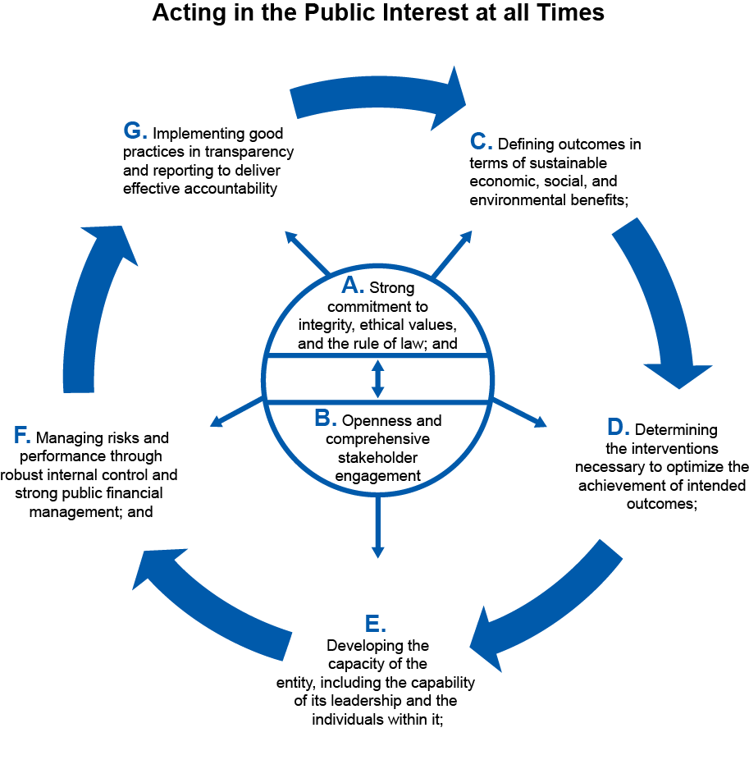
Good Governance in the Public Sector: An International Framework
Good Governance in the Public Sector

Slide 22
Principle A
Good Governance in the Public Sector
Behaving with integrity, demonstrating strong commitment to ethical values, and respecting the rule of law

Slide 23
Principle B
Good Governance in the Public Sector
Ensuring openness and comprehensive
stakeholder engagement

Slide 24
Principle C
Good Governance in the Public Sector
Defining outcomes in terms of
sustainable economic, social, and
environmental benefits

Slide 25
Principle D
Good Governance in the Public Sector
Determining the interventions necessary
to optimize the achievement
of the intended outcomes

Slide 26
Principle E
Good Governance in the Public Sector
Developing an entity’s capacity,
including the capability of its leadership
and the individuals within it

Slide 27
Principle F
Good Governance in the Public Sector
Managing risks and performance
through robust internal control and
strong public financial management

Slide 28
Principle G
Good Governance in the Public Sector
Implementing good practices
in transparency, reporting, and audit,
to deliver effective accountability

Slide 29
Supplement
Good Governance in the Public Sector
Examples of the principles and guidance
Questions for consideration
Further reading
Important sources of information

Slide 30
Looking Ahead
Good Governance in the Public Sector
July 2014
Publication of the Framework
Presentation: CIPFA Annual Conference in London
Dissemination via CIPFA, IFAC, IFAC member bodies & affiliates, professional accountants, and INTOSAI?
Implementation support and discussion on the IFAC Global Knowledge Gateway
www.ifac.org/Gateway

