Slide 1
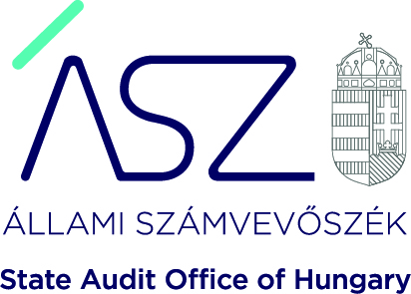
Applying compliance principles with respect to the challenges of the pandemic and the opportunities of digitalisation

Slide 2

The challenges of the pandemic
The aim is
to ensure effective communication
without personal contact with the auditees,
which is highly important during the pandemic
to reduce the workload of audited entities
    to increase effectiveness of audit activity
    at the same time
Digital & methodological developments are key drivers
to further technological developments
!

Slide 3


Thanks to the results of digital and technological developments,
much wider range of auditees will be assessed through fewer document audits
and more auditees will receive feedback on their performance in a shorter timeframe
  in order to improve public finance situation as quickly as possible
Methodological improvements
    In recent years, SAO of Hungary has increasingly focused on its advisory role.
    These improvements include:
    development and operation of data gathering system that places less burden on auditees,
    definition of the scope of relevant documents to be used for audit work.

Slide 4
Changes in audit approach
    significantly shortened timeframe for the implementation phase of audits
    increasing effectiveness of the audit activity through audits covering full scope of the given area
    while focusing on small amount of selected documents for the assessment
This enables SAO to assess relevant areas of responsible management,
accountability and transparency at numerous audited entities simultaneously,
consequently through the increasing number of auditees, it will lead to
an overall improvement of public finance and accountability in public sector.

Slide 5
- on pre-determined subject based on pre-established criteria
- obtaining and evaluating evidence as
to whether a given subject matter is in compliance with applicable authorities identified as criteria
Monitoring audits
    are based on the methodological principles of compliance audit
    focus on small amount of selected audit documents that are relevant and essential from the audit’s point of view
    provide „snapshot” , up-to date information about the given area, about the given group of auditees
That’s why monitoring audits are called real-time audits as well

Slide 6
Benefits of monitoring audits
    Monitoring audits support the improvement of public finance at auditees who benefit from the real-time assessment and clear recommendations for the future, based on the current situation, set of relevant documents and using priority criteria for the audit work.
This is also in line with the audit objectives of SAO, which are:
increase audit coverage
real-time assessment of segments not yet audited
provide support to auditees
thereby further strengthening the advisory role of the SAO as well as contributing to „well-managed state”, meanwhile ensuring effective use of SAO resources.

Slide 7

The SAO is committed to digitalization and seeks for forward-looking solutions that can boost its efficiency.
Digital improvements –
Supporting quality-assured audit process
the technological, quality-assured audit process is supported by a software
used for answering audit questions listed on worksheets
based on Lean methodology and principles of process organization in this software audit tasks are defined such a way that enforces flawless implementation

Slide 8
The SAO is committed to digitalization and seeks for forward-looking solutions that can boost its efficiency.
Digital improvements –
Automated assessment of audit documents
the software robot works along rules previously defined by the SAO
it can be easily scaled, which ensures flexibility and rapid adaptation to changes as well
automation of certain audit (sub)processes supports efficiency, since it enables significant resource savings
in addition, it also helps reduce time needed for the given processes.

Slide 9
Thank you for your kind attention!
www.asz.hu
www.aszhirportal.hu

