Slide 1


Supporting high quality & high impact compliance audits
IDI update at 18 Annual Meeting of Compliance Audit Subcommittee
28 October 2021

Slide 2

Global compliance audits of Transparency, Accountability & Inclusiveness in the use of emergency funding for COVID 19 ( TAI Audits )
Professional Education for SAI Auditors ( Pilot) CA
CA Global Public Goods
Connecting the dots

Slide 3
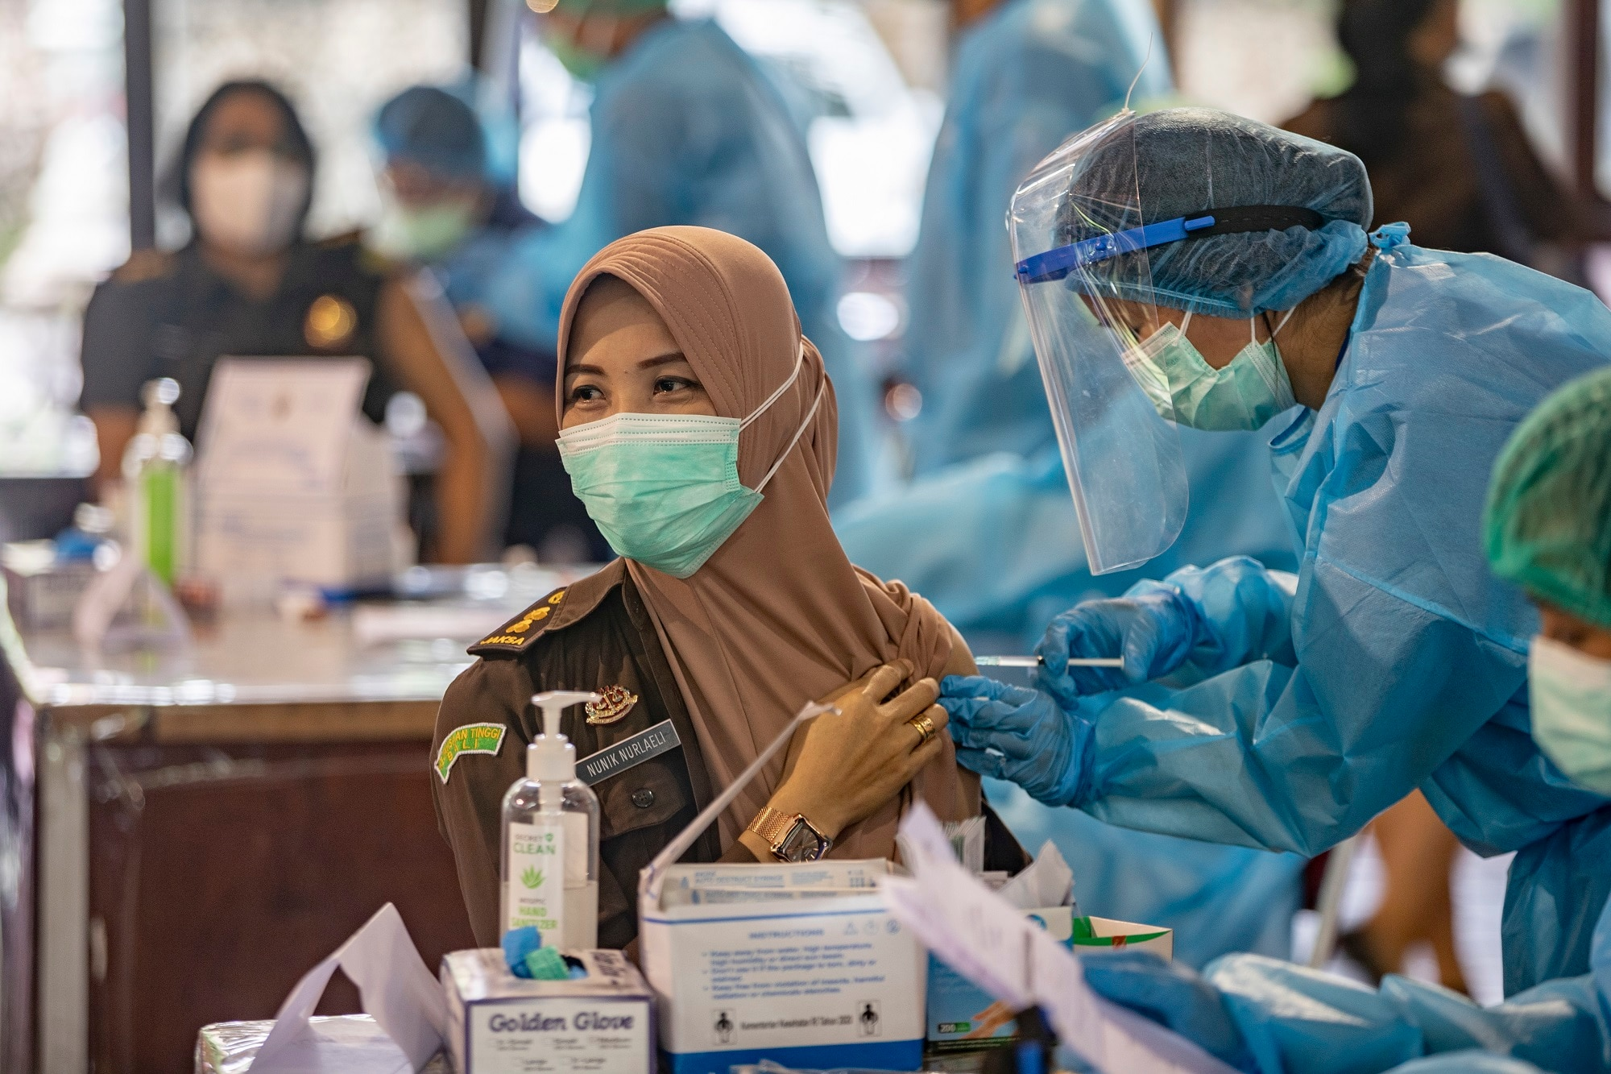

TAI Audits
ISSAI based, agile compliance audits that examine transparency, accountability and inclusiveness of compliance frameworks and implementation related to
Emergency public procurement, management of donations, supply
Socio – economic packages
National rollout of COVID-19 vaccines
Focus on quality, impact and stakeholder engagement

Slide 4
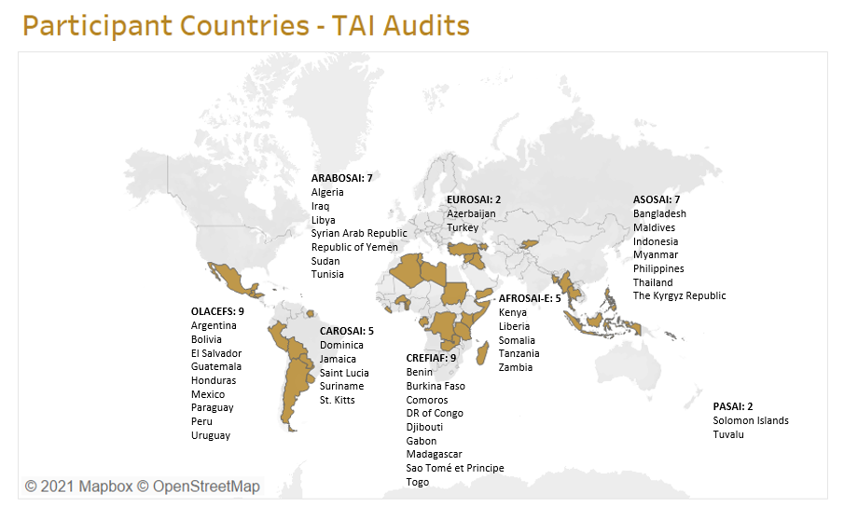
TAI Audits : 46 participating SAIs from all INTOSAI regions

Slide 5
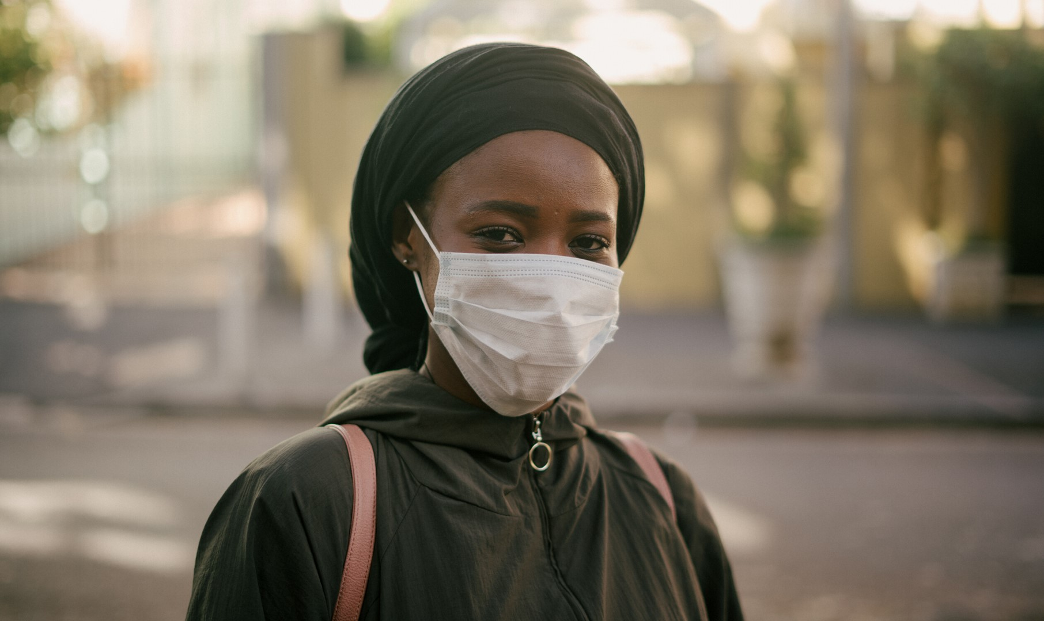


211
SAI PARTICIPANTS
36
SAI MENTORS
Female
55%
46 SAIs
Male
45%
GENDER DISTRIBUTION

Slide 6
IDI support to the SAIs
2020-2022
Needs Assessment
Leadership Conversations & Stakeholder engagement
Integrated Education & Audit Support platform
Facilitate regional/local level support
Facilitate audit impact
‘How to’ practical guide for TAI audits & Audit Question Bank
https://www.idi.no/work-streams/professional-sais/tai-audits/tai-guide

Slide 7

Professional Education
for SAI Auditors-Pilot (PESA-P)
Professional Education for SAI Auditors (PESA-P) (idi.no)

Slide 8


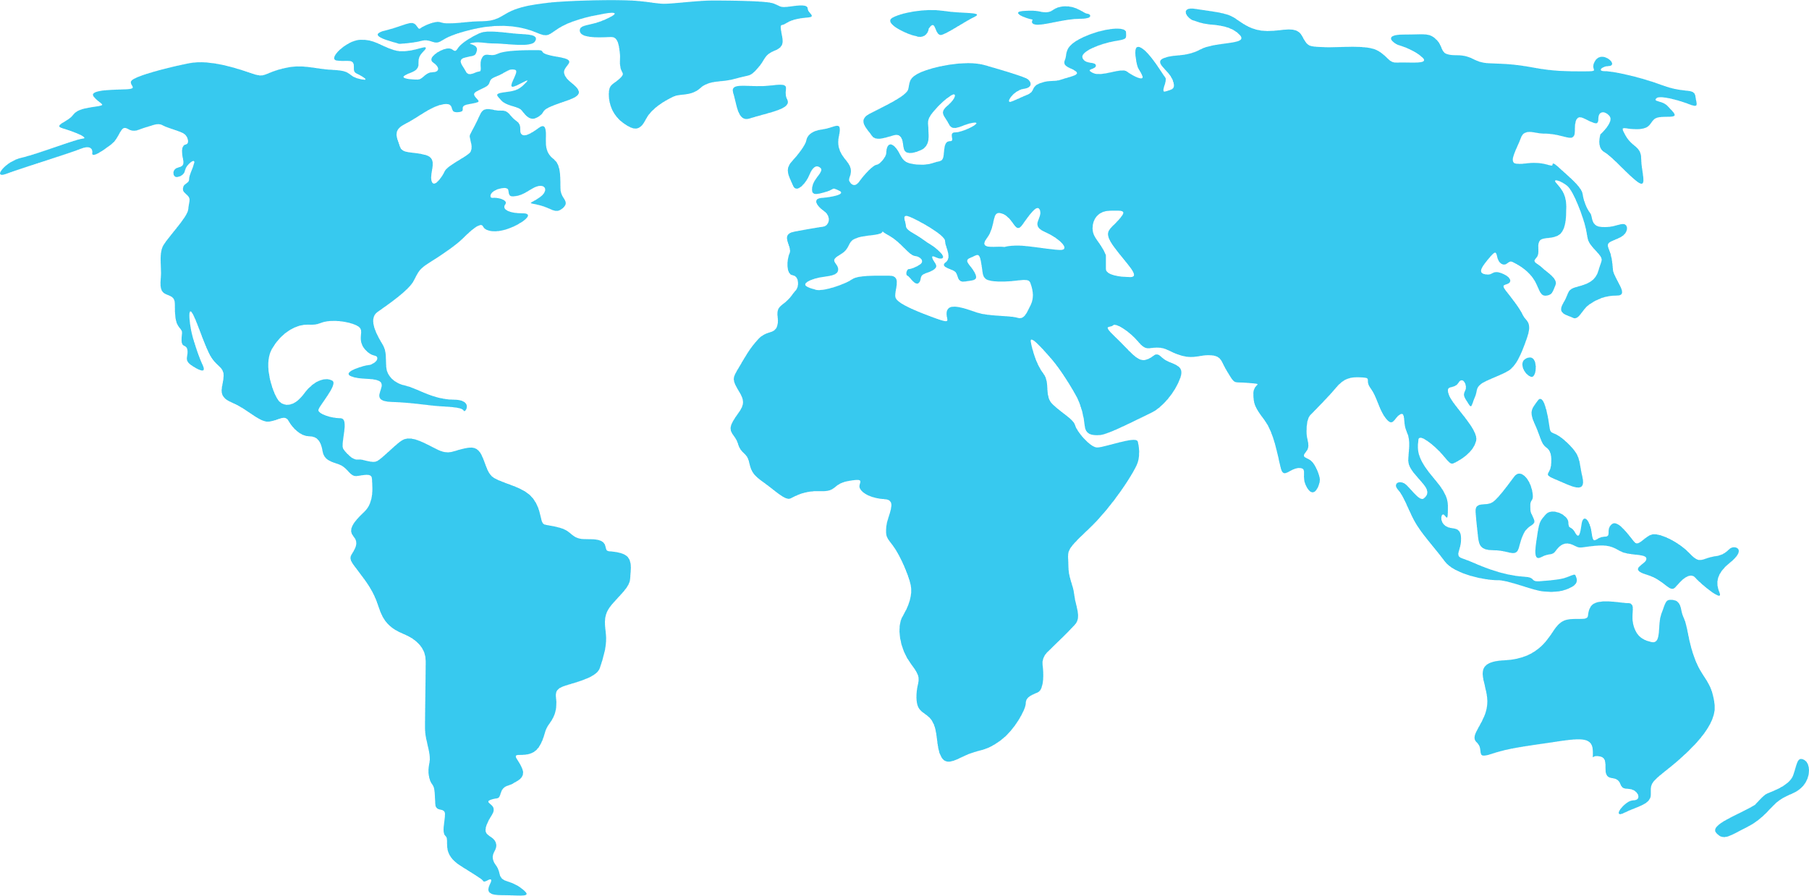




PESA-P
Male
48%
872
87 SAIs
Female
52%
SAI AUDITORS
409
GENDER DISTRIBUTION
SAI AUDITORS
SAI COACHES
Compliance Audit
61
SAIs
53%
FEMALE
47%
MALE
118
COACHES
Notes:
you are not alone
Reach out to others/us
Add coaches
Mention global spread

Slide 9
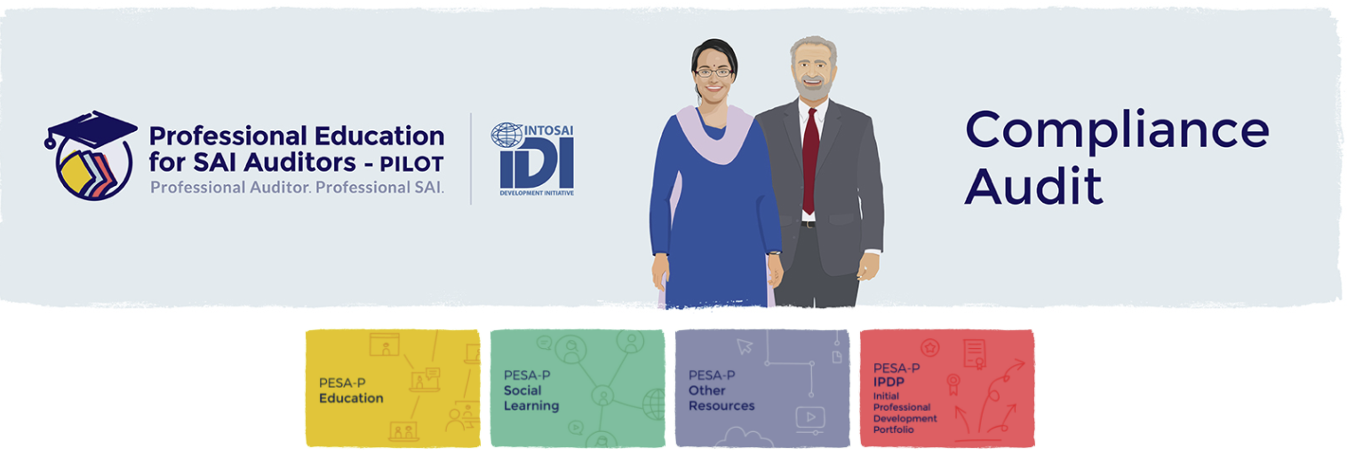
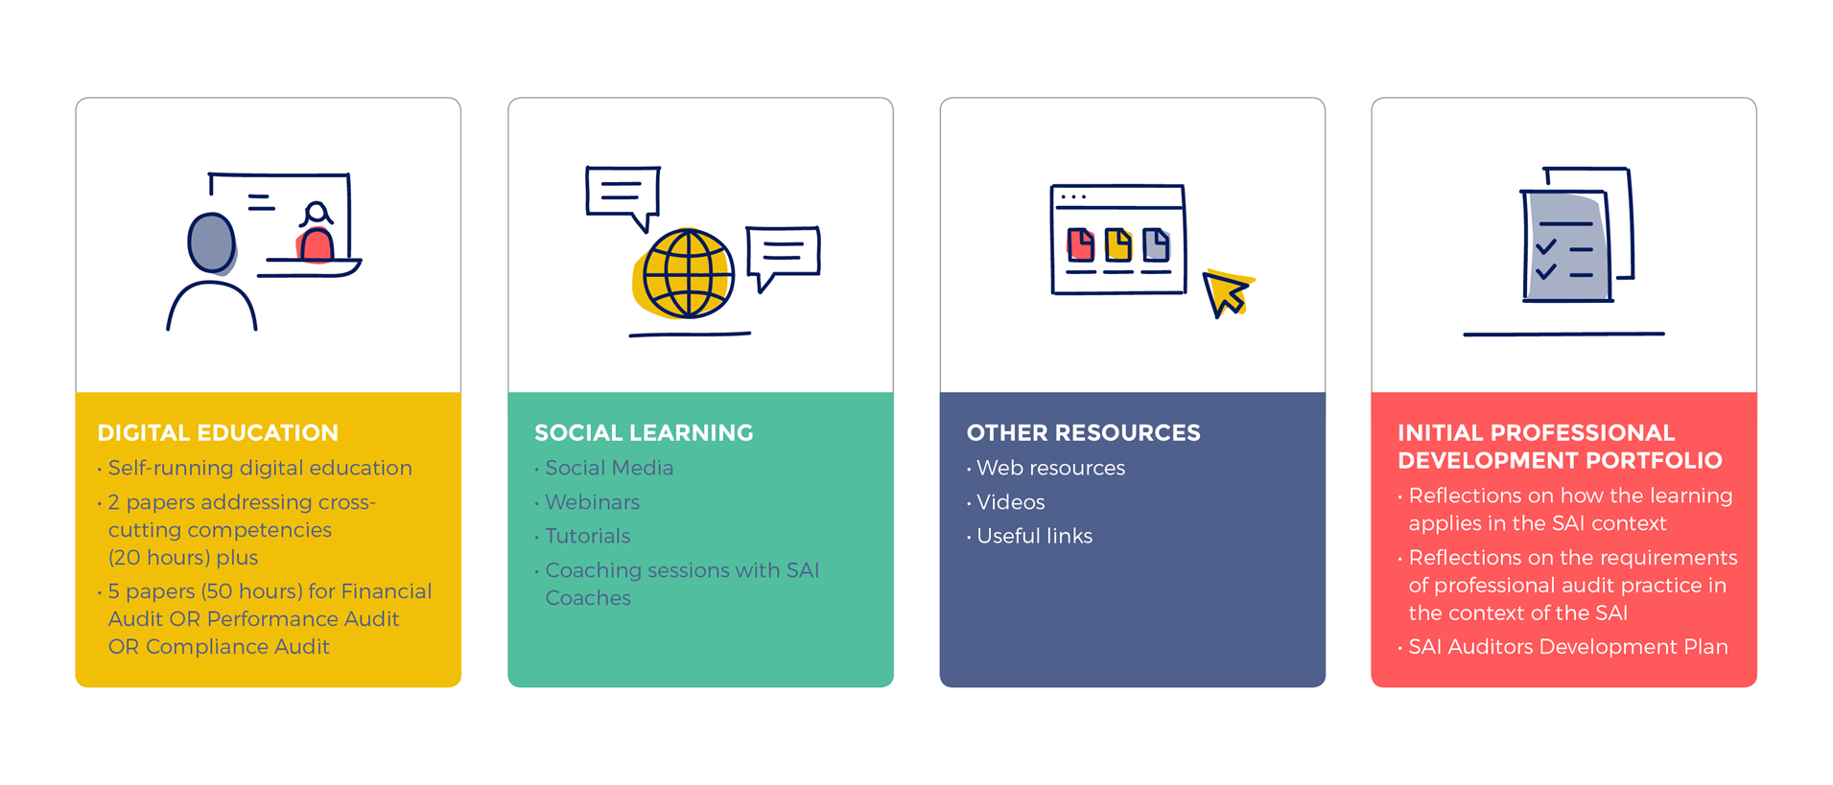

Slide 10
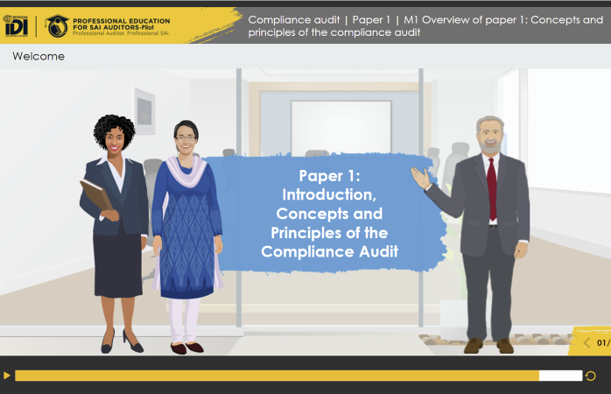
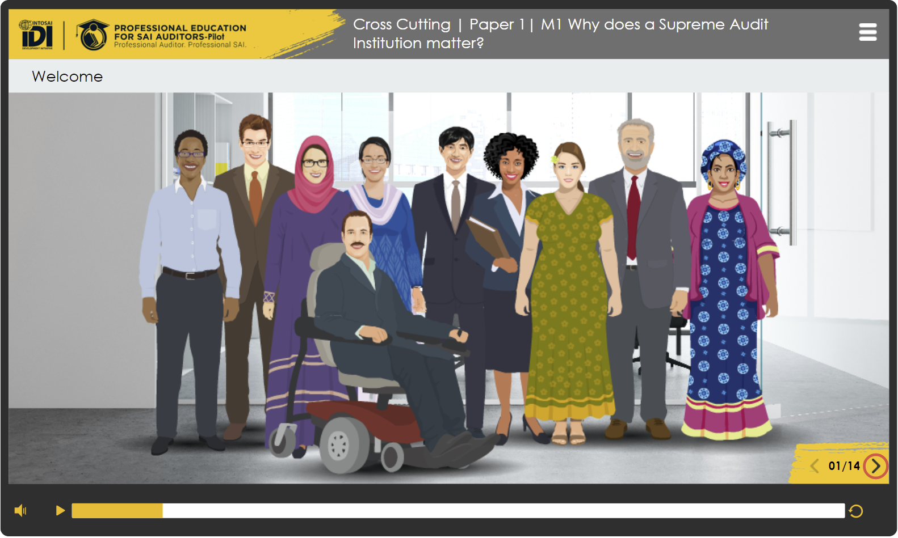

Slide 11

Global Public Goods : Compliance Audit
CA iCAT & Guidance Version 1 available ( Arabic, French, English, Spanish )
CA Handbook version 1 (English) by end of 2021
https://www.idi.no/our-resources/global-public-goods/professional-sais-gpg

Slide 12

Connecting the dots
Quality Management of compliance audits
Leveraging on technological advancement in compliance audits
Contribution of compliance audits to equal futures for all
Compliance audits and climate action
Facilitating audit impact of compliance audits

