Slide 1
Harmonization project
CAS project group
(Chair, Slovakia, European Court of Auditors)
CAS meeting Batumi, Georgia 27th of September 2011

Slide 2
Purpose of the harmonization project
The purpose of this project is to provide a conceptual basis for public sector auditing and ensure consistency in the ISSAI framework.
Notes:
Then I will explain to you the different goals of the project.

Slide 3
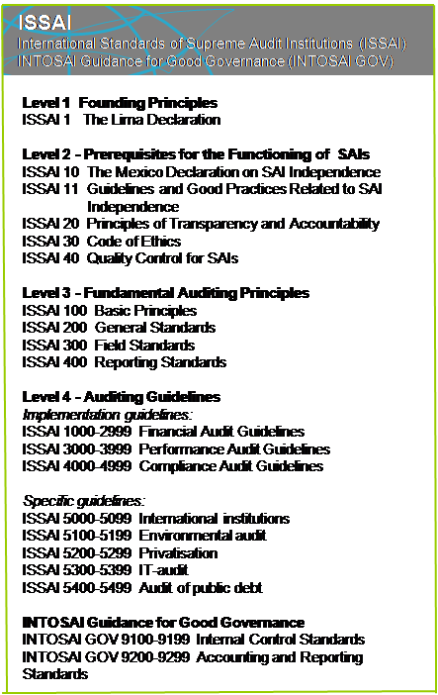
Overview of the ISSAI framework (2)
Level 2 - Prerequisites for the Functioning of SAIs
    ISSAI 10 The Mexico Declaration on SAI Independence
    ISSAI 11 Guidelines and Good Practices related to SAI
    Independence
    ISSAI 20 Principles of Transparency and Accountability
    ISSAI 30 Code of Ethics
    ISSAI 40 Quality Control for SAIs
PSC
INTOSAI Professional Standards Committee

Slide 4
Overview of the ISSAI framework (3)
Level 3 - Fundamental Auditing Principles
    ISSAI 100 Basic Principles
    ISSAI 200 General Standards
    ISSAI 300 Field Standards
    ISSAI 400 Reporting Standards
The Harmonizing Project
2010-2013
PSC
INTOSAI Professional Standards Committee

Slide 5
Overview of the ISSAI framework (4)
Level 4 - Auditing Guidelines
    Implementation guidelines:
    ISSAI 1000–2999 Financial Auditing (Including guidelines based
    on International Standards on Auditing)
    ISSAI 3000-3999 Performance Audit Guidelines
    ISSAI 4000-4999 Compliance Audit Guidelines
PSC
INTOSAI Professional Standards Committee

Slide 6
Harmonization project
Revise the ISSAI 100-999 fundamental auditing principles
Make limited editorial changes in the ISSAIs
10-99
Ensure alignment level 4 (Implementing guidelines and level 3 (Fundamental Auditing Principles)
Consider the extent to which the ISSAI 5000-5999 Specific Guidelines can be aligned with the ISSAI 100-4999
Notes:
NB: bullet point 3 will influence the work of CAS

Slide 7

CAS’ contribution to the development of public sector auditing
Bridging the gap between financial audit, performance audit and the extended public perspective (compliance with laws, regulations, rules etc.)

Slide 8
Mandate – Governance – Framework – Authorities - Reporting
Financial Audit
Compliance Audit
Performance Audit
Audit tasks / Audit assignments / Subject matters – Types of criteria
Input
Process
Products
Effects
Increasing complexity in achieving assurance
Notes:
NB: this was accepted by the committee after Bratislava; it is pursued to be incorporated into the new level 3 (regardless of structure – p.t. ISSAI 100)
Purpose-driven definition of the differences

Slide 9
Status of the project
ISSAI 100: The essence of public sector auditing
ISSAI 200: Principles of Financial Auditing
ISSAI 300: Principles of Performance Auditing
ISSAI 400: Principles of Compliance Auditing
Notes:
First and foremost discuss new ISSAI 400, but also ISSAI 100 in more general terms.

Slide 10
ISSAI 400
Principles of Compliance Auditing
Will define and express INTOSAI’s recognition of the principles for auditing of compliance with authorities.

Slide 11
ISSAI 400 - Structure
Introduction
The elements of Compliance Audit
Governance framework and authorities
Basic concepts
Basic requirements
Unlawful acts
Alternatives and premises for reporting
The relationship between ISSAI 1250 and ISSAI 4200
Notes:
Discussion in Luxemburg: Does the structure/headlines work, and what contents do they encompass?

Slide 12
Introduction
Definition of Compliance Audit
How to achieve a definition of Compliance Audit comparable to the ”Three E’s” of Performance Audit ?

Slide 13
ISSAI 4000
Compliance audit deals with the responsibility of the SAI to audit whether the activities of public sector entities are in accordance with the relevant laws, regulations and authorities that govern such entities. This involves reporting on the degree to which the audited entity is accountable for its actions and exercises good public governance. More specifically, these elements may involve auditing to what extent the audited entity follows rules, laws and regulation, budgetary resolutions, policy, established codes, or agreed upon terms, such as the terms of a contract or the terms of a funding agreement. Compliance audit tasks performed by SAIs may cover a wide range of subject matters and may vary widely on an international basis.

Slide 14
ISSAI 4100
“The particular objectives of a compliance audit must be tailored to the circumstances, based on the subject matter and criteria involved. In general, the objectives of public sector auditors in performing compliance audits are to:
(a) Gather sufficient appropriate audit evidence to conclude whether the information on a particular subject matter is in compliance, in all material respects, with a particular set of criteria, and
(b) Report the findings and conclusions to the legislature and/or other bodies as appropriate.”

Slide 15
ISSAI 4200
“Depending on the mandate and constitutional role of the SAI, the overall objectives of public sector auditors in performing compliance audit in connection with the audit of financial statements are to:
(a) Obtain reasonable assurance about whether the activities, financial transactions and information reflected in the financial statements are, in all material respects, in compliance with the authorities which govern them,
and
(b) Report the findings and conclusions to the legislature and/or other bodies as appropriate.”

Slide 16
New ISSAI 400
Depending on the mandate and constitutional role of the SAI/public sector audit institution, the overall objectives of public sector auditors in performing compliance audit are to:
Obtain assurance (i.e. limited or reasonable) as to whether the activities, financial transactions and information are, in all material respects, in compliance with the authorities which govern the audited entity (i.e. rules, laws and regulation, budgetary resolutions, policy, established codes, or agreed upon terms, such as the terms of a contract or the terms of a funding agreement).
Compliance audits performed by SAIs (public sector auditors) may cover a wide range of subject matters and may vary widely on an international basis.
Report the findings to the legislature and/or other bodies as appropriate. This may be in the form of a report, conclusion or an opinion.
Notes:
Stop!!
Mandate/constitutional framework
Professional contents
Scope (type of subject matters)
Types of reporting
Later:
Varieties: as an audit type of its own, integrated with financial & performance

Slide 17
Viewpoints?
Compliance Audit defintion:

Slide 18
Relationship between the three types of auditing
Compliance - with applicable laws and regulations
Financial – the reliability of financial reporting
Performance – economy, efficiency, effectiveness
Compliance audit can be an audit type of its own, performed related to the audit of financial statements, or as a part of performance audit.

Slide 19
Broad concepts
SAFEGUARD OF RESOURCES
THE GENERAL STATE ACCOUNTS
SUBJECT MATTER
UNDERLYING TRANSACTIONS OF THE BUDGET
Notes:
Spørre ut: andre typer subject matters
Underlying transactions of the budget
Safeguard of resources
The general state accounts

Slide 20
Alternatives and premises for reporting
Assurance both when
Giving an opinion
Giving the elaborated answer to specific audit questions

Slide 21
Relationship between 1250/4200
Purpose-driven definition of the differences
Any other relevant elements to make it clearer?

Slide 22
Concepts for discussion
Fraud, irregularities or suspected unlawful acts?
SAI or public sector audit institution?

Slide 23
Stategic approach of CAS I
Development of public sector auditing within the specific context of the public sector
Development of broad concepts and definitions
Compliance Audit profits from structure and continuity of financial audit, and the political relevance and diversity in evidence gathering procedures of performance audit

Slide 24
Strategic approach of CAS II
Strengthen the common public sector approach in ISSAI 100
Building on the professional development of level 4
Preserving good and relevant elements of existing level 3 documents
Common issues of the three branches will be included in ISSAI 100 and only specificities will be presented in ISSAI 400
Stand alone documents with the same structure

Slide 25
Issues to be discussed in Washington
29th of November -1st of December 2011
What conditions must be met for a SAI to assert that it is complying with the ISSAIs?
How much of the ‘old’ text of ISSAI 100-400 should be preserved? (what are experiences with application current 3rd level standards – are they useful? Are they incorporated into written auditing procedures of SAIs etc)
Opinions on choices of terminology and development of definitions
Notes:
Explanation

Slide 26
Written comments from committee members
Deadline 28th of October 2011

