Slide 1
ISSAI Implementation Initiative – 3i Programme
19 June 2013, Stockholm, Sweden

Slide 2
Presentation Plan
3i Results so far
Resources
3i Experiences and Lessons Learned
3i Results Framework – Phase 1
IDI draft Strategic Plan 2014-2018
Plan for 2013/2014
33i Objective

Slide 3

3i Objective
Current Situation
ISSAI based audit practice
Support SAIs in developing countries in
implementing ISSAIs

Slide 4

ISSAI Implementation – SAI Perspective
What do ISSAIs say ? What is my SAI situation in relation to ISSAIs ?
What are my SAIs needs for ISSAI Implementation ?

Slide 5
ISSAI Implementation – SAI Perspective
How can I implement ISSAIs ?

Slide 6
3i Results Framework
1.Development of Global Public Goods
2.ISSAI Certification Programmes
3.ISSAI Knowledge Network/Community of Practice
4.ISSAI Based Cooperative Audits
5.SAI level ISSAI Implementation Startup

Slide 7
ISSAI Implementation Support
What do ISSAIs say ?
What does my SAI need in order to implement ISSAIs
How can my SAI develop a strategy to implement ISSAIs
How my SAI implement ISSAIs at the level of audit practice
iCATs
ISSAI Certification
ISSAI based audits
Startup support
3i Community portal
ISSAI Implementation Handbooks

Slide 8
3i Results so far
The iCATs and the 3i Management Workshops have been ‘eye openers’ for SAI management and staff.
Greater understanding of implementation implications
Informal networks and bilateral cooperation
Feedback to standard setting mechanism

Slide 9

3i Results So Far
Three iCATs Developed
Financial audit, performance audit and compliance audit ISSAIs at level 4.
Handbook
Two Draft ISSAI Implementation Handbooks developed
For Financial and Performance Audit.
  E-courses on iCATs completed
  First phase of ISSAI Certification Programme – 261 participants from 67 SAIs. Two E-courses on Implementing ISSAIs and one workshop on Facilitating ISSAI Implementation developed
Certification
3i Management Workshop
Five 3i Management Workshops held
164 top managers from 77 SAIs conducted strategic discussions on ISSAI Implementation . 54 statements of commitments signed
3i Portal
3i Community Portal launched

Slide 10
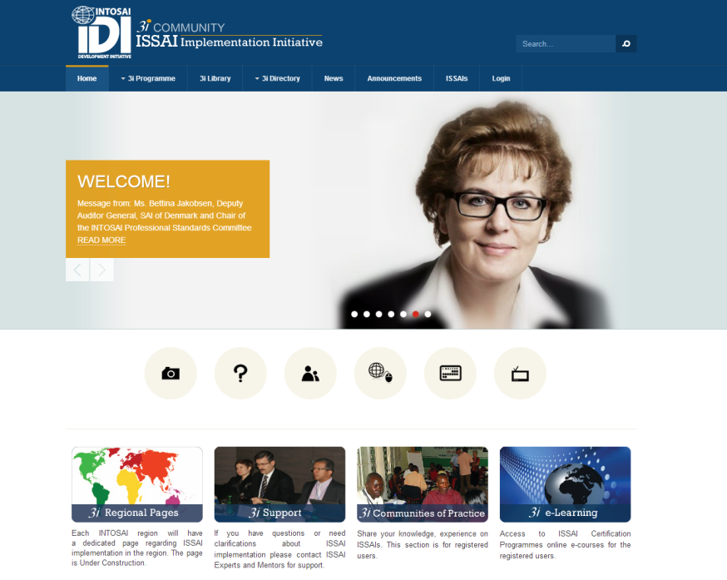
3i Community Portal
www.idicommunity.org

Slide 11
Plan 2013
ISSAI Certification Programme ( PA & FA)
  E-course on Implementing ISSAIs
  Workshop on Facilitating ISSAI Implementation
Cooperative Performance Audit on Public Debt ( PASAI)
Product Development Meeting for ISSAI Implementation Handbook – Compliance Audit
Mapping Workshop – AFROSAI-E

Slide 12
Plan 2014
Completion of ISSAI Certification Programme
Review of iCATs
Cooperative Audits
SAI level support
Evaluation of Phase 1

Slide 13
Non-English Language Regions
ARABOSAI
USD 500000 from USAID
Translation of 3i material by SAI UAE
OLACEFS
Project proposal sent to GIZ, WB, IADB and USAID
Translation of 3i material by SAI Mexico
CREFIAF
Project proposal sent to CIDA, MOF-France, European Commission

Slide 14
Financial Resources
    World Bank Grant
    2012 : USD 950 000
    2013 : USD 1.35 million

Slide 15
In Kind Contribution from the SAIs
ISSAI Mentors
No. | Financial Audit | Performance Audit | Compliance Audit
1. | Cook Islands | Fiji | Grenada
2. | Jamaica | India | Lesotho
3. | Philippines | Lesotho | Samoa
4. | United Arab Emirates | St. Lucia | Turkey
5. | AFROSAI-E Secretariat | Bhutan
6. | Canada | Brazil
7. | Bhutan
8. | Tanzania
ISSAI Experts
FAS | PAS | CAS
2 Experts from SAI Estonia and SAI Sweden | 2 Experts from SAI Brazil | 3 Experts from SAI Tunisia (2) and SAI Norway

Slide 16
In Kind Contribution from the SAIs
Host SAIs
No. | Activity | Host SAI
1. | 3i Management Workshop, CAROSAI | SAI Suriname
2. | Planning Meeting for ARABOSAI/CREFIAF 3i Programme | SAI Morocco
3. | 3i Management Workshop ASOSAI | SAI Cambodia
4. | Product development meeting for ISSAI Implementation Handbook –Performance audit | SAI Bhutan
5. | Design meeting for Workshop on Facilitating ISSAI Implementation | SAI Bhutan

Slide 17
Contributions
IDI Contribution
Responsible for 3i
Administrative costs
Staff payment other than salary
Regional Contribution
Administration, facilitation, hosting, monitoring
PSC and Sub Committee Contributions
Provision of expertise for developing products, certification programme, expert advise

Slide 18
3i Experiences
SAI level understanding of ISSAIs
Ability to exercise professional judgment
SAI leaders at the centre of implementation
Need to look at the entire framework
Resource persons for SAI level issues in the ISSAI framework

Slide 19
3i Experiences
Language issues
Maintenance of tools and guidance
Need for SAI level support to create critical mass
Need for scaled up, continuous support from PSC and its subcommittees

Slide 20
IDI draft SP 2014-2018
Strategic Priorities
IDI Strategy
IDI Capacity

Slide 21
Strategic Priorities
  The value creation by SAIs that the IDI hopes to contribute to
  Focus areas for IDI support
SP1. Contribute to Strengthening the accountability, integrity and transparency of government and public entities
SP2. Demonstrating ongoing relevance to citizens and other stakeholders
SP3. Leading by example

Slide 22
IDI Strategy/Outcomes
What outcomes will the IDI aim for in creating value for SAIs?
IS1. Effective SAI capacity development programmes
IS2. Global Public Goods used by stakeholders
IS3. Stronger regional bodies, networks and communities
IS4.Scaled up and more effective support to SAIs

Slide 23
Implementation Strategies
Engage in continuing research and development activities in emerging areas.
Contribute to advocacy of SAIs for their institutional development
Leverage IT to provide effective and cost efficient professional tools and learning solutions
Promote and support gender mainstreaming by SAIs
Support SAIs in having professionally accredited personnel
Increase outreach by also providing capacity development support on cost recovery basis
Strengthen coordination of SAI capacity development support
Enhance capacity for measurement of SAI Performance
Draw on peer-peer cooperation of client SAIs for supporting capacity development
Strengthen needs assessment, follow up, monitoring and evaluation mechanism for IDI

