Slide 1


TSF’s Analysis on ISQM1
June, 2021
Technical Support Function

Slide 2

Analysis of ISQM1
ISQM 1 it replaces ISQC1 and it deals with the firm’s responsibility for quality through having a system of quality management. The audit firms are required to shift from quality control to quality management and to design a system of quality management to manage the quality of engagements performed by the firm.

Slide 3
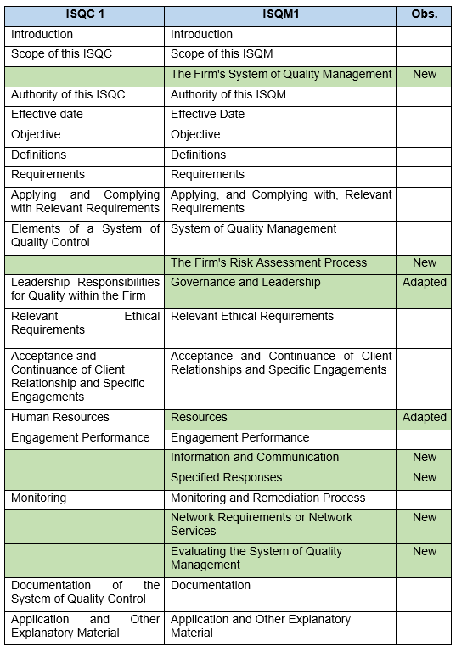
Analysis of ISQM1
As a structure, the differences between
ISQC1 and ISQM1 are the following:

Slide 4
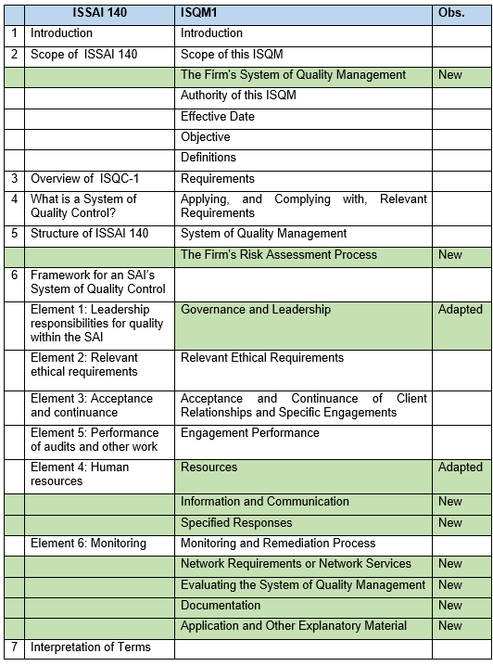
Analysis of ISQM1
As a structure, the differences between
ISSAI 140 and ISQM1 are the following:

Slide 5
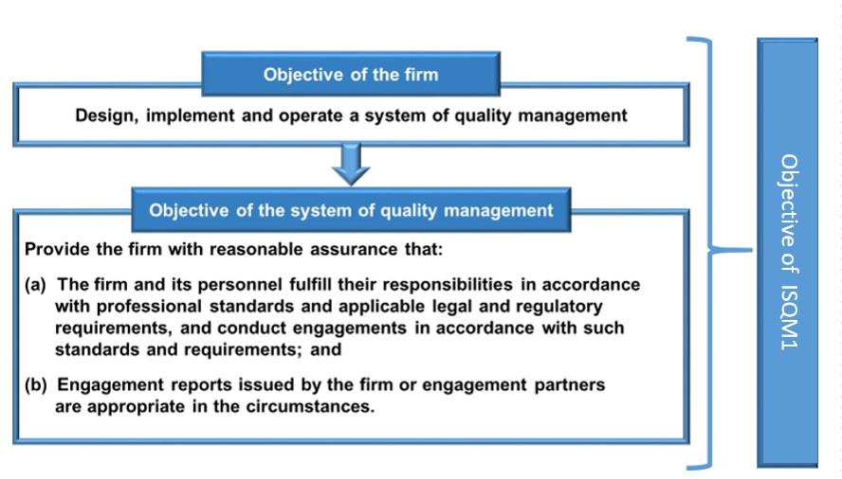
Analysis of ISQM1
The scope of the standard is to implement:

Slide 6
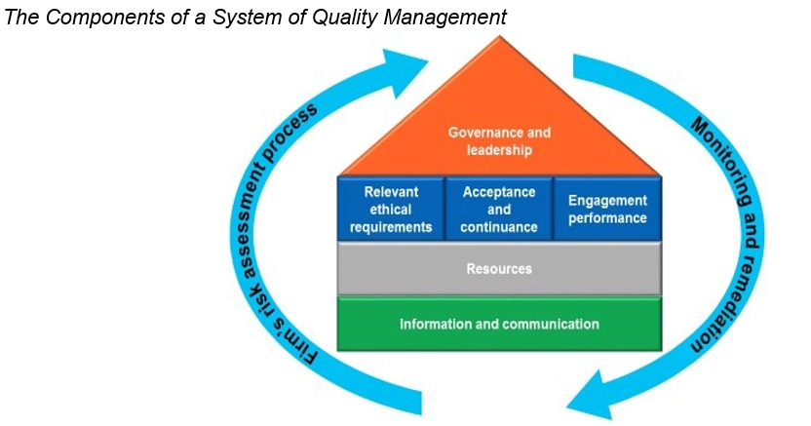
Analysis of ISQM1
ISQM1 has a new approach focused on quality management based on eight components as follows:

Slide 7
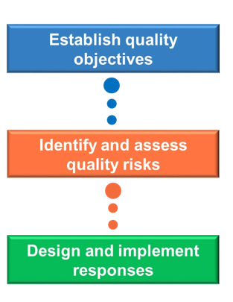
Analysis of ISQM1
The firm’s risk assessment process

Slide 8
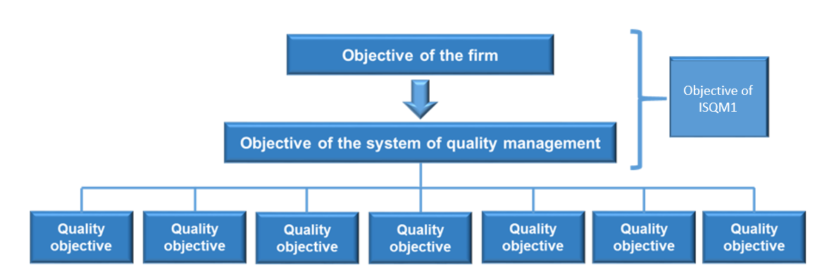
Analysis of ISQM1
Establish quality objectives for each component of SQM

Slide 9
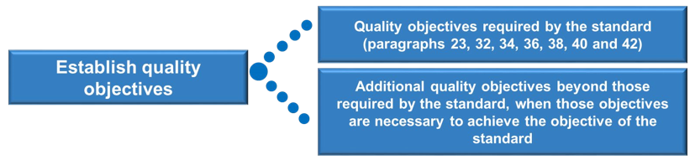
Analysis of ISQM1
Establish quality objectives

Slide 10
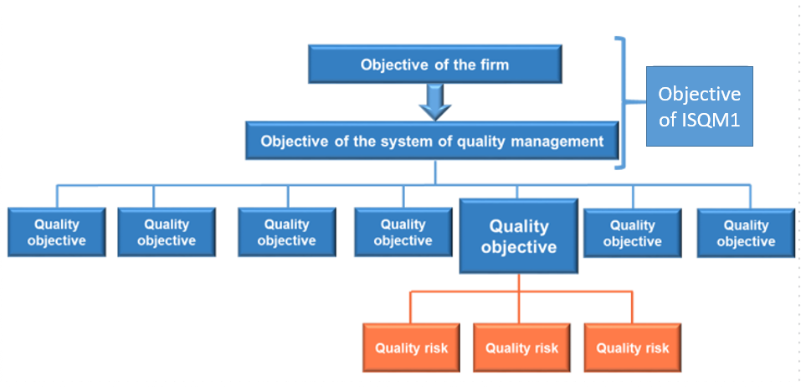
Analysis of ISQM1
Identify and assess quality risks for each objective of SQM

Slide 11
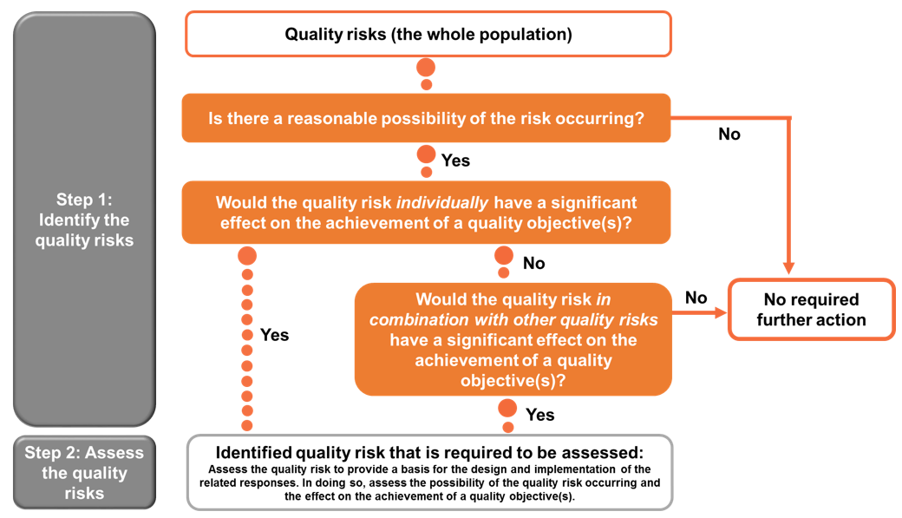
Analysis of ISQM1
The process of identifying and assessing quality risks

Slide 12
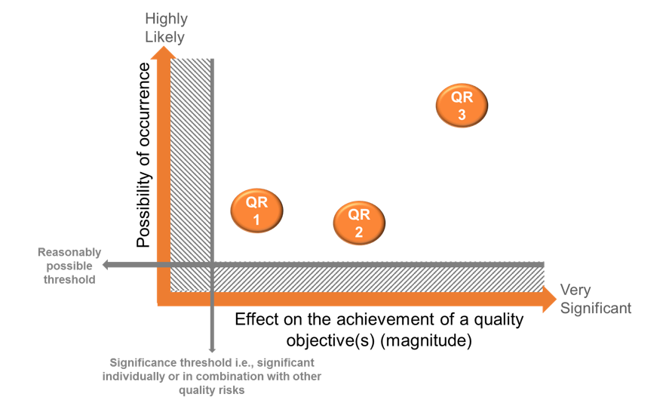
Analysis of ISQM1
Taking in consideration of the possibility of occurrence and effect on the achievement of a quality objectives

Slide 13
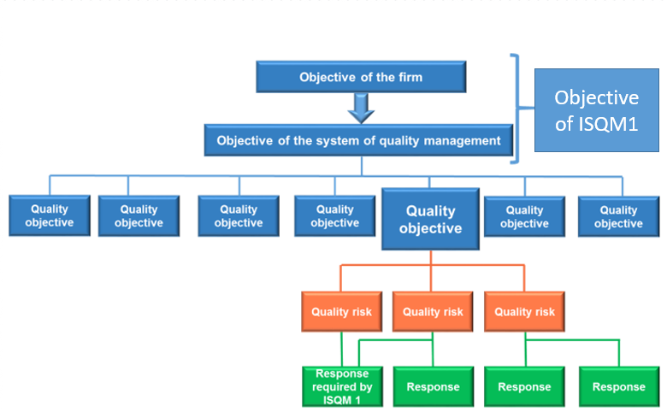
Analysis of ISQM1
Designing and implement responses to address the quality risks which can affect the objectives of SQM

Slide 14
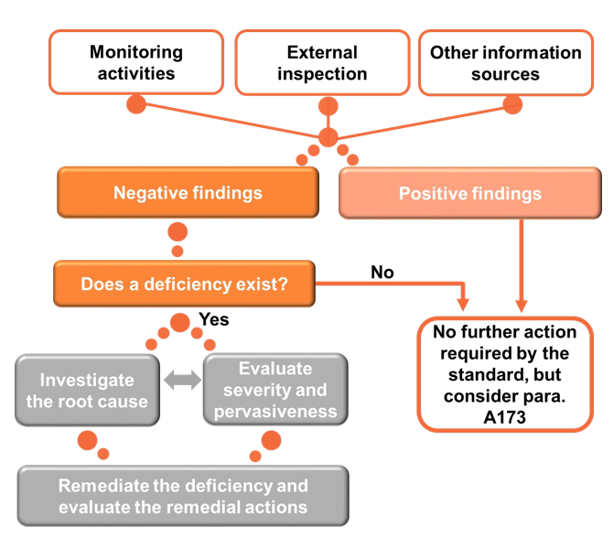
Analysis of ISQM1
Evaluating findings and identifying deficiencies

Slide 15
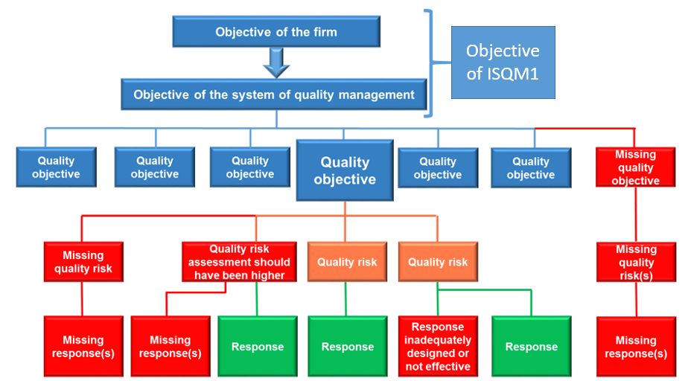
Analysis of ISQM1
Deficiencies that may arise in the firm’s system of quality management

Slide 16
Analysis of ISQM1
The TSF’s recommendations are:
To update ISSAI 140 by taking over the main requirements of the new ISQM1 and raising them to the rank of principles, and the application instructions to be used to develop a guide for the implementation of a quality management system.
Also, when updating ISSAI 140 then there is a need to logically re-arrange 8 elements of quality management (as cited in ISQM 1) to form a logical path of quality management in the public sector audit.

Slide 17
Analysis of ISQM1
Regarding the size of the changes required, the TSF’s recommends are the following:
ISSAI 140 to take over from ISQM1 only the principles of a quality management system.
To develop a new Guide 9xxx to take the applicability and explanations as guidelines for the development and implementation of a quality management system.
ISA 220 should be used to update the practical notes in GUID 2900.

Slide 18
Analysis of ISQM1
What is ISQM2 ?
ISQM 2 is about Engagement Quality Review – EQR. It is intention is to review and challenge the work of the Reviewer. This is because in the private sector audit needed a mechanism to challenge the work of the review. ISQM to a large extent might not be applicable to the public sector where the review work is more structured.
The TSF’s recommendation is:
ISQM 2 to be used to update GUID 1900 and verify the implications on the SAI-PMF methodology.

Slide 19
Thank you for your attention
Technical Support Function

