Slide 1

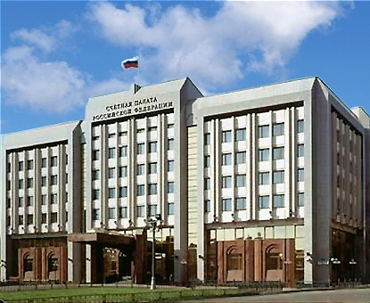
The Accounts Chamber
of the Russian Federation
How SAIs influence Good Governance
in the Public Administration: an experience of the Accounts Chamber of the Russian Federation
Vladimir Volkov,
The Head of Summary Inspection
of Summary Audit Department
of the Accounts Chamber of the Russian Federation

Slide 2

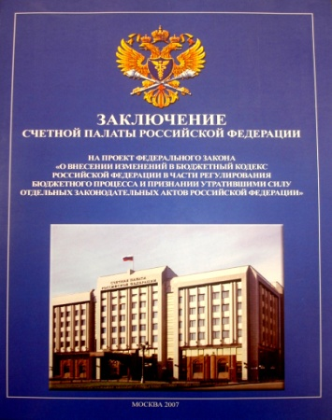


The Accounts Chamber of the Russian Federation www.ach.gov.ru
The legal framework of the activities of the Accounts Chamber of the Russian Federation,
that enables really to influence Good Governance in the Public Administration
Constitution of the Russian Federation
Federal law «On the Accounts Chamber of the Russian Federation»,
April 5th, 2013
(new version)
Acknowledged principles and norms of international law, international agreements of the Russian Federation, international legal principles of independent audit
(Article. 101, part. 5)
For the purpose of exercising control over fulfillment of the federal budget the Federation Council and the State Duma establish the Accounts Chamber, the composition and the order of the activities of which are determined by the Federal Law
The Budget Code of the Russian
Federation
2

Slide 3




The Accounts Chamber of the Russian Federation www.ach.gov.ru
Special status of the Accounts Chamber of the Russian Federation,
that gives real opportunity to influence Good Governance in the Public Administration
the Accounts Chamber of the Russian Federation
Supervising public body:
permanent Supreme Audit Institution
Institution of the civil society:
is accountable to the Parliament and to all tax payers, through democracy procedures
3

Slide 4

The principles of audit conduction, formulated in the Law on the Accounts Chamber of the Russian Federation
The Accounts Chamber of the Russian Federation www.ach.gov.ru
Legality
Efficiency
Objectivity
Independence
Openness
Publicity
4

Slide 5
Счетная палата Российской Федерации www.ach.gov.ru
Basic tasks of the Accounts Chamber of the Russian Federation
Control on target and efficient use of the federal budget funds and extra-budgetary funds.
Audit of performability and effectiveness of strategic goals of social and economic development achievement.
Detection of performance and complience of order of forming, management and regulation of federal and other funds.
Development of methods of performance and complience audits of mentioned order.
Analysis of shortcomings and violations detected in the process of forming, management and regulation of federal and other funds, proposals for their elimination and for improvement of the budget process on the whole.
Estimate of efficiency of tax and other benefits and budget credits at the expense of the federal budget funds.
Detection of validity of budget reporting of chief administrators of the federal budget funds and extra-budgetary funds and of annual reporting on execution of these funds.
Control on legality and timeliness of movement of the federal budget funds and extra-budgetary funds in the Bank of Russia and other credit institutions.
Assurance of measures aimed at counteraction to corruption.
Implementation of basic tasks of the Accounts Chamber enables really to influence Good Governance in the Public Administration.
5

Slide 6
The Accounts Chamber of the Russian Federation www.ach.gov.ru
The uniform system of control over formation and execution of the federal budget and budgets of state extra-budgetary funds
Preliminary audit of draft budgets for a corresponding financial year
On-going analysis and control –in the process of execution of budgets of the current financial year
Follow-up control of executed budgets for the reporting financial year
Federal budget, budgets of state extra-budgetary funds
Theme control and examining activities
6

Slide 7

Communication of the Accounts Chamber of the Russian Federation, that gives real opportunity to influence Good Governance in the Public Administration
Счетная палата Российской Федерации www.ach.gov.ru
Participation in the Parliament control execution (according to the competence)
Communication with audit bodies of the subjects of the Russian Federation
Possibility of regular informing the President of the Russian Federation on basic results of the activities
Communication with federal bodies of governmental authorities, state control and law enforcement bodies
Communication with SAIs of other states and international organizations (including study of international experience)
Communication with citizens
7

Slide 8
Счетная палата Российской Федерации www.ach.gov.ru
Forms of communication of the Accounts Chamber of the Russian Federation, that give real opportunity to influence Good Governance in the Public Administration
Informing the President of the Russian Federation, the chambers of the Parliament, other federal and regional bodies of governmental authorities, enterprises and institutions on the results of control and examining activities (notions, prescriptions, conclusions, informative letters).
Reports to the President of the Russian Federation relating to the most important results of the activities, during meetings, sessions of the State Council and other actions with participation of the President of the Russian Federation.
Participation in the Parliament hearings (including on conclusions of the Accounts Chamber on the draft budgets and annual reports on executed budgets), meetings of the committees and the commissions of the Parliament (relating to discussion of the results of the Accounts Chamber activities, quarter implementation of notions and prescriptions, proposals for improvement of the budget legislation).
Communication with federal and regional bodies of governmental authorities, audit bodies of the subjects of the Russian Federation and of municipal formations, including on the basis of agreements.
Communication with state control and law enforcement bodies, including through joint inspections, submission of materials of the Accounts Chamber to law enforcement bodies on the facts of gross violations of legislation and on additional requests.
8

Slide 9
Счетная палата Российской Федерации www.ach.gov.ru
Submission of the materials of the Accounts Chamber of the Russian Federation on the results of control and examining activities and reaction of law enforcement bodies
(in 2013)
1183 materials – to the chambers of the Parliament
366 notions and 1 prescription of the Accounts Chamber – to the Ministry of Finance, chief administrators of the federal budget funds
445 informative letters, including:
31 – to the President of the Russian Federation,
79 – to the Government of the Russian Federation
114 materials – to the Prosecutor General’s Office, other law enforcement bodies
60 materials – on additional requests of law enforcement bodies
39 criminal cases on the materials of the Accounts Chamber
575 administrative penalties on the notions of the Accounts Chamber,
including discharge of 75 persons
9
9

Slide 10
The Accounts Chamber of the Russian Federation activities with applications of citizens (on the results of 2013)
The Accounts Chamber of the Russian Federation www.ach.gov.ru
The activities of the Counseling Office of the Accounts Chamber
(personal reception of 126 citizens)
Analysis of applications of citizens on violations of budgetary legislation and taking into consideration of a corresponding information during planning of control activities and carrying out of audits
(2279 applications of the citizens were registered and considered.
42 applications were taken into account in planned control activities for 2013,
18 applications are assumed to be taken into account for 2014)
Feedback with the citizens, applied to the Accounts Chamber
(1246 notifications on addressing applications to competent bodies and
566 direct explanations were sent to citizens)
10

Slide 11
The Accounts Chamber of the Russian Federation www.ach.gov.ru
Basic mechanisms of informing the public on the activities of the Accounts Chamber of the Russian Federation (in addition to activities with applications of citizens)
Mass media publications, reports, information about the Accounts Chamber activities – 91,6 ths.
Visits of the web-site of the Accounts Chamber – 770 ths.
TV- and radio materials on the activities of the Accounts Chamber – 3400
Video materials on YouTube on the activities of the Accounts Chamber – weekly
Reports in micro blog of the Accounts Chamber in Twitter – 420
Press-releases concerning the Accounts Chamber activities – 375
Repeated awarding of the Accounts Chamber with the Golden Diploma «For information transparency and professionalism» of the national competition «Golden Diploma», established by the Financial Press-club of Russia
11

Slide 12
The Accounts Chamber of the Russian Federation
Thank you for attention!

