Slide 1
The Institute of Internal Auditors:
Serving the Global Internal Auditing Profession
Gerry Cox, CMIIA, CIA, CRMA,
Chief Executive, South West Audit Partnership Ltd
Chair IIA Global Advocacy Committee
INTOSAI PSC Meeting June 2013
Notes:
Goal – To Impress – Let them know who we are, what we do and how we got there. Focus on IPPF, Global Reach, ability to turn the ship around and our impact on the good governance, risk management and supporting good financial practices to protect the public good.

Slide 2

Overview
Serving the Internal Auditing Profession
Elevating the Profession
What’s Next for Internal Audit

Slide 3
Serving the Profession

Slide 4
The Global IIA
Established in 1941
Global Headquarters in Altamonte Springs, Florida USA
Internal Audit Profession’s Acknowledged Leader, Chief Advocate, and Principle Educator

Slide 5

The Global IIA Body By the Numbers
180,000 members
115,000 Certified Internal Auditors
190 countries
109 Institutes (+ US, Canada, Caribbean)
601 full and part-time staff
400 plus volunteer leaders
$100.7 million in global revenue*
$7 million of net contribution
$63 million in net assets
* Combined statistics from IIA HQ and Global Institutes for FY ending in 2011

Slide 6
Global Strategic Plan
The IIA’s Core Purpose
To advance the profession and its value around the world.
The IIA’s Big Audacious Goal
Internal audit professionals will be universally recognized as indispensible to effective governance, risk management, and control.
Notes:
The Core purpose identifies the big picture – why the organization will or should not exist 10 to 30 years into the future. What sense of purpose will motivate members to dedicate their creative energies to The IIA and its efforts over a long period of time?
As you can see on the screen, the core purpose of The IIA is simple: To advance the profession and its value around the world.
The 10- to 15-year envisioned future consists of a single, big audacious goal (BAG) or vision. Because it is “audacious” it represents a significant challenge, and its achievement will require all members, institutes, and committees to embrace it. It helps to set the direction for the succession of future three- to five-year strategic plans.
I believe we all want to embrace the goal that “Internal audit professionals will be universally recognized as indispensible to effective governance, risk management, and control.”

Slide 7
Strategic Goals
GOAL A: PROFESSIONALISM
The IIA will be the driving force for the development of high-performing internal audit professionals, indispensible to their organizations.
GOAL B: MEMBERSHIP/VALUE PROPOSITION
The IIA will deliver the value that compels current, future, and former internal auditors to be members.
GOAL C: ADVOCACY
The IIA will have positively raised the profile of, and demand for, professional internal auditing globally.

Slide 8
Strategic Goals
GOAL D: GOVERNANCE
The IIA will have a global operating model in place where all affiliated institutes are aligned on core principles.
GOAL E: FINANCIAL
IIA Global operations will be self-sufficient financially with adequate reserves to carry out its core purpose and strategic direction.

Slide 9
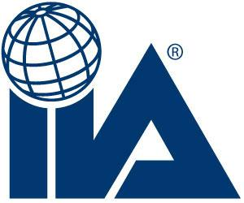
Knowledge & Research
Certifications & Professional Development
Network
Standards & Guidance
International Professional Practices Framework (IPPF)
Internal Auditor, CAE Resources, Tone at The Top CBOK, IIA RF
CIA, CCSA, CGAP, CFSA, CRMA
Conferences, Seminars, Webinars
Institutes, Chapters, Volunteers,
External Stakeholders
Notes:
The IIA is the global voice, acknowledged leader, principal educator, and recognized authority of the internal audit profession and maintains the International Standards for the Professional Practice of Internal Auditing (Standards)

Slide 10
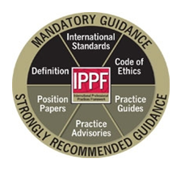
International Professional Practices Framework (IPPF)
Comprehensive Guidance for the Profession
Speak the same professional language.
Accountable to a common set of standards and guidance.
Formally adopted as part of several industry and country specific regulations.
Translated into 28 languages.
Notes:
The IIA provides comprehensive guidance for the profession through its globally acknowledged International Professional Practices Framework (IPPF). The IPPF comprises the official Definition of Internal Auditing, the International Standards for the Professional Practice of Internal Auditing (Standards) included in Attachment A, the Code of Ethics, Practice Advisories, Position Papers, and Practice Guides. Thus, internal auditors everywhere speak the same professional language and universally hold themselves accountable to adherence to a common set of standards and guidance. Globally, the IPPF has been formally adopted as part of several industry and country-specific regulations.
To be effective and provide the utmost value in assuring effective governance, risk management and control; internal auditors worldwide make a commitment to professionalism by practicing in accordance with the Standards. The Standards, along with the Definition of Internal Auditing and the Code of Ethics, form the mandatory guidance for all seeking to practice the profession of internal auditing. Complimented by the strongly recommended Practice Guides, Practice Advisories and Position Papers, the entire IPPF is assessed, evaluated and enhanced on a continuous basis.

Slide 11
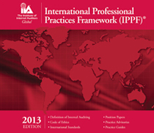
Standards-Setting Process
International Internal Audit Standards Board (IIASB)
Reviewed at least once every 3 Years
Extensive Consultation and Discussion
Worldwide Solicitation for Public Comment
IPPF Oversight Council (IPPFOC)
Notes:
The IIA is globally recognized as the acknowledged leader, chief advocate and principle educator for internal audit. A trustworthy global guidance–setting body, The IIA provides internal audit professionals worldwide with authoritative guidance.
The review and development of the Standards is an ongoing process. As part of the IPPF due process, the Standards must be reviewed at least once every three years in order to remain current, relevant, and timely. The International Internal Audit Standards Board (IIASB) engages in extensive consultation and discussion prior to issuing the Standards. This includes worldwide solicitation for public comment including internal auditing professionals and their stakeholders, through the exposure draft process. All exposure drafts are posted on The IIA's website as well as being distributed to all IIA Institutes.
In order to promote inclusiveness, transparency, and other qualities that increase internal audit stakeholders’ confidence that the outputs of standard-and guidance-setting committees are in the public interest, the IPPF Oversight Council (IPPFOC) was established in October 2010. Its mission is to evaluate and advise on the adequacy and appropriateness of The IIA’s standard-and guidance-setting processes.
Appointed by The IIA Board of Directors, the stakeholder organizations serving on the council represent boards, management, public and private sector auditors, regulators and government authorities, investors, and international organizations. Current members of the IPPFOC include representatives from the International Federation of Accountants (IFAC), National Association of Corporate Directors (NACD), International Organization of Supreme Audit Institutions (INTOSAI), World Bank and Organizations for Economic Cooperation and Development (OECD), being chaired by the fully independent representative from IFAC.
Based on recommendations from the IPPFOC, in 2011 The IIA incorporated stakeholder input throughout the standard-setting process. Currently The IIA Standards Board (IIASB) twenty-one person membership includes two members from representatives from stakeholder organizations, the Association of Chartered Certified Accountants (ACCA), and INTOSAI with representation from a total of fifteen different countries.
Notable, IPPFOC recommendations, among other important things, have resulted in the incorporation of an enhanced consultation process for future standard-setting. The current review of the Definition of Internal Auditing began with a consultation process that included both internal audit practitioners and external stakeholders and the IIASB will continue to seek external stakeholder input in its future standard-setting.
Additional information on the IPPFOC can be found The IIA’s website using the following link IPPFOC Charter.

Slide 12
IIA Public Sector Committee
In Development
Practice Guides
  How to Build a Strategic Competency Plan in the Public Sector
  Assessing Organizational Governance in the Public Sector
Leading Practices
  Legislation of Internal Audit in the Public Sector (formerly titled Model Legislation)
  Model Internal Audit Charter for the Public Sector
  Audit Committees in the Public Sector
  INTOSAI Standards and IIA Standards - A Comparison
Notes:
All expected to be released in 2013 or early 2014

Slide 13
IIA Public Sector Committee
Responses to Exposure Drafts
Responses Submitted Since May 2012
  INTOSAI - ISSAI 100 – 400: Fundamental Principles of Public Sector, Financial, Performance and Compliance Auditing.
  IFAC Exposure Drafts ED 2&3, Conceptual Framework for Public Sector Entities.
Responses Scheduled for Submission
  INTOSAI ISSAI 5700 - Guidelines for the Audit of Corruption Prevention in Gov Agencies
Notes:
Listing of responses submitted by PSC on behalf the IIA’s Global Membership

Slide 14
Elevating the Global Internal Auditing Profession
Notes:
Focus on our advocacy efforts.

Slide 15
Chief Advocate
Outreach to critical stakeholder organizations aimed at building the credibility of The IIA as a global standard-setting body and seeking recognition of the critical role of internal auditing to good governance, risk management and control
Standard Setting Bodies
Exchanges
Government/Auditor General
Institutes/Chapters
Enhance the Global Profile of and Demand for Professional Internal Auditing
Notes:
Key Strategic Goal – Enhance the global profile of and demand for professional internal auditing
Organization Engagement
Financial Stability Board (FSB) - Inclusion of Standards in FSB Compendium of Key Standards for Sound Financial Systems
International Integrated Reporting Council (IIRC) -President and CEO invited to serve on council. Influencing Integrated Reporting Framework.
International Federation of Accountants (IFAC) - Revised Memorandum of Understanding with goal of recognition of the Standards
Organization for Economic Cooperation and Development (OECD) - Opportunities to influence public sector and corporate governance and risk management initiatives.
International Organization of Supreme Audit Institutions (INTOSAI) - Serve on Professional Standards Committee and related subcommittees to influence standards under development.
Organization Engagement – North America
House of Financial Services - 61 Members (33 Republican/ 28 Democrats) 16 Meetings Majority and Minority Staff 9 Republican offices ( 5 with members) 5 Democratic Offices (all staff)
CPA Caucus – 12 Members (10 House/2 Senate) 7 Meetings 4 members and staff 3 staff only
Senate Banking Committee – 22 Members (12 Democrats/10 Republicans) Met with Special Counsel for the Banking Committee (Stephen Kroll) Senate/House Leadership 5 Meetings with Staff Senate Majority Leader (Harry Reid /D-NV) Senate Minority Leader (Mitch McConnell/R-KY) Speaker of the House (John Boehner/R-OH) House Majority Whip (Kevin McCarthy R-CA)
House Minority Whip (Steny Hoyer D-MD)
Organization Engagement
Securities & Exchange Commission (SEC) 4 Meetings 3 Commissioners (Walter, Aguilar, & Paredes) Director, Office of Compliance, Investigations and Examinations (di Florio)
Public Company Accounting Oversight Board (PCAOB) 4 Meetings Met with 4 of 5 Board Members (Doty, Franzel, Hanson, & Harris) Biannual meetings with Chief and Deputy Chief Auditors

Slide 16

Key Focus
International Federation of Accountants (IFAC)
Financial Stability Board (FSB)
International Integrated Reporting Council (IIRC)
US Congress/Regulators
Organization for Economic Cooperation and Development (OECD)
International Organization of Supreme Audit Institutions (INTOSAI)
Notes:
Collaboration and Advocacy Efforts with These Organizations. Examples include:
FSB – Financial Stability Board – Adoption of The Standards in to the FSB Compendium of Key Standards for Sound Financial Systems
2. IIRC – International Integrated Reporting Council – Influencing the role of the internal auditing in integrated reporting - a concise communication about how an organization’s strategy, governance, performance and prospects lead to the creation of value over the short, medium and long term.
IFAC – International Federation of Accountants – Endorsement/recognition of The Standards
OECD – Organization for Economic Cooperation and Development – Influence public sector and corporate governance and risk management initiatives.
INTOSAI – International Organization of Supreme Audit Institutions – Endorsement/recognition of The Standards within Supreme Audit Institutions and influencing standards/guidance being developed by INTOSAI.
BASEL - Basel Committee on Banking Supervision – Influencing guidance from an internal auditing perspective.
ISO – International Organization for Standardization – Monitoring the issue of guidance related to risk management and corporate governance to influence from an internal auditing perspective.
ACCA – Association of Chartered Certified Accountants – Monitoring activities for potential opportunity to collaborate on initiatives related to internal auditing.
IMF – International Monetary Fund - Monitoring activities for potential opportunity to collaborate on initiatives related to internal auditing.
IOSCO – International Association of Securities Commission - Monitoring activities for potential opportunity to collaborate on initiatives related to internal auditing.
World Bank - Monitoring activities for potential opportunity to collaborate on initiatives related to internal auditing.
ICFM -International Consortium of Government Financial Managers – Member of the Board of Directors with the objective of influencing internal auditing initiatives within the global Government Financial Manager community.
ISACA – Information Security Audit and Control Association – Collaboration efforts with the objective of supporting the global internal auditing profession.

Slide 17
What’s Next?
Notes:
What’s next for the profession that will guide what we do for our members and the internal auditing profession.

Slide 18

Globally Advocating Good Governance, Risk Management and Control
FOUR PRINCIPLES
Strong and Effective Audit Committee
Clear Accountability of Risk Management and Control
Properly Structured, Operate in Compliance with Standards, and Required
Reporting Lines for CAE Enhance Organizational Independence.

Slide 19
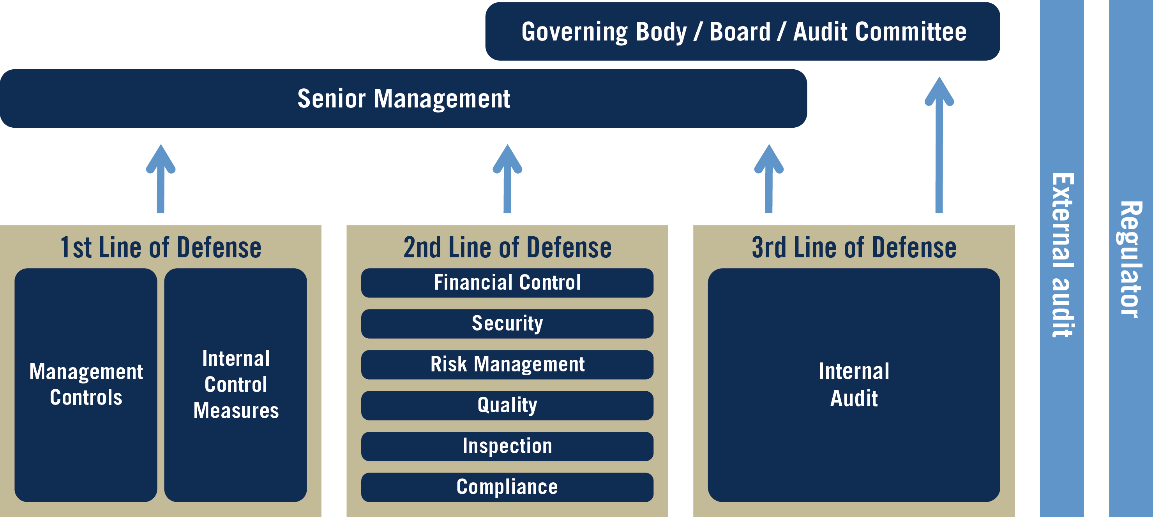
Supporting Internal Audit as a
Third Line of Defense

Slide 20
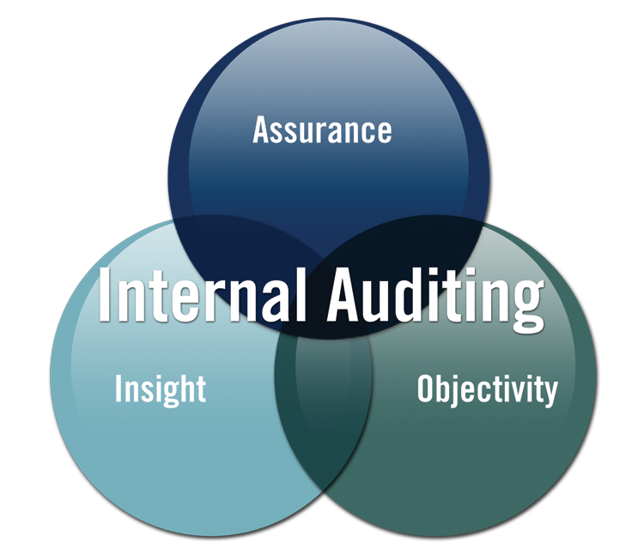
Ensuring Internal Audit is Positioned Correctly
Governing bodies and senior management rely on Internal Auditing for objective assurance and insight on the effectiveness and efficiency of governance, risk management and internal control processes.

Slide 21
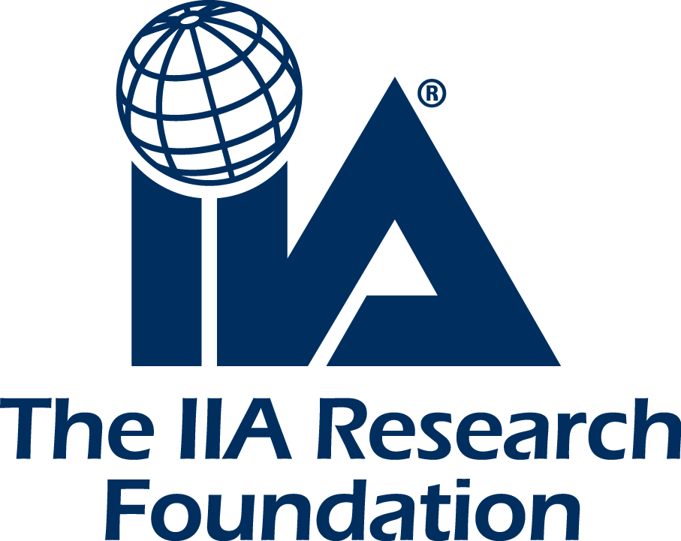
Questions?
The Institute of Internal Auditors
Gerald Cox, CIA, CRMA, CMIIA
Chief Executive, South West Audit Partnership Ltd
Chair IIA Global Advocacy Committee
www.southwestaudit.co.uk

