Slide 1
OECD Study on good public governance: the role of SAIs
Meeting of the INTOSAI Subcommittee on Internal Control Standards
27-28 May 2014, Vilnius, Lithuania
Ishat Reza
Portfolio Manager (Audit and Internal Control), OECD

Slide 2


Introduction
Sponsored by Brazil’s Tribunal de Contas da União (TCU)
Multi-year project (2013-2016)

Slide 3












Participation of peer SAIs
12 peers on five continents
South Africa
Canada
Chile
Korea
USA
India
France
The Netherlands
Mexico
EU
Poland
Portugal

Slide 4
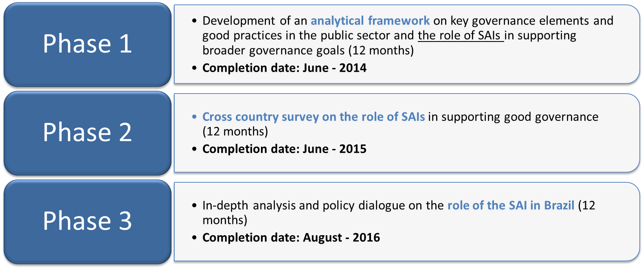
Three phases
Compiling good practices and case studies

Slide 5
Purpose and Objective of the Study
To strengthen good governance and sound public management through SAI audit and counselling work
To facilitate dialogue within SAIs, and between SAIs and the Executive
  Common goal: working in the public interest
Better governance = public trust

Slide 6
Public Governance

Slide 7
Good Governance in a Strategic and Open State
Strategic agility
Government’s capacity to identify and address internal and external challenges correctly
Strategic capacity
Institutional robustness of the state, notably its structures and networks that enable the state to achieve coherence in strategy, policy and purpose, without inefficiencies, redundancies or overlaps
Open government
Ability and willingness of the state to show how its actions and decisions are consistent with clearly defined and agreed objectives, and to work outward with non-state actors
Effective processes
Systems and processes, or a machinery of government that the state can leverage to ensure economy, efficiency and effectiveness in its delivery of public outputs

Slide 8
Areas of government activity
Budgeting
is at the heart of enabling programme and service delivery, along with good public financial management
Regulatory policy
delivers regulations that meet underlying public policy objectives and positively impacts the economy and society
Centre of Government (CoG)
are critical for ensuring coherence across government with respect to policies and programmes, and co-ordination among stakeholders in the execution of the policy process
Internal control
assure the effectiveness and efficiency of government operations, the reliability of financial reporting, and compliance with applicable laws, regulations and policies

Slide 9
Main Question
How can SAI work evolve to have a greater impact on good governance?
  Financial audits
  Compliance audits
  Performance audits
  Good practice guides
  Counselling/advice

Slide 10
Maturity of SAI analysis
TRANSPARENCY
EFFECTIVENESS,
EFFICIENCY, ECONOMY
INSIGHT
FORESIGHT
ASSURANCE
INSIGHT
FORESIGHT
ACCOUNTABILITY

Slide 11
Evolving SAI work
Moving beyond traditional audits
Assessing the:
  procedures and systems related to the policy process for accuracy, quality, reliability, integrity, effectiveness, efficiency and economy
  programmes and policies for effectiveness, efficiency and economy
  actors involved in the systems
Providing guidance and information

Slide 12
Areas of enhanced activity
Budgeting
OECD Draft Principles of Budgetary Governance e.g. Alignment with strategic priorities, transparency, effectiveness of capital budgeting
Regulatory policy
OECD Council Recommendation on Regulatory Policy and Governance e.g. risk, oversight
Centre of Government (CoG)
Whole-of-government reports to support COG’s oversight and co-ordination functions
Internal control
Collaboration/Co-ordination with IA & IC
Issuing guidelines, performance auditing, regulatory management issues
Assessing institutions at the Centre
Providing guidance, including on anti-corruption
Assessing IA, IC, oversight and RM

Slide 13
Next steps
Phase I – (June 2014)
  Preliminary Version of the Analytical Framework
  INTOSAI-ICS research papers & survey data
Phase II (July 2014 – June 2014)
  Implementing the analytical framework
  Survey of peer SAIs and the Executive
  Compiling good practices and case studies in the four areas of government activity, including in internal control

Slide 14
Final word
Let’s discuss sharing information, coordinating and mutually benefiting over the coming year
Dankie Merci Thank you Danke
ačiū dank u ধন্যবাদ Mulțumesc
dziękuję спасибо Takk
ishat.reza@oecd.org

