Slide 1


Awareness Raising Activities in ARABOSAI National Audit Court’s Experience
Kingdom of Bahrain
Jun 2011
PSC
INTOSAI Professional Standards Committee

Slide 2
ARABOSAI DELEGATES
September 21 – 23 Kuwait
PSC
INTOSAI Professional Standards Committee

Slide 3
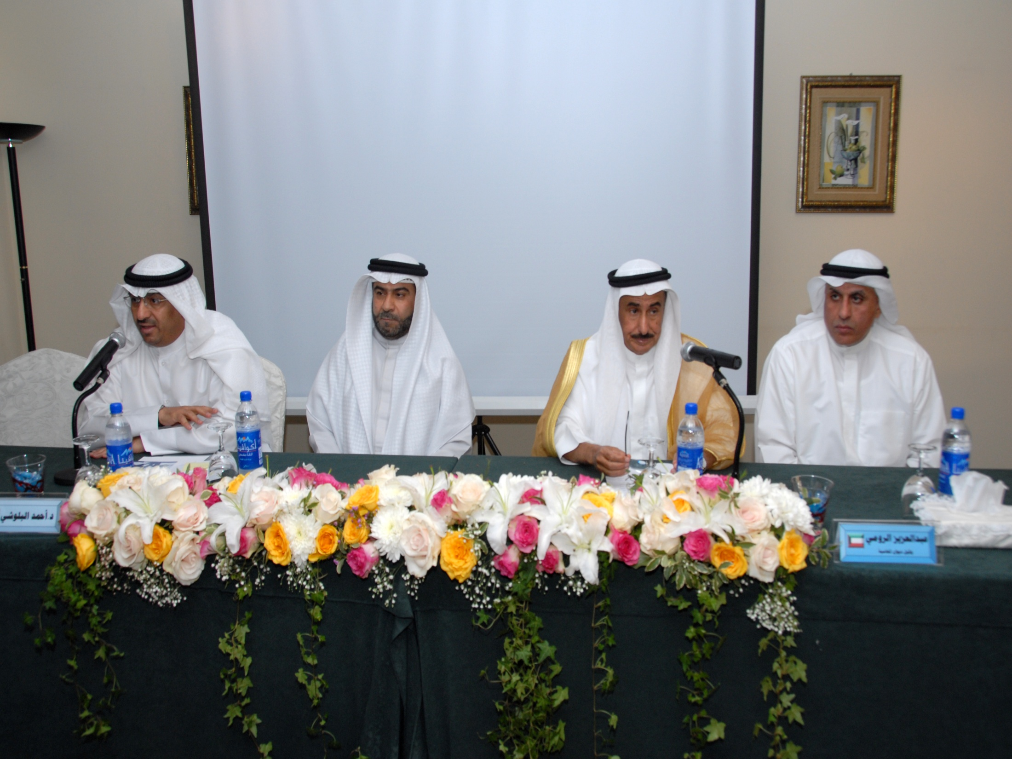

Slide 4
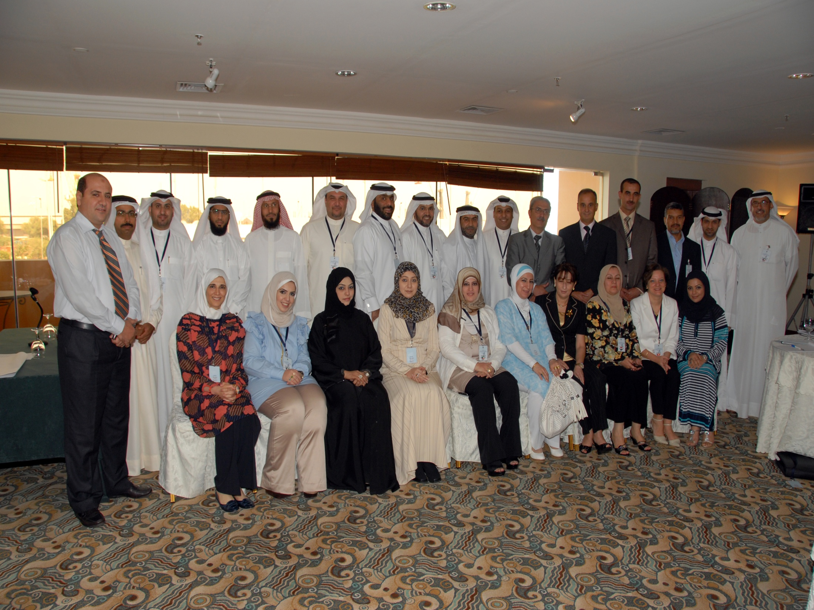

Slide 5
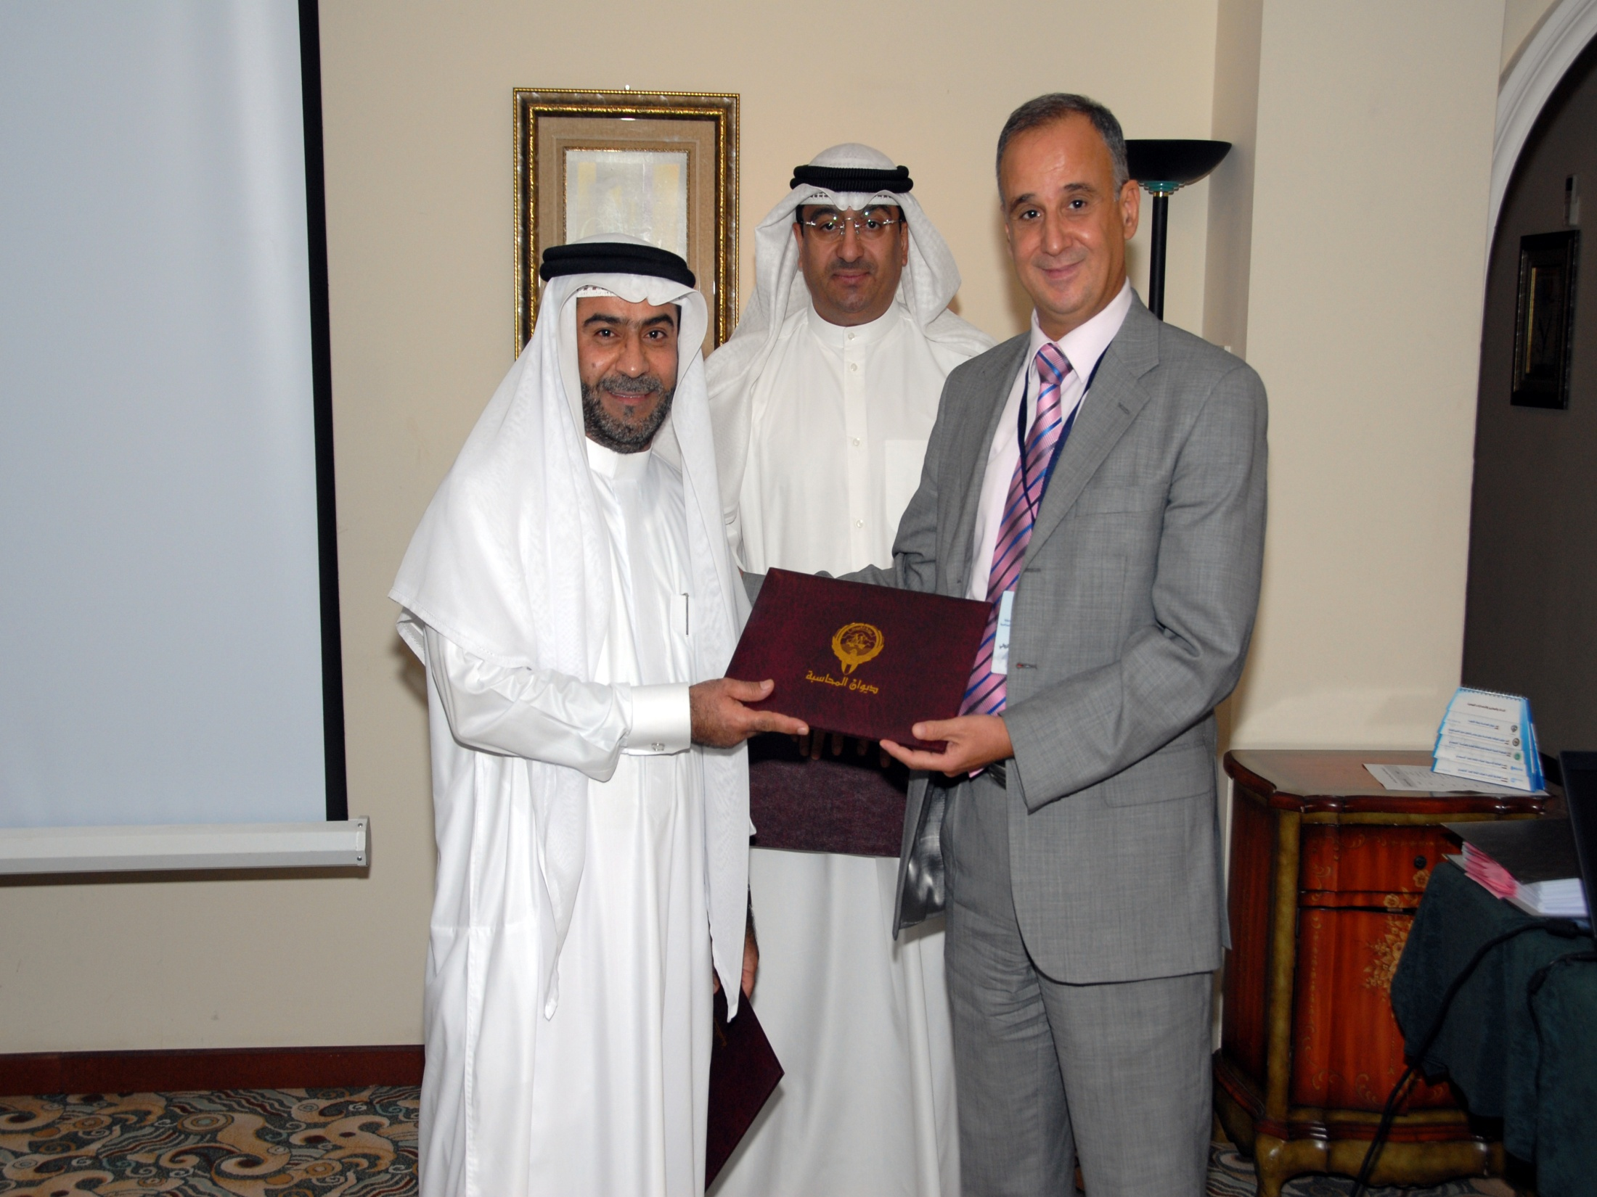

Slide 6
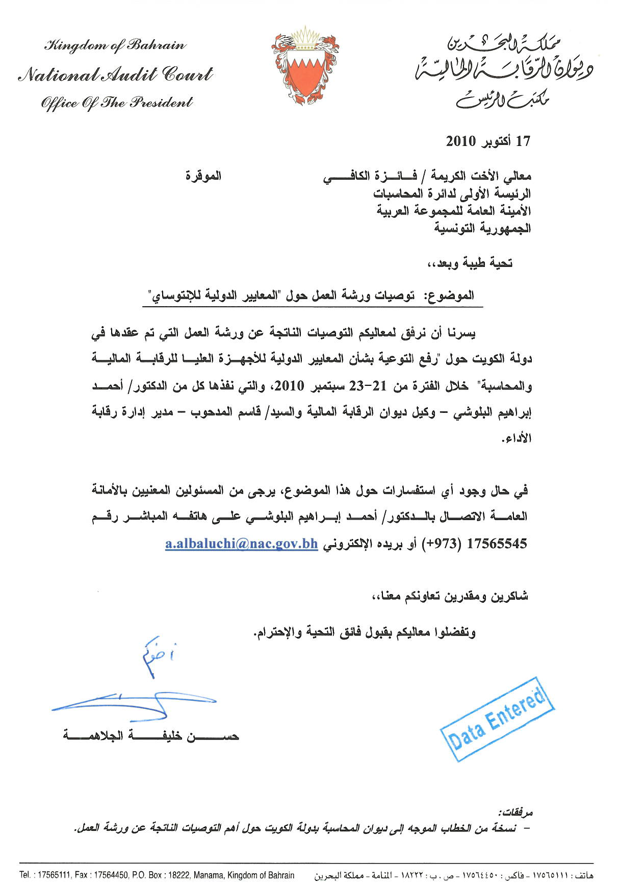

Slide 7
Gulf Co-operation Council Undersecretary’s Meeting
May 29- 30 Riyadh
PSC
INTOSAI Professional Standards Committee

Slide 8
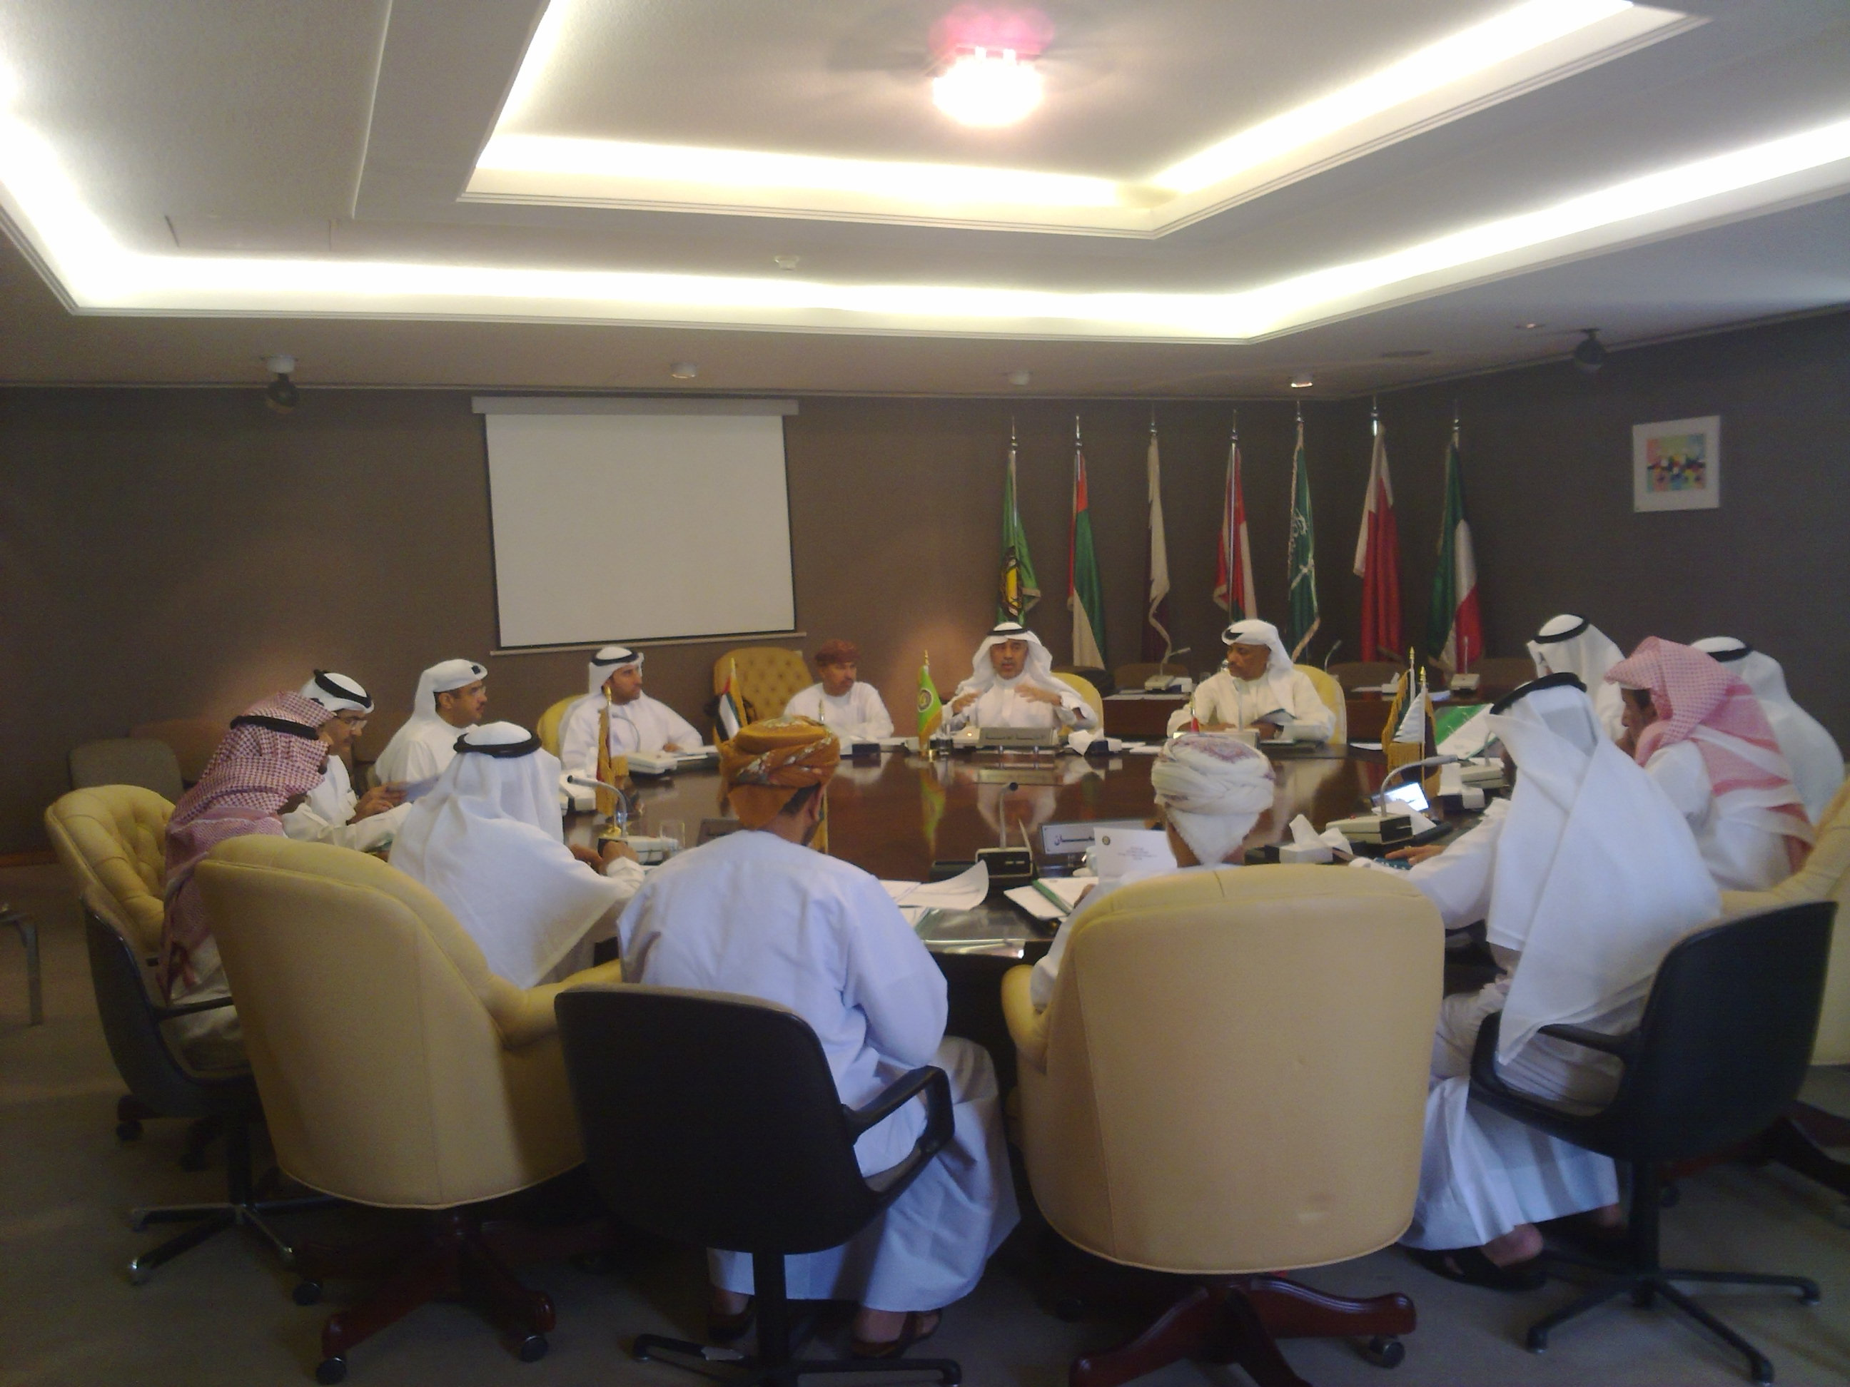

Slide 9
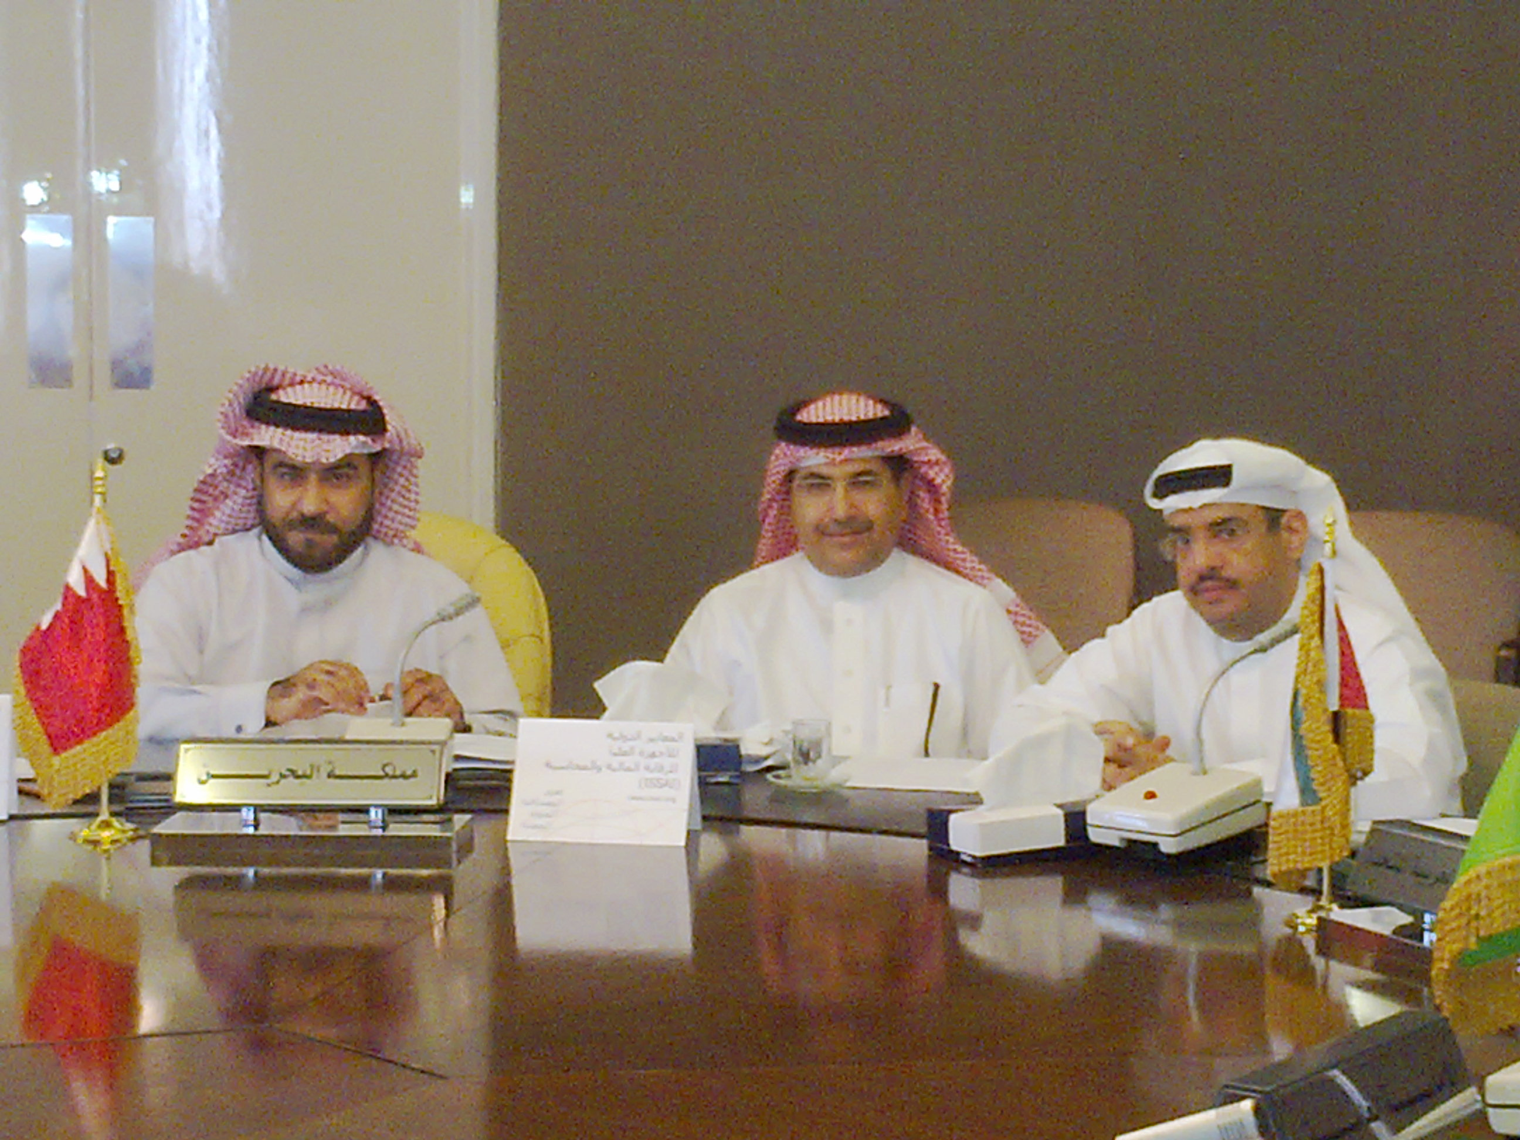

Slide 10
National Audit Court
June 4 Bahrain
PSC
INTOSAI Professional Standards Committee

Slide 11
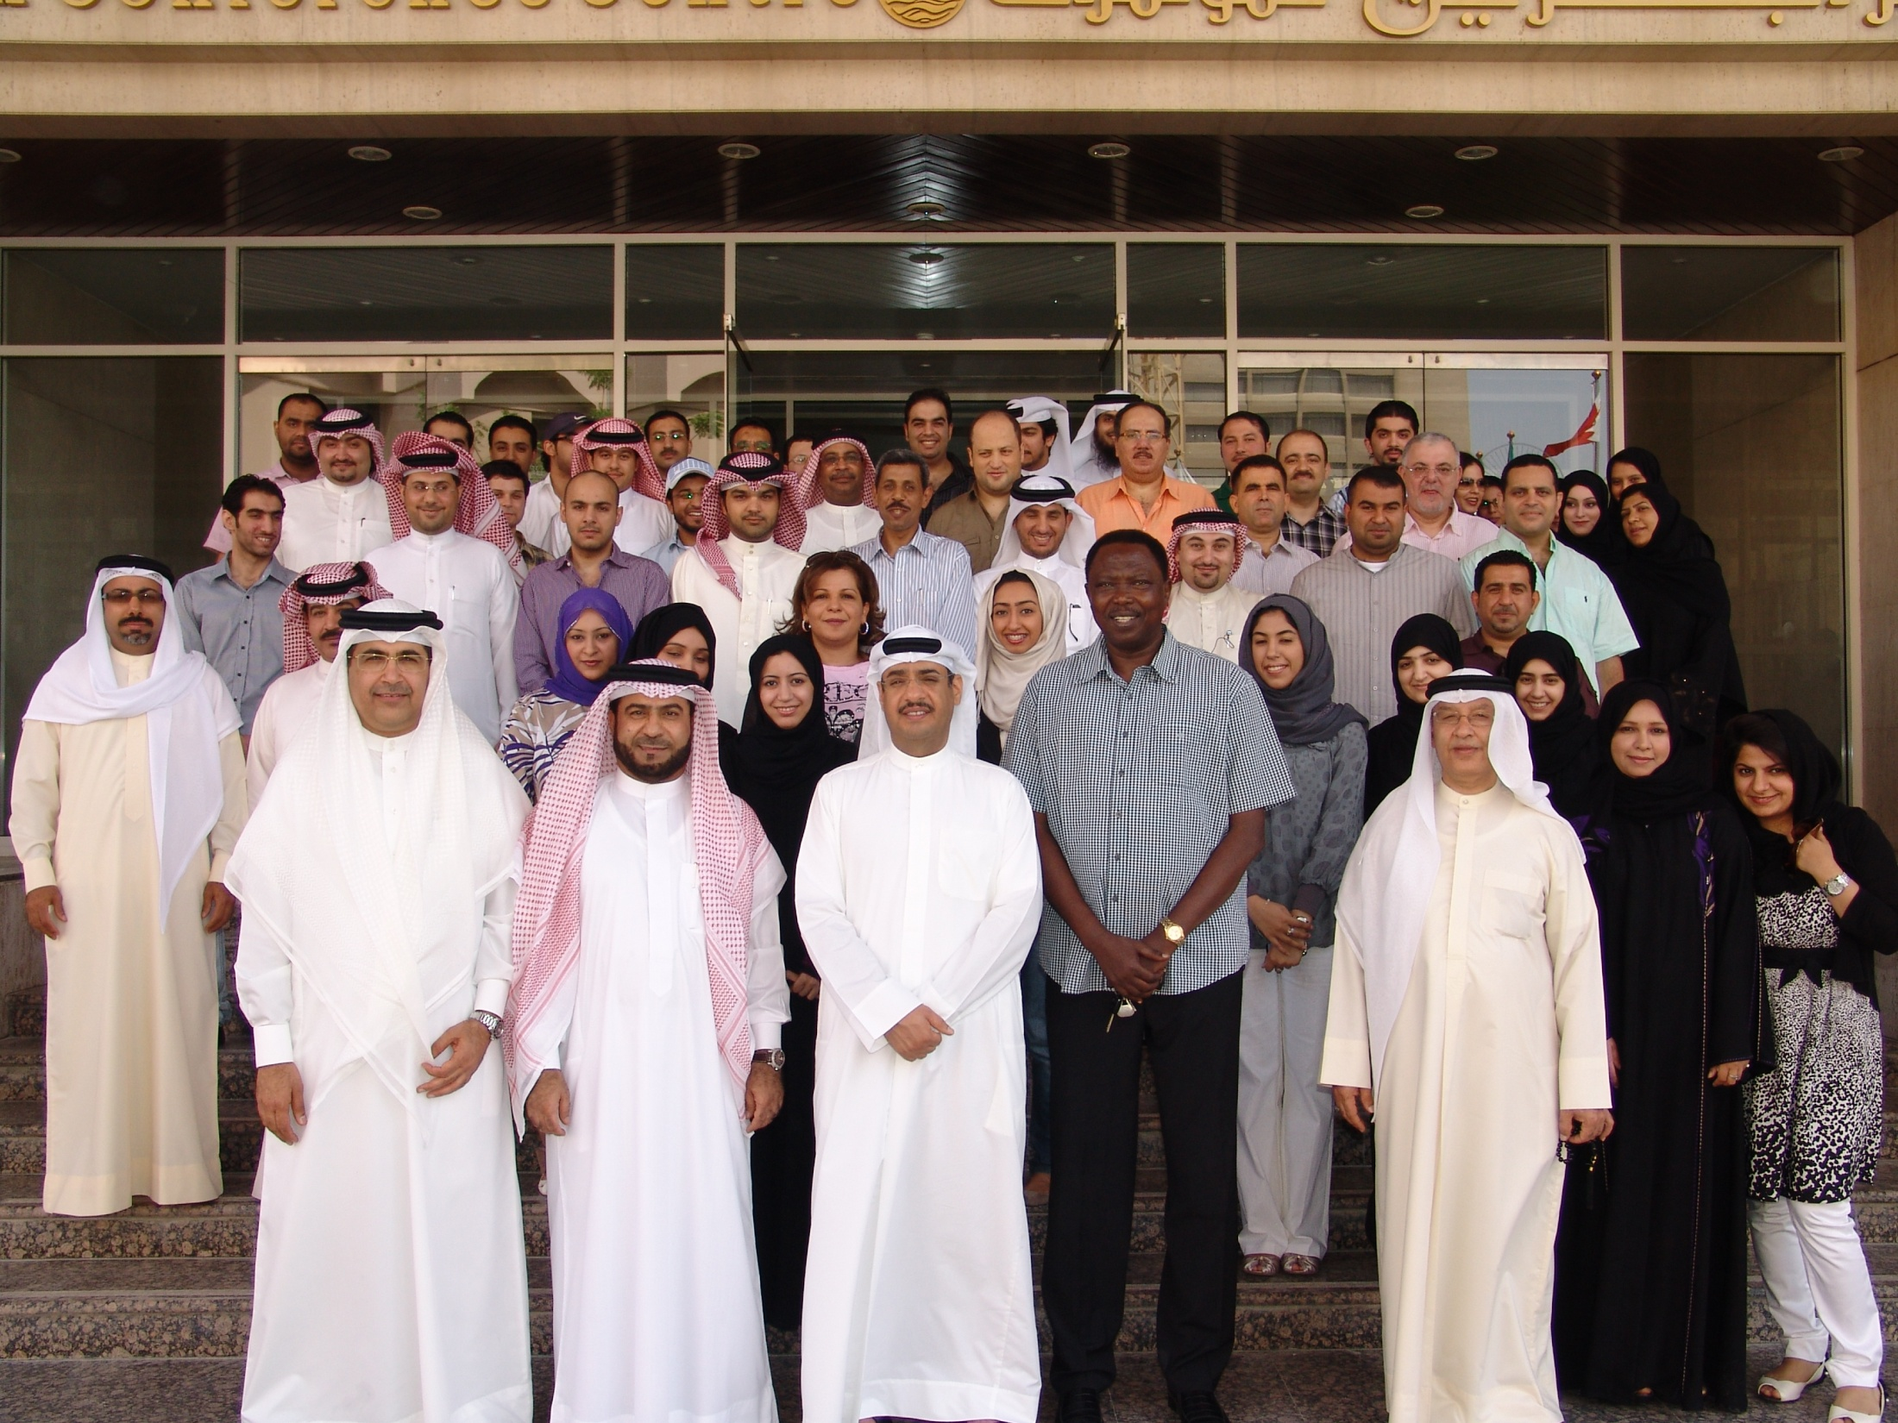

Slide 12
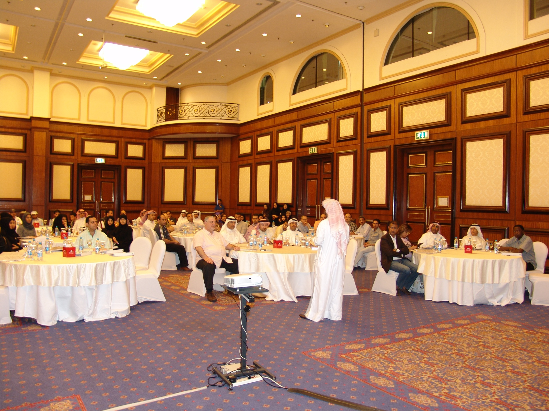

Slide 13
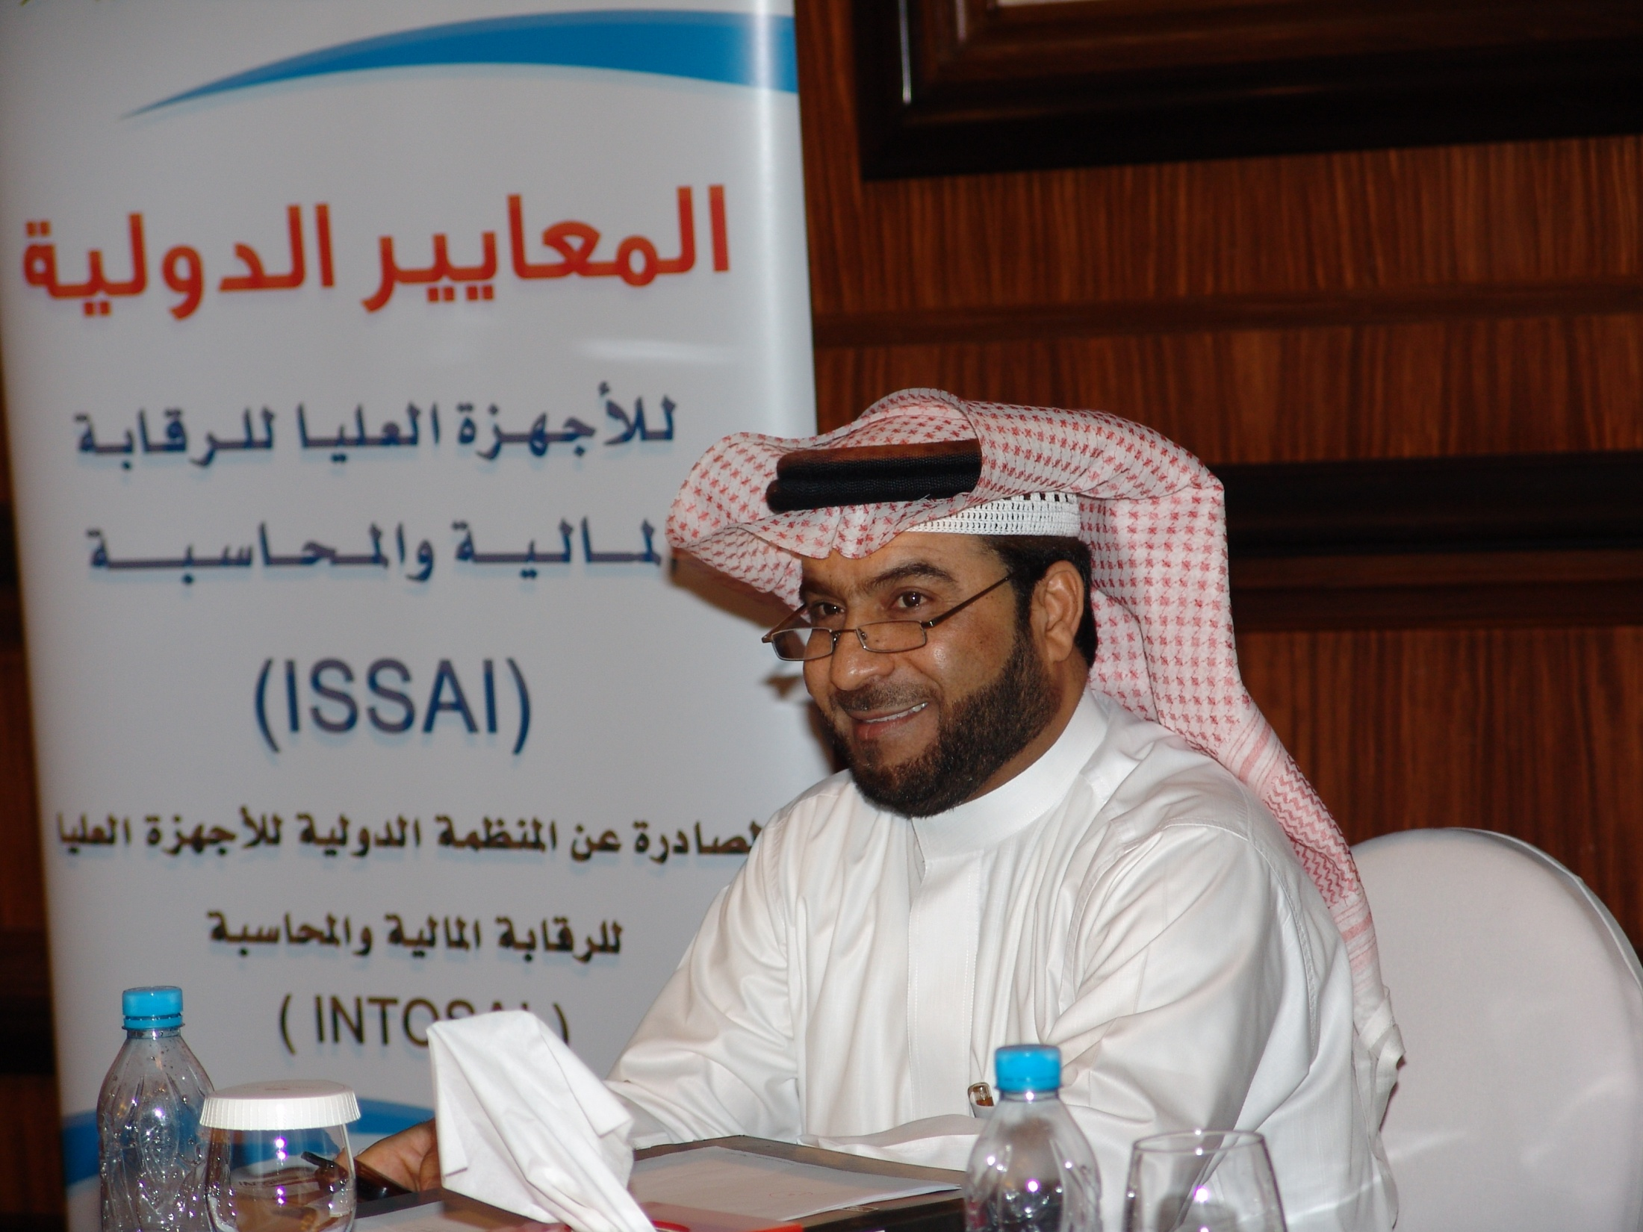

Slide 14
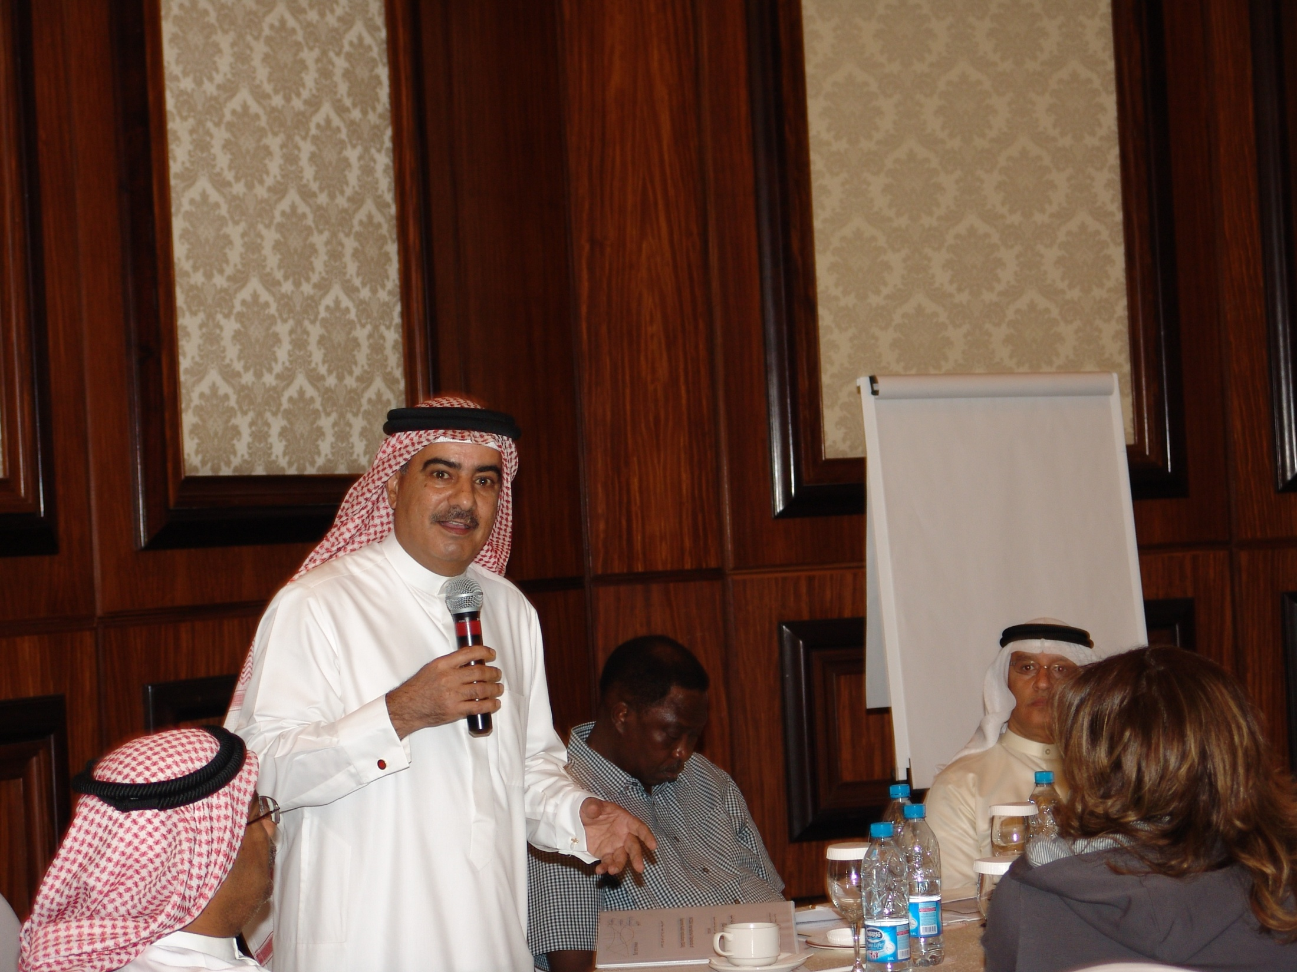

Slide 15
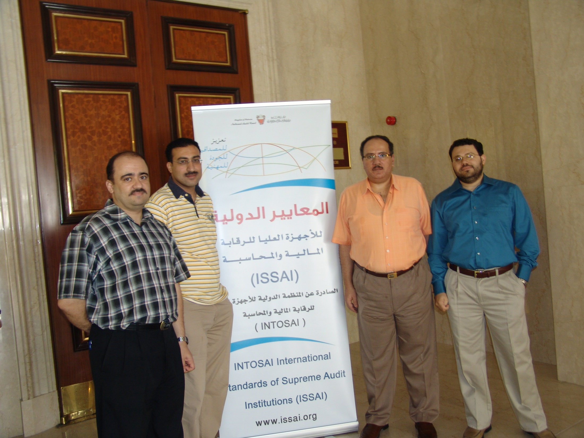

Slide 16
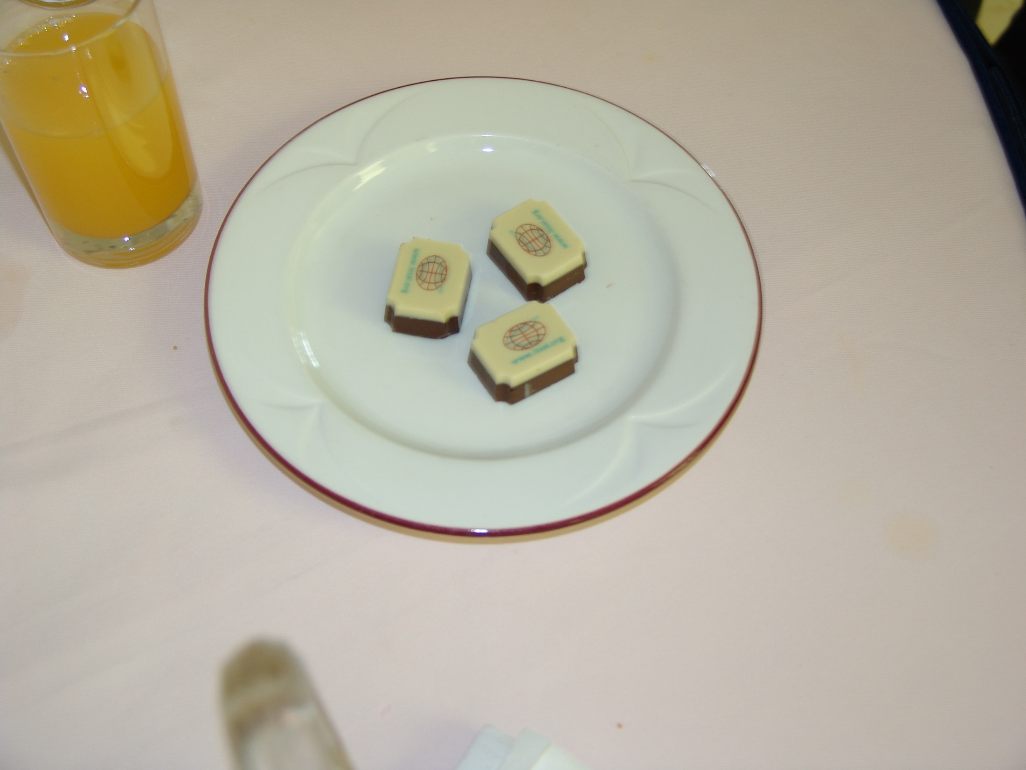

Slide 17
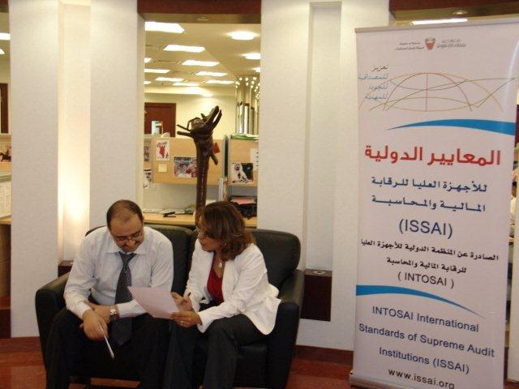

Slide 18
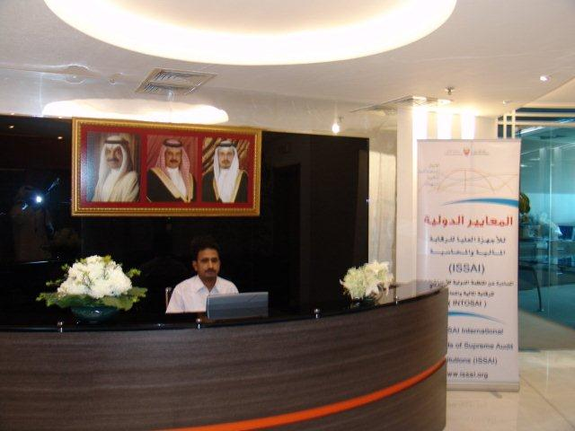

Slide 19
Thank you…
PSC
INTOSAI Professional Standards Committee

