Slide 1

ISSAI 4000:
The first
Compliance Audit Standard of INTOSAI
Mona Paulsrud
CAS meeting, Oslo
17th of September 2014

Slide 2
ISSAI Framework
Level |  | Subject | ISSAI No
1 | Founding Principles | Lima Declaration | 1
2 | Prerequisites for functioning of SAIs | Independence Transparency and Accountability Ethics Quality | 10-40
3 | Fundamental Auditing Principles | Basic Principles General -, Field – and Reporting Standards | 100-400
4 | Auditing Guidelines | Financial Audit Guidelines Performance Audit Guidelines Compliance Audit Guidelines Specific Guidelines | 1000-2999 3000-3999 4000-4999 5000-5999

Slide 3
Bejing 2013:
Fundamental principles of public sector auditing

Slide 4
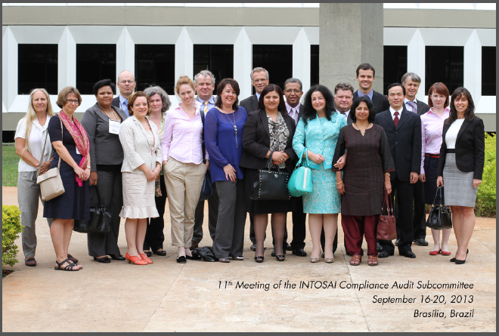
CAS Brasília 2013
New ISSAI 4000:
One, common authoritative standard for compliance auditing directly applicable to all SAIs.

Slide 5

2013: Strategic crossroads

Slide 6
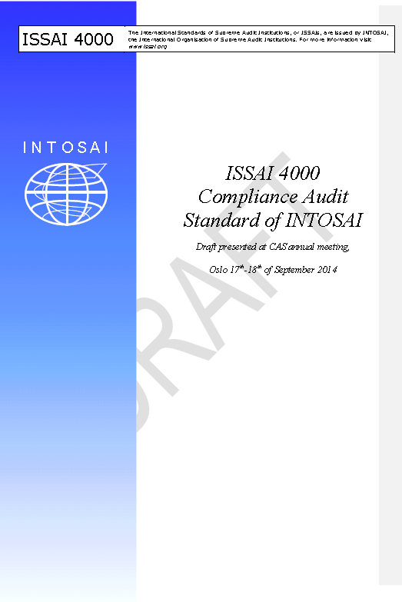

Slide 7
Priorities in developing new ISSAI 4000
Prior to the next CAS meeting, a first draft of such a document is to be developed. The priorities of the committee in developing the document will be the following:
Develop the shall-requirements: what is common for everyone.
The specific considerations of the courts: on each requirement to consider if there is a need for specific issues related to courts

Slide 8

Three maintenance groups

Slide 9
Maintenance group nr. 1:
Technical issues
Group members:
Tunisia, South Africa, India, Portugal, Norway
The structure of the document
How to distinguish in form and contents between requirements and guidance
Structure and form of each paragraph
Whether, how and where to place examples and appendixes in the document structure

Slide 10
Maintenance group nr. 2
Group members:
Romania, Namibia, ECA, China and Brazil
«Streching the elastic»:
Assurance
Opinion and conclusion

Slide 11
Maintenance group nr. 3
Group members:
India, ECA, Lithuania, Slovakia, Hungary, China and Saudi-Arabia
«CAS property»
Authorities
Regularity & propriety
Identifying the subject matter and criteria

Slide 12
The court group
Group members:
Tunisia, Brazil, Romania and Portugal
Specific considerations of the courts incorporated into the new ISSAI 4000.

Slide 13
Work ahead
December 2014:
ISSAI 4000 draft for comments in PSC steering committee
May 2015:
ISSAI 4000 exposure draft to the PSC steering committee
August- October 2015:
ISSAI 4000 exposure period
May 2016:
ISSAI 4000 endorsement version to the PSC steering committee
October 2016:
ISSAI 4000 endorsement at INCOSAI,
Abu Dhabi

