Slide 1
The Next
Strategic Development Plan for IFPP

Slide 2
Decisions at the 11th PAS-meeting in Budapest
“There was agreement that the ongoing process towards the development of the next SDP should be a top priority. The PAS Secretariat needs to follow this process closely, and will report on developments to PAS members when appropriate.
It was also suggested that PAS member be surveyed to obtain information about what members believe should be included in the next SDP as the committee`s top priorities”

Slide 3
The SDP – what it is
Citation from the SDP 2017-2019:
“The SDP provides the general strategy and overall working plan for the development of INTOSAI principles, standards and guidance on auditing”

Slide 4
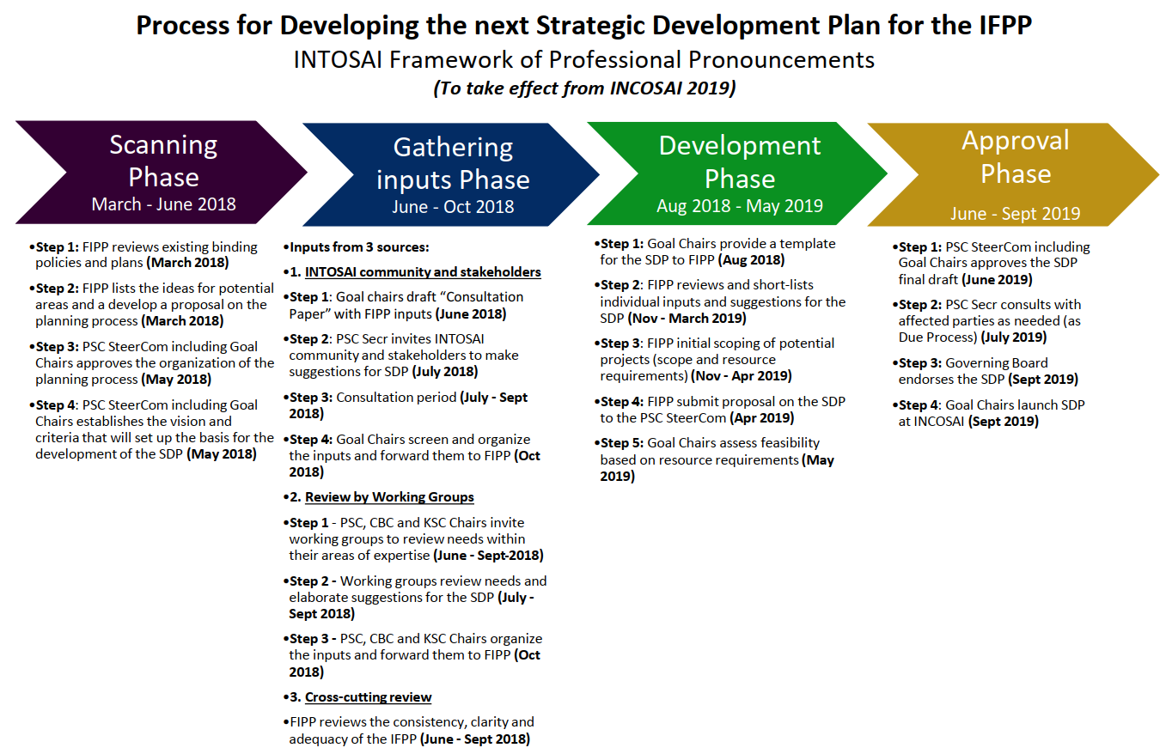

Slide 5
Some thoughts on the “Gathering inputs phase”
Broad involvement both of SAIs and INTOSAI entities – by PSC chair
Not entirely clear how and why suggestions are prioritised
A number of ailments where a pronouncement is not the right medicine?

Slide 6
PAS process
July 30th 2018: Consultation call to PAS members on potential new SDP projects
October 3rd 2018: PAS conclusions sent to PSC
January 17th 2019: FIPP shortlist sent to subcommittees for comments
February 12th 2019: PAS chair provided comments to FIPP shortlist

Slide 7
PAS conclusions of Oct 3rd
No need for new projects related to the ISSAI 3000
Broad assessment of the IFPP
  harmonization
  language
  technical quality
IFPP GUIDs should be directly related to standard issues
Subject matter specific guidance should be taken out of the IFPP

Slide 8
Suggested projects in next SDP
Variable clarity regarding content – somewhat difficult to assess
Difficult also to assess need of resources
… but not too bad☺
  Most initiatives going forward have good merit
  Important initiatives for an improved IFPP

Slide 9
A number of «potential projects»?
Some SDP-suggestions wide in scope and proposed to be based on «research initiatives»
Difficult to know the potential result
Next SDP should be focussed and lean
Sequencing – should not forget the reason for establishment of IFPP and FIPP

Slide 10
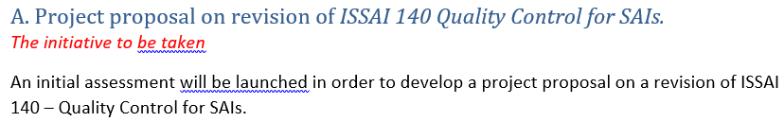
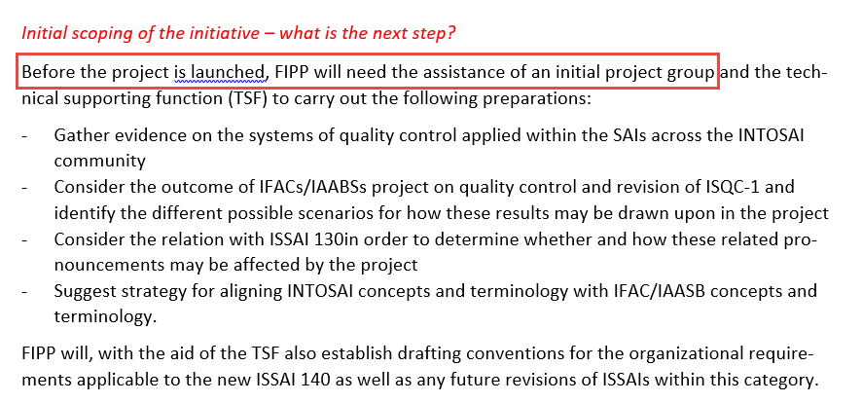
FIPP – an active role in development?

Slide 11
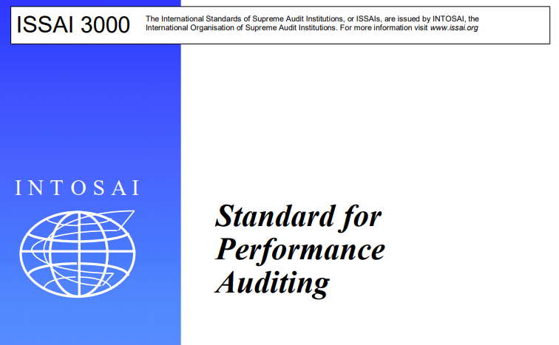
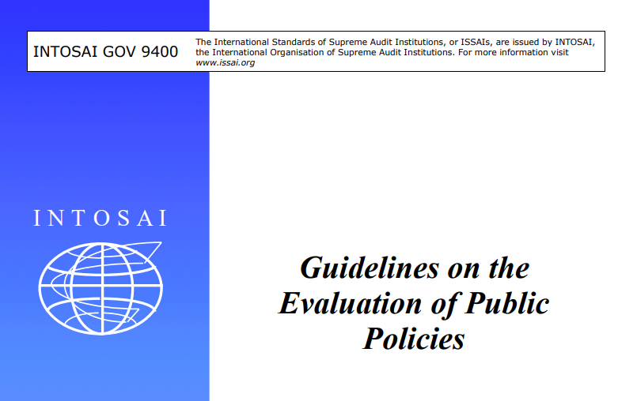
The 9000 initiative not included by FIPP
How to proceed with alignment of ISSAI 3000 with GUID 9400?

Slide 12
Subject matter specific guidance
Is valuable
Very valuable «global public goods» produced by a number of INTOSAI working groups
Knowledge sharing between auditors is extremely important

Slide 13
However…
Sharing knowledge is not a standard issue
It cannot be about “what performance audit is”
Is mainly about subject matter knowledge?
Subject matter specific guidance
- should not be part of the IFPP and thus not part of the next SDP

Slide 14
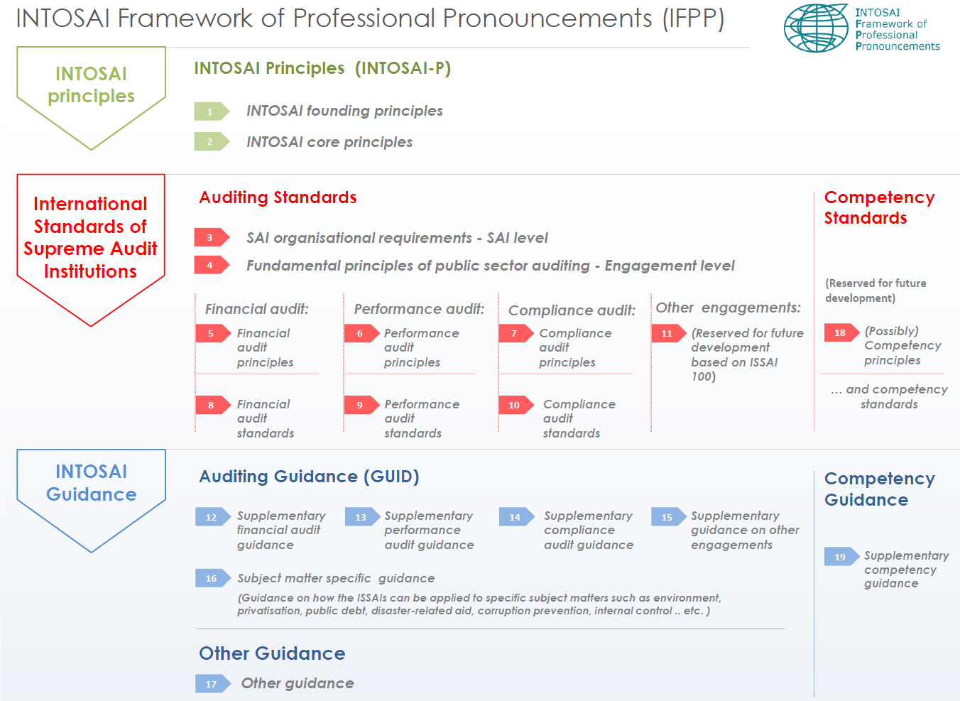

Slide 15
Conclusion PSC-Steering Committee meeting 2018
“Questions were raised whether subject matter guidance should be part of the framework. These documents can be useful for SAIs, but not necessarily as professional pronouncements.
As the IFPP was recently approved, at this stage no further considerations will be given to reconsider the structure of the IFPP. Lower priority should be given to this kind of guidance in the next SDP”
Subject matter guidance
should not be part of the IFPP
Thus, no such projects in the next SDP
A good thing – very few such suggestions for the next SDP so far

Slide 16
Conclusion needed
We should conclude which potential projects should be a priority for the PAS
So next: A walkthrough of the FIPP shortlist

