Slide 1
Data Science
&
Machine Learning
Musings and some examples from OAG Norway
Jan Roar
Chief Data Scientist
OAGN Innovation Lab

Slide 2
The OAGN Data Science Project
2017.02 Project Initiative
2017.03 Inspirational Visit NAO
2017.05 Data Centre Project established
2018.10 Staff increase
2019.01 OAGN Innovation Lab established

Slide 3
Purpose
Curating data for financial and performance audit
On-demand data analytics
Promoting data science and the use of machine learning at the OAGN
Experiment with new technologies and methods

Slide 4
We automate the boring stuff,
so you can audit the exiting stuff!

Slide 5
Where we come from
2 political scientists
1 economist
1 sociologist
1 physicist
… we’re not an IT project, we’re a data science project

Slide 6
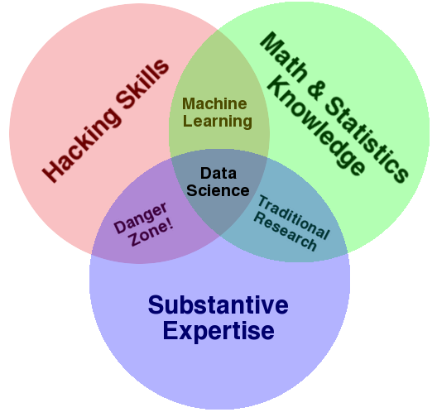
What is Data Science
You need both:
Coding skills
Statistical skills
Audit skills
http://drewconway.com/zia/2013/3/26/the-data-science-venn-diagram

Slide 7
The world is overflowing with data
This is difficult to manage for SAIs

Slide 8
Partly because of this
Law on The Office of the Auditor General of Norway § 12:
«The OAGN can, without restrictions of confidentiality, demand any information, any disclosure or any document, and execute any examination deemed necessary by the OAGN to fulfil audit tasks.»
(my own highly informal translation)

Slide 9
  Data → Information → Knowledge → Wisdom

Slide 10
What’s all this about machine learning?
«Everybody» keeps fussing about
machine learning and artificial intelligence these days
… and you can get a bit worried…
… when seeing stuff like this…

Slide 11
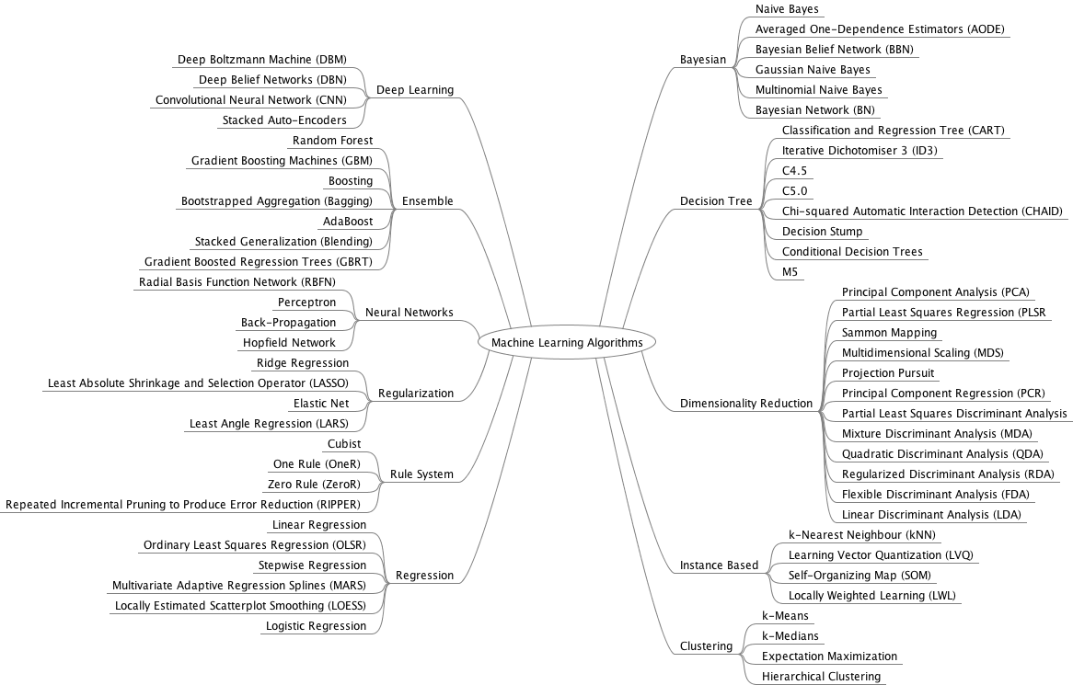

Slide 12
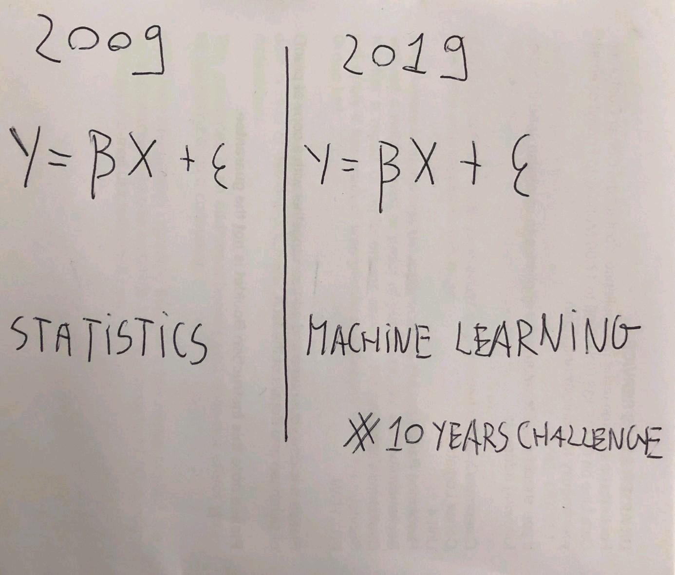
However…
Found on LinkedIn

Slide 13
What’s the point – an example
You have 10 000 pages of procurement contract documents (text)
And you have regulations for procurement
Then you want to compare the 10 000 pages and the regulations
To uncover illegal purchases
Can machines do this for us?

Slide 14
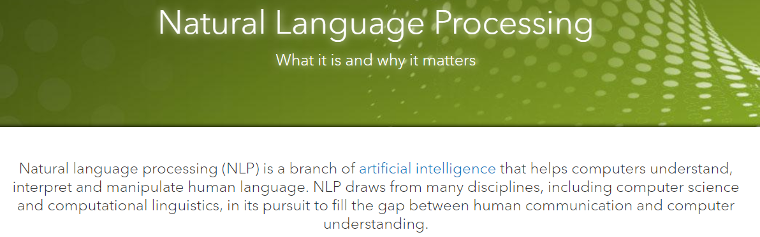

Source:
https://www.sas.com/en_us/insights/analytics/what-is-natural-language-processing-nlp.html

Slide 15
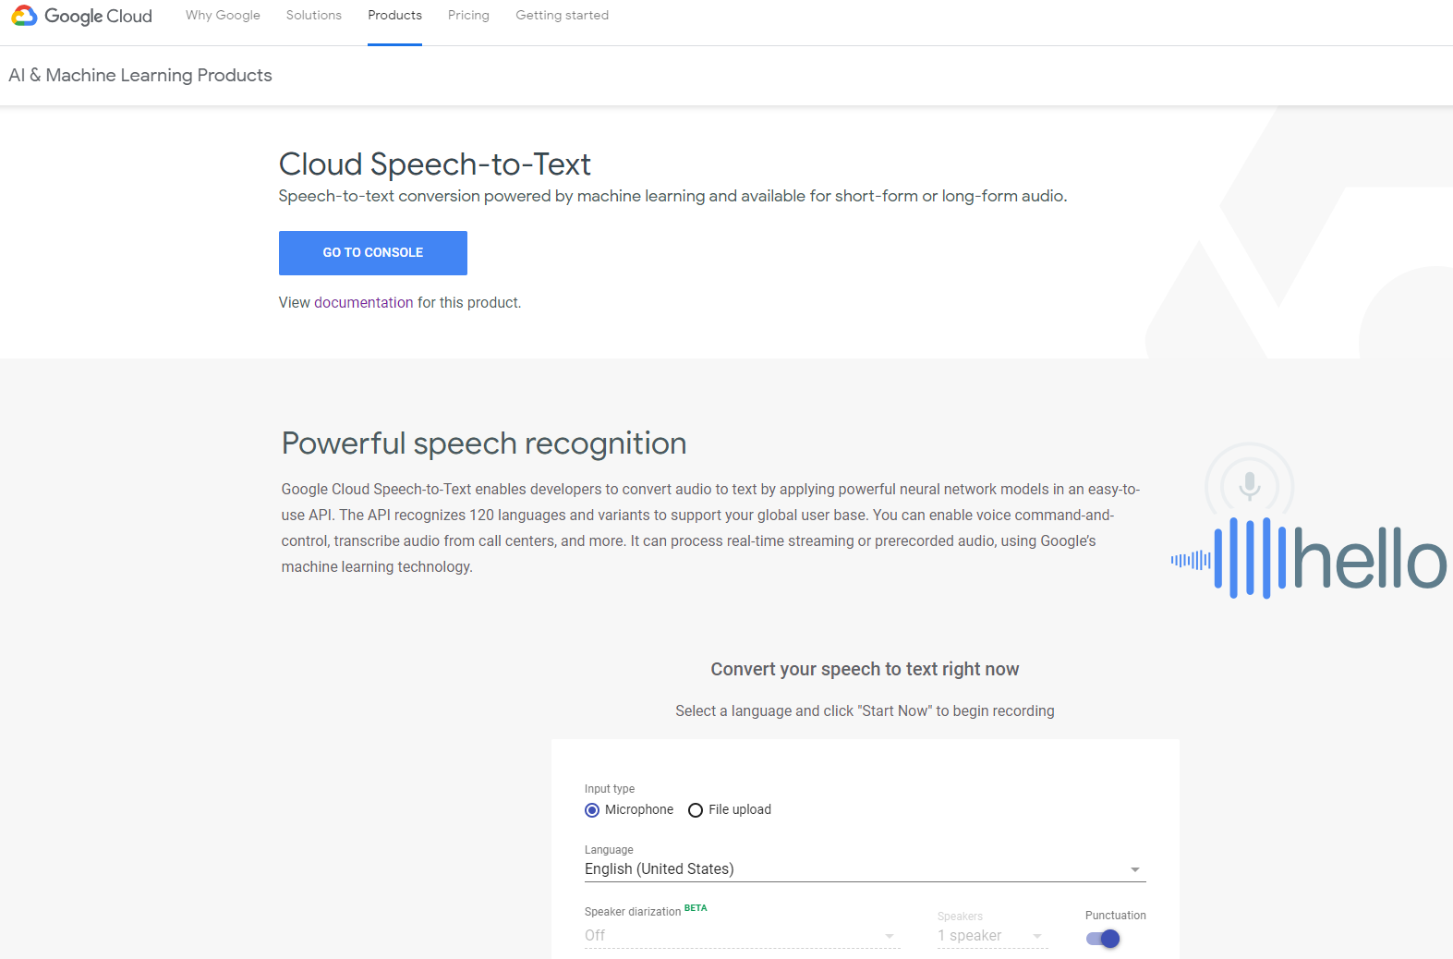

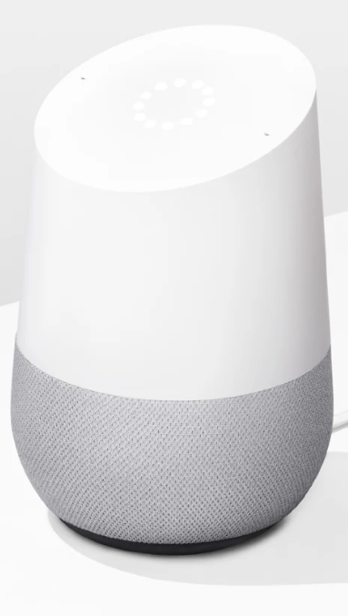
NLP in practice – from speech to text

Slide 16
Algorithms – Economic, but Effective?
government have started using machine learning, for example in awarding grants
  even for decisions involving discretionary considerations
we will need performance auditors that can look into “the black box of algorithms”
to evaluate and conclude on decisions made by machines

Slide 17
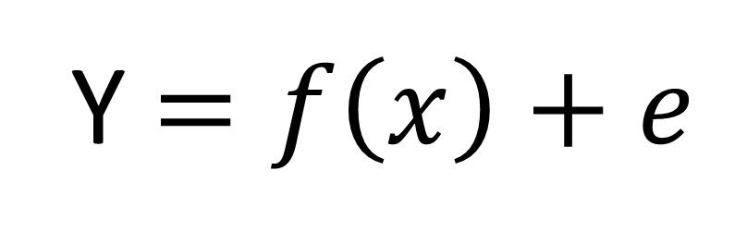
If you understand this, you have understood machine learning
Y $=f\left(x\right)+e$

Slide 18
Some concrete examples

Slide 19
Example: Webapp for DEA-analysis
DEA = Data Envelopment Analysis
Benchmark analysis based on Output vs. Input
Example:
  District courts – how many judges/office clerks vs. how many cases handled
Productivity Analysis

Slide 20
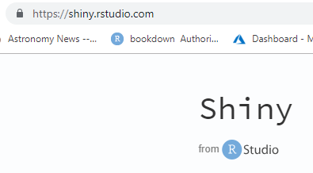
DEA – efficiency in the form of productivity
DEA an important method for performance audit, but
Most software for DEA is old and/or user unfriendly
Several packages in R for doing DEA # but not easy to use
So: we wrote a Shiny app for DEA
We named it pioneeR

Slide 21
We’re open!
pioneeR is open source (free to use and free to edit the source code)!
You can find us on GitHub*:
github.com/Riksrevisjonen/pioneeR
* The largest collection of open source software on the Internet

Slide 22
Takeaway:
Program code is universal
As such very easy to share

Slide 23
Search: 19 000 PDFs – what to do
We have 19 000 PDF documents from Norwegian hospital boards
25 hospital boards, 12-14 board meetings a year, last 5 years)
All documents published on the web (25 different websites)

Slide 24
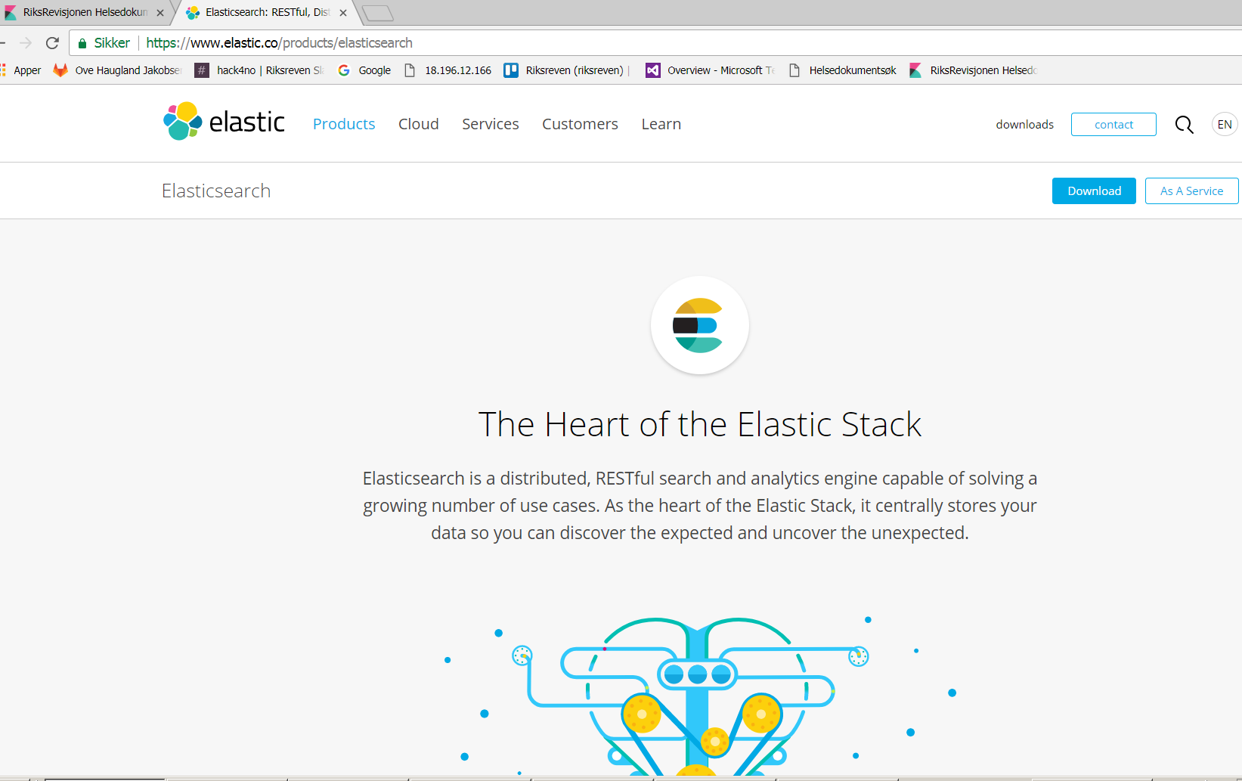

Slide 25
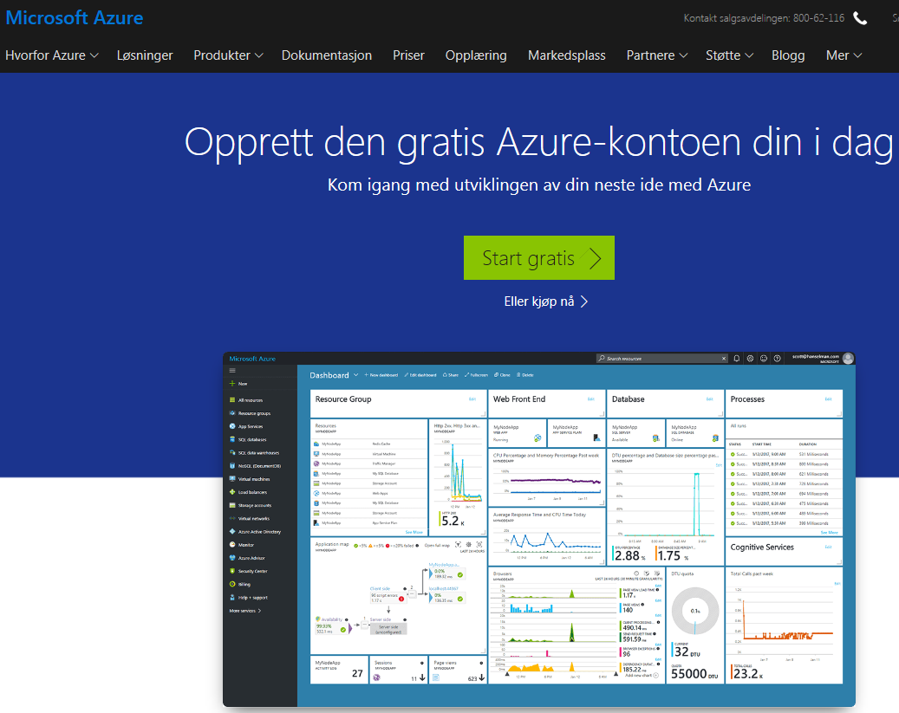
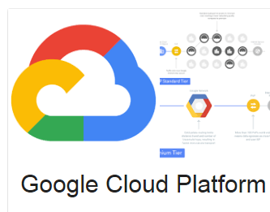

Cloud Platform:
The big 3

Slide 26

Cloud computing
You need heavy computing machinery to run machine learning on large datasets
Buy an on-prem machine
for $ 10 000?
Or rent one in the cloud
for $ 50 a week?

Slide 27
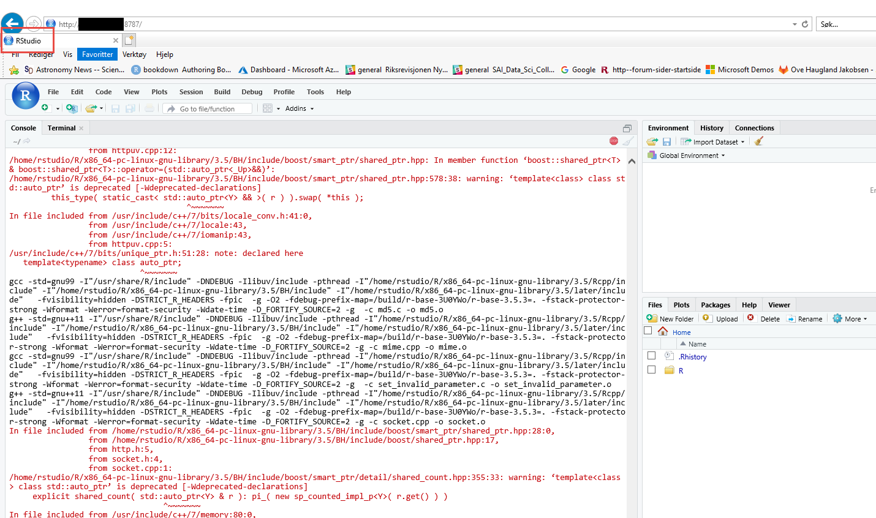

Slide 28
Summary: Some success factors
We were given full freedom to experiment
Recruited people from audit, not IT
There were no detailed planning — only the “what”, not the “how”
Full support from top management
Short development cycles # agile development
Prioritise solutions to long standing issues

Slide 29
www.saireports.org
A final snack before we adjourn

