Slide 1
PAS Activities Update
Hege Larsen
PAS Secretariat
12th annual meeting of the Performance Audit Subcommittee
Johannesburg 9-10 April 2019

Slide 2
Content
Member updates
PAS Work Plan 2017-2019
2018 PAS meeting
SDP for the IFPP 2017-2019
Other INTOSAI meetings
Communication: initiatives and status
ISSAI updates

Slide 3
Content cont…
PAS Terms of Reference (ToR), revised 2018
INTOSAI/PAS Hearings
Auditing Sustainable Development Goals
IDI/PAS collaboration on implementation of the 3000 series
Other activities and collaboration
Summing up

Slide 4
Member updates
New member: State Audit Bureau of Qatar
New observer: Office of the Comptroller and Auditor General of Ireland
Membership update process:
Seeking confirmation from less active PAS members about their membership status
How do we define active membership in the future?

Slide 5
PAS Work Plan 2017-2019
Support implementation of the ISSAI 3000 series, in close cooperation with IDI
Work towards realising the SDP for the IFPP
Contribute to the follow-up and review of the UN Sustainable Development Goals, crosscutting priority 2 of the INTOSAI Strategic Plan goal 2: - undertaking performance audits that examine the economy, efficiency, and effectiveness of key government programs that contribute to specific aspects of the SDGs
Be an arena for sharing good practices in performance audit

Slide 6
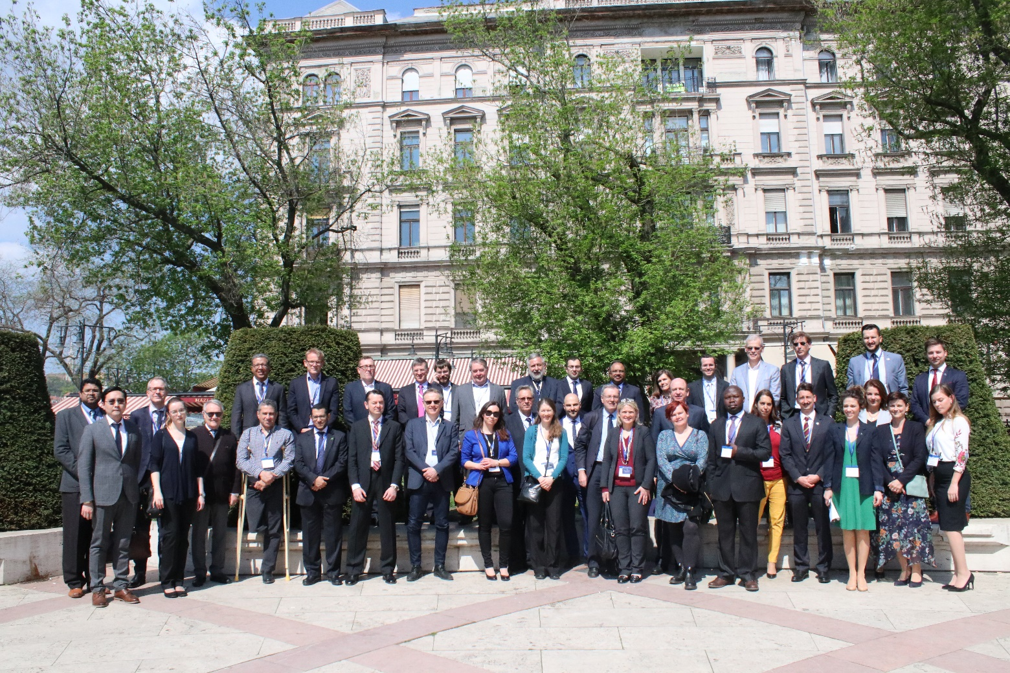
2018 PAS meeting: Budapest, Hungary

Slide 7
2018 PAS meeting, main agenda items
The relationship between evaluation and performance audit
  including an introduction by chair of Working Group on Evaluation of Public Policies and Programs (WGEPPP)
SDP for the IFPP
  current SDP, process towards developing the next SDP
Initiatives in data science
  presentations by SAIs Brazil, the Netherlands, UK NAO
Auditing Sustainable Development Goals (SDGs)
Collaboration between PAS and IDI on ISSAI implementation

Slide 8
2018 PAS meeting – priorities
2018-2019 priorities |  | Responsible | Comment/status
1 | Follow-up SDP 2017-2019, including existing engagements | Dedicated project members, PAS Chair/Secretariat | Continuous follow-up. In reality, no set deadline for these projects
2 | Continue working with IDI to secure the quality of implementation material | Dedicated members, PAS Chair/Secretariat | Ongoing. More involvement planned for 2019. Wish list: detailed “action-plan” for PAS/IDI collaboration
3 | Work with the PSC to get a better strategic basis for the next SDP (2020-2025) | PAS Chair/Secretariat | Top priority, continuous follow-up. SDP for the IFPP to be approved at PSC Steering Committee meeting June 2019 and INCOSAI September 2019
4 | Participate in the IDI project on SDG lessons learned/audit results | SAI Netherlands | To be reviewed by SAI Netherlands in May/June, to be finalised summer 2019
5 | Set up a project group to collect and analyse existing information about implementation of PA standards |  | Inconclusive discussion. No start-up initiatives

Slide 9
Other decisions from 2018 meeting
Continued collaboration with WGEPPP
Teamwork.com
SDP for the IFPP: PAS resources to projects
Continued focus on data science / knowledge sharing
Notes:
Sdp for the ifpp: decision about how chair approaches members to ask for resources to concrete projects as they materialise

Slide 10
Strategic Development Plan for the INTOSAI Framework of Professional Pronouncements
In accordance with last year´s decisions, PAS involvement in developing the next SDP has been, and still is, a top priority
Time- and resource consuming: both involvement in the existing plan and being involved in the development of the next
We return to this topic in dedicated sessions later today and first thing tomorrow morning

Slide 11
Other INTOSAI meetings 2018
PSC Steering Committee Meeting, European Court of Auditors (ECA)
WGEPPP workshop, Cour des comptes, France
Working Level Meeting of INTOSAI-regions Coordination Platform, IDI
SAI Leadership and Stakeholder Meeting – Contributions of SAIs to the 2030 Agenda and the SDGs. IDI/UNDESA
Internal Control Standards Subcommittee meeting, SAI Poland
71st INTOSAI Governing Board meeting, SAI Russia

Slide 12
Communication: initiatives and status
Teamwork.com
PAS website: some challenges
  Alternatives?
PAS Newsletters will continue (2-3 publications per year)
Other suggestions?
Notes:
PAS website: functionality, solution: working with PSC chair on solutions, considering different options. One possibility: creating our own website from scratch, link this on the PSC site.

Slide 13
ISSAI updates
ISSAI 3100 translated to Spanish by the European Court of Auditors´ Spanish Language team
  Published on www.issai.org
INTOSAI´s process on ISSAI interpretation and translation
Migration of framework
  Re-numbering and re-labelling process
  Then: translation to all official languages
  Formatting migrated documents
  New framework to be launched at 2019 INCOSAI

Slide 14
ISSAI updates cont.: the 3000 series
During migration into the new framework, there will be no changes to ISSAI 3000 except some formatting. However:
ISSAI 3100 Guidelines for Performance Audit:
  To be moved to the GUID 3900 series
ISSAI 3200 Guidelines for the Performance Audit process
  To be moved to the GUID 3900 series

Slide 15
PAS Terms of Reference (ToR)
Revised in 2018
Approved by INTOSAI Governing Board November 2018
Next revision: no later than 2024
Most significant changes:
  elaborated on active involvement (but could we have taken this further?)
  details around meetings (hosting, expenses)
  procedures (working language, appointment of new members, reporting, voting and communication)

Slide 16
INTOSAI/PAS hearings
Legitimacy that comes from having your support and hearing your valuable insights and experiences
Valuable information from members
Professional discussions and dealing with methodological issues

Slide 17
Hearings cont.; selected hearings 2018/19
Consultation for the development of the next SDP for the IFPP (2020-2025) – in multiple stages:
  approval of process May 2018
  July-October: open consultation including all PAS members, PAS feedback submitted 3 October 2018
  February 2019: PAS feedback to FIPP´s initial assessment of incoming project ideas. See meeting compendium p. 10-18

Slide 18
Hearings, cont.
Internal PAS hearing: draft Terms of Reference
  Planned hearing for January 2020: draft PAS Work Plan 2020-2022
SDGs hearing February 2019:
  Valuable feedback for our collaboration with the IDI on SDGs – 13 member SAIs responded to this hearing
Interpretation and translation of ISSAIs hearing
Technical Support Function (TSF)

Slide 19
Auditing Sustainable Development Goals
Partnering with IDI and INTOSAI Chair
  expert group participation – INTOSAI Chair UAE
  auditing implementation of SDGs – IDI
INTOSAI Strategic Plan, crosscutting priority 2: contribute to the follow-up and review of the UN SDGs
  Second goal: undertaking performance audits that examine the economy, efficiency and effectiveness of key government programs that contribute to specific aspects of the SDGs
Apart from this, our main concern is to monitor developments on auditing SDGs, because PA is the more frequently used audit type
PAS involvement in IDI publication on auditing preparedness

Slide 20
SDGs, cont.: publication on experiences from auditing preparedness
SAI Netherlands: reviewer of draft May/June 2019
Title of publication: Are Nations Prepared for Implementation of Agenda 2030? Supreme Audit Institutions´ insights and recommendations
This publication aims to:
Notes:
This publication will communicate key messages related to the audit of preparedness to multiple stakeholders - SAI leadership and staff across INTOSAI regions, INTOSAI bodies, INTOSAI regions, national governments, Parliaments, UN agencies, development partners, civil society organizations, professional bodies, academia, private sector and citizens.

Slide 21
IDI and implementation efforts
IDI SDGs Audit Model (ISAM)
Professional Education for SAI Auditors (PESA)
Performance audit implementation handbook
  PAS involvement
SDGs: “Are Nations Prepared for Implementation of Agenda 2030? SAIs´ insights and recommendations” publication 2019
Action plan or detailed plan for PAS/IDI collaboration
  Including project timelines, responsibilities, deliveries, meetings, etc.

Slide 22
Other activities and priorities
SDGs expert group with INTOSAI Chair United Arab Emirates
WGEPPP: GOV 9400 and the relationship between performance audit and evaluation
Active collaboration with the other PSC subcommittees
Collaboration with other stakeholders

Slide 23
Summing up
Massive workload, many processes, a number of projects and collaborations
Hearings: we rely on continued input from PAS members upon request – we need your support and your knowledge!
Rely on your ideas for the next Work Plan, but also your resources
Priority: figure out effective communication channels. Transparency issue as well as a practical issue

Slide 24
Thank you for your attention
Questions or comments?

