Slide 1
Update
INTOSAI processes

Slide 2
A lot could have been said, but…
I will limit myself to addressing the following issues:
FIPP (a good thing, even better communication could be desirable)
FIPP Drafting Conventions (a good idea, will be addressed in next SDP)
Establishing a Technical Support Function (also a good idea, still some uncertainties)
INCOSAI 2019 theme paper

Slide 3
INTOSAI - A lot of progress has been made
IFPP
FIPP
SDP
TSF
This is very good

Slide 4
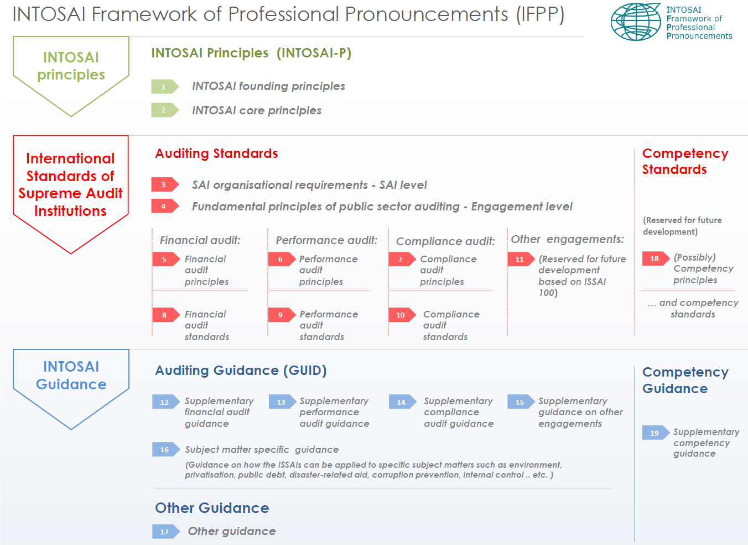

Slide 5
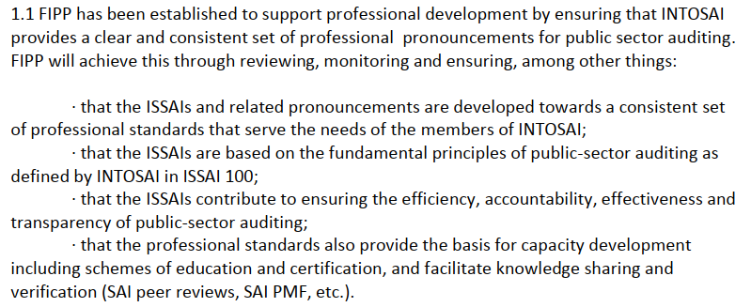
FIPP – terms of reference

Slide 6
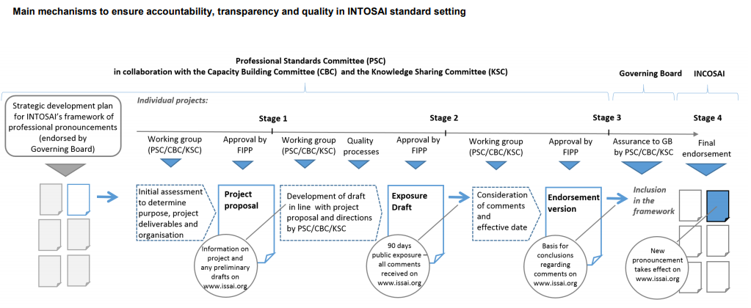
Due Process summarized

Slide 7
FIPP Drafting Conventions
FIPP has produced two «drafting conventions»
  For GUIDs
  For «Application material»
Will apply also for the PAS

Slide 8
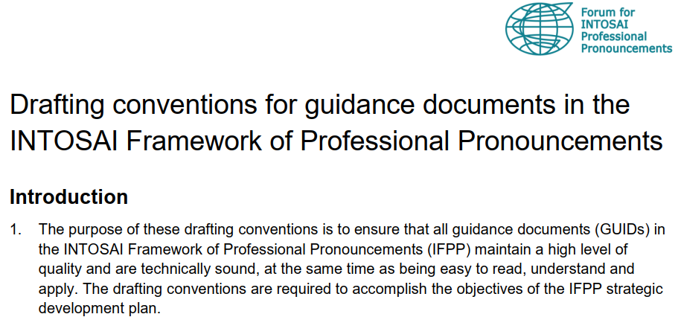
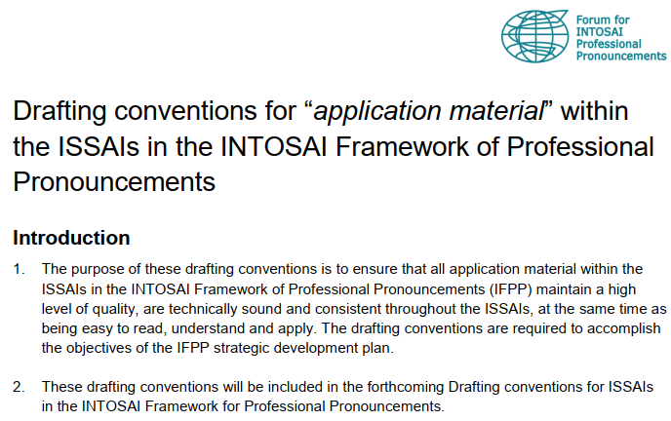
FIPP Drafting Conventions

Slide 9
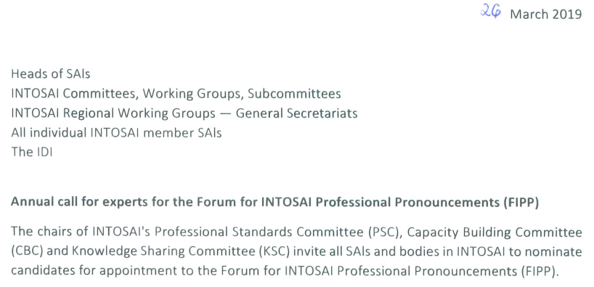
FIPP - call for candidates
A good idea with people with PAS-experience in the FIPP – please consider☺

Slide 10

TSF – Technical Support Function
From INTOSAIs Strategic Plan
- under key strategies related to standards setting

Slide 11
TSF - main benefits
help make the standard setting process more efficient and effective
by making dedicated staff available to work on standard setting activities
reduce reliance on voluntary contributions from SAIs

Slide 12
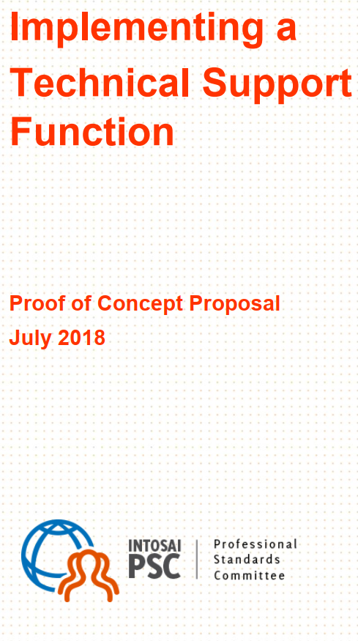
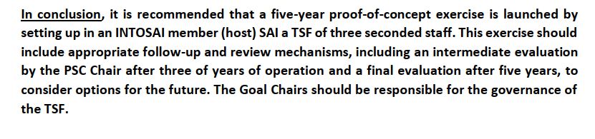

Slide 13

INCOSAI 2019 paper
http://www.intosai.org/events/congresses-incosai/next-congress.html

