Slide 1
14th CAS meeting
Performance reporting
Presentation by SAI-SA

Slide 2
Reputation promise/mission
The Auditor-General of South Africa has a constitutional mandate and, as the Supreme Audit Institution (SAI) of South Africa, exists to strengthen our country’s democracy by enabling oversight, accountability and governance in the public sector through auditing, thereby building public confidence.
Notes:
Emphasise – through auditing. AGSA/ auditors does not form part of management or decision-making.
Auditors audit the measurement of performance by management and is not responsible for the measurement of performance but to determine whether performance reporting is credible.

Slide 3
Topics to discuss
Background
Legislation and framework for performance management and reporting
Audit of predetermined objectives

Slide 4
Background

Slide 5
Audits performed by SAI-SA
Annual audit mandate: Section 28(1) of Public Audit Act – an audit report must reflect an opinion or conclusion on:
Discretionary audits mandate: Section 28(2)(b) of the Public Audit Act
Whether financial statements fairly presents…
Auditee’s compliance with any applicable legislation…
reported information relating to the performance of the auditee against predetermined objectives
If required by the AuditorGeneral, the auditor must report whether the auditee’s resources were procured economically and utilised efficiently and effectively (Performance Audit)
Annual audits cycle
National and provincial government): Year-end 31 March (audit report deadline – 31 July)
Local government: Year-end 30 June (audit report deadline – 30 Nov)

Slide 6
Audit of reported performance information defined
Annual audit of reported actual performance against predetermined objectives, indicators and targets as contained in the annual performance report of the auditee
It focuses on confirming:
compliance with applicable legislation
usefulness of performance information contained in the annual performance report
reliability of performance information contained in the annual performance report
The mandate to audit performance reporting is derived from sections 20(2)(c) and 28(1)(c) of the Public Audit Act (PAA) which requires that “an audit report must reflect an opinion or conclusion on the performance of the auditee against predetermined objectives.”
It applies to all spheres of government and all organs of state.

Slide 7
Legislation and framework for performance management and reporting

Slide 8
Legislation and framework for performance management and reporting
Legislation
Public Finance Management Act (PFMA) and Treasury Regulations
Municipal Finance Management Act (MFMA)
Municipal Systems Act (MSA) and regulations
Framework for performance management and reporting
Financial Management of Parliament and Provincial Legislation Act (FMPPLA)
The framework (FMPPI) issued by National Treasury provides guidance on how to practically adhere to the legislative requirements and reporting on performance, specifically the setting of indicators and targets.
The framework for strategic plans and annual performance plans provides guidance on the development of strategic and annual performance plans. The guidance sets out the framework to align strategic and annual performance planning.
Audit criteria
The principles and requirements of the legislation and regulations above constitutes the framework for management and reporting on predetermined objectives which is used as the basis for the audit of performance information

Slide 9
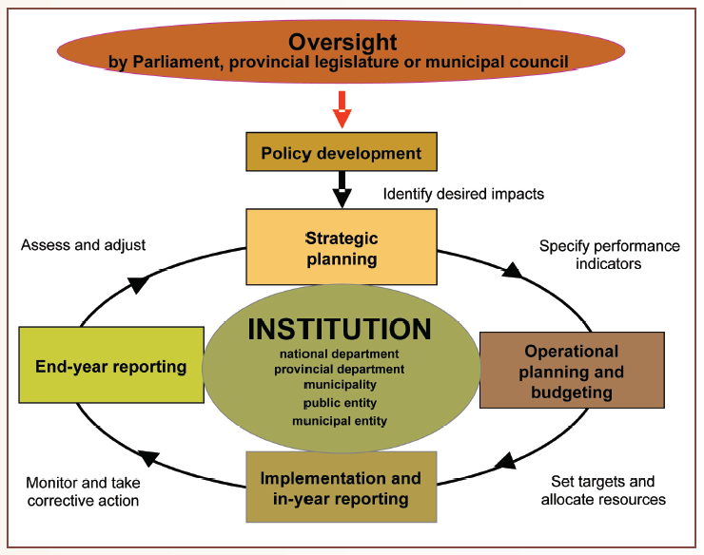
Performance planning, budgeting and reporting cycle
Notes:
To ensure effective and efficient organisational performance management all institutions should have this overall performance management process and system in place, as set out in the Framework for managing programme performance information as issued by the National Treasury.
The planning, budgeting and reporting cycle describes the relationship between these processes and emphasises that the executive is accountable to the relevant elected representative body for the entire process. The performance information process begins when policies are being developed, and continues through each of the planning, budgeting, implementation and reporting stages. Full and regular reports are required at each stage of the process.
Performance information should also be available to managers at each stage of the planning, budgeting and reporting cycle so that they can adopt a result-based approach to managing service delivery. This approach emphasises planning and managing with a focus on desired results, and managing inputs and activities to achieve these results.
It is important to manage performance as a process and not as an event.

Slide 10
Key performance accountability documents
1. Strategic/Corporate plan
2. Annual performance plan (APP)
3. Budget
4. Quarterly performance reports
5. Performance agreements
6. Annual performance report
Consistent structures to facilitate understanding and accountability
Enable linkage between plans and actual performance
Notes:
The key performance planning documents for departments /entities are the annual performance plan (APP), budget and strategic plan (SP).
The SP, APP and budget are forward-looking, set out what the department /entity intends to do and the funds it will raise and spend.
The annual report, on the other hand, is backward-looking as it reports on actual performance at the end of the financial year, reporting on how the APP and budget were implemented.
Annual reports must be aligned with the planning documents and department budget for the year reported on.
This means that the APP, budget, SP , quarterly performance reports and annual report should have similar and consistent structures to facilitate understanding and to enable the linkage between plans and actual performance

Slide 11
Audit of predetermined objectives

Slide 12
AGSA Multi-year strategy for audit of performance information
Financial years 2004-05 to 2008-09
Financial years 2009-10 to current
Phased-in approach
Factual audit findings reported in both management and audit reports
No audit opinion in audit reports
Interaction with stakeholders (NT, Presidency, DPSA) to determine and test audit approach
Inputs to drafting of NT frameworks (FMPPI)
Completed phased audit approach
Audit to the extent necessary to express an audit conclusion
Audit conclusion in the management report for all auditees
Audit reports contain material audit findings – not audit opinions

Slide 13
Audit criteria
Main criteria
Sub-criteria
Compliance with legislation
Applicable to performance management and reporting
Presentation and disclosure
Usefulness
Measurability
Relevance
Consistency
Validity
Reliability
Accuracy
Completeness
Notes:
During the audit of performance information the following audit criteria is tested:
Compliance with legislation:
Testing against compliance with regulatory requirements is done in relation to performance management and reporting. Examples of this include the need for auditees to have approved strategic plans and annual reports that include the auditee’s performance against predetermined objectives.
Usefulness
Presentation and disclosure : Performance information in the annual performance report is presented and disclosed in accordance with the requirements contained in legislation, frameworks, circulars and guidance
Measurability : Indicators are well defined and verifiable, and targets are specific, measurable and time bound, as required by the National Treasury Framework for managing programme performance information.
Relevance : Performance measures / indicators relate logically and directly to an aspect of the entity’s mandate and the realisation of its strategic goals and objectives , as required by the National Treasury Framework for managing programme performance information.
Consistency : Objectives, performance measures / indicators and targets are consistent between planning and reporting documents
Reliability:
Validity : Reported performance occurred and pertains to the reporting entity.
Accuracy : Amounts, numbers and other data relating to reported performance have been recorded and reported accurately.
Completeness : All actual performance is recorded and included in the reported performance information
.

Slide 14
Audit approach
Scoping of subject matters using qualitative criteria
1
Understand and test the design and implementation of the performance
management systems, processes and
relevant controls
2
Test the measurability, relevance, presentation and consistency of planned and reported performance information
3
4
Test the reported performance information against relevant
source documentation to verify the validity,
accuracy and completeness of reported performance information
5
Evaluate and conclude on the usefulness and reliability of the reported performance information for scoped performance programmes and objectives
Notes:
The AGSA’s audit approach to AOPO involves the following –
Understanding of internal policies, procedures and controls related to management of and reporting on performance information.
Understanding and testing of systems and controls relevant to recording, monitoring and reporting on performance information.
Verifying the existence, measurability and relevance of planned and reported performance information.
Verifying consistency between the Strategic plan/APP and the annual performance report.
Verifying the presentation of performance against predetermined objectives in the APR against the format and content requirements as required ito the National Treasury.
On this basis auditors conclude on the usefulness and reliability of the reported performance information for selected programmes or objectives.
Comparing reported information for selected programmes or objectives to relevant source documentation to verify validity, accuracy and completeness thereof.

Slide 15
Relationship with financial audit and compliance audit
Pre-engagement activities
Audit planning
Execution, evaluation and reporting
Combined engagement letter
Combined pre-liminary understanding working paper
One audit team
Combined audit strategy
Combined understanding of the entity
Separate risk assessment but integration is preferred where possible (e.g. business processes, discussion amongst the audit team, fraud risk assessment)
Separate materiality concepts
Separate audit work – integration preferred where audit evidence is the same for compliance and/or financial and/or performance.
Findings reported separately.

Slide 16
Audit reporting – Management report
Provide reasonable assurance in the form of an audit opinion
Audit opinions are prepared in terms of ISAE 3000
Opinion is expressed on the usefulness and reliability of the reported performance information for each subject matter scoped in
Audit opinions currently ONLY included in the report to management
Notes:
Audit conclusions are prepared in terms of International Standards of Assurance Engagements (ISAE) 3000: Assurance engagements other than audits of review of historical financial information.
This conclusion is currently only reported in the management report .
A conclusion is expressed on –
-the usefulness and reliability of the reported performance for selected programmes/objectives/development priorities.
The material misstatements identified that results in a conclusion reported, will be included in the management report as the basis for the conclusions with due consideration of both quantitative and, especially, qualitative materiality considerations.
Also refer to AG Directive

Slide 17
Audit reporting – Auditor’s report
Reporting on the audit of financial statements
Reporting on the audit of compliance with legislation
Report on audit of performance information against predetermined objectives
Reasonable assurance is provided in the auditor’s report (Attestation)
Audit performed on limited assurance principles - Auditor’s report only reflects material findings on non-compliance identified (Direct reporting)
Audit teams can choose between limited or reasonable assurance principles. Auditor’s report only reflects material findings on usefulness and reliability of reported performance information (Attestation)
Auditor's report template.docx

Slide 18

Questions

Slide 19
THANK YOU

