Slide 1


Miscellaneous
Funds
Issai.org
Next venue

Slide 2

Expected expenditures
 | €
Translating and formatting standards and guidance | 16.000,00
Renew ISSAI.org website | 10.000,00
Publicity materials for booth at INCOSAI | 5.000,00
Initial travel costs TSF | 10.000,00
Total cost (estimated) | 41.000,00
Total funds available | 53.711,16
Balance | 12.711,16

Slide 3
ISSAI website

Slide 4
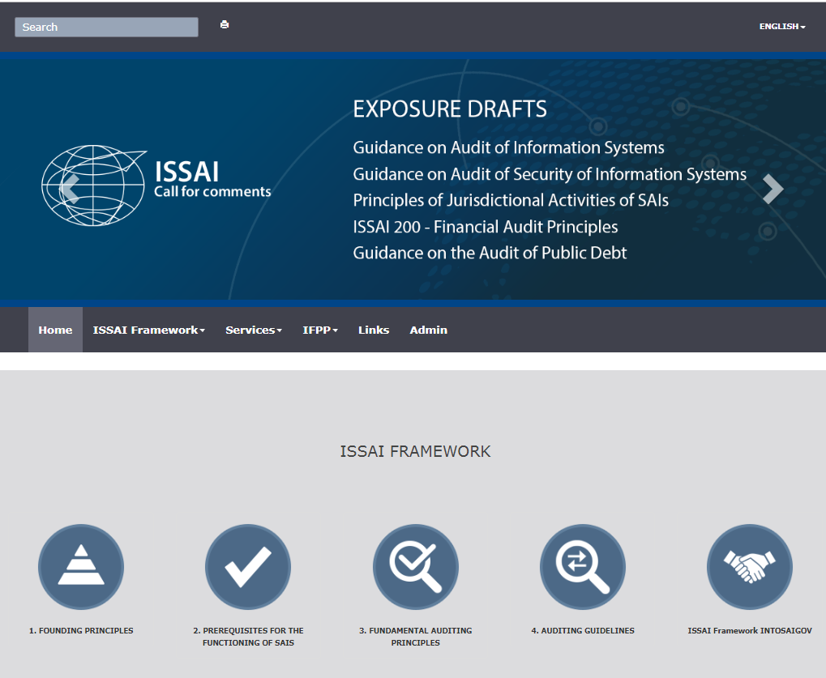
This is the before…
Notes:
https://ypqthz.axshare.com/#g=1&p=draft_comments&c=1

Slide 5
https://ypqthz.axshare.com/#g=1&p=draft_comments&c=1

Slide 6

Next venue
INDIA
Thanks for having us!

Slide 7
Thank you!
PSC Secretariat
psc@tcu.gov.br
eca-psc@eca.europa.eu
Paula Hebling Dutra
dutraph@tcu.gov.br

