Slide 1


Translation of pronouncements
Translating the International Standards of Supreme Audit Institutions (ISSAIs)

Slide 2

“
The quality of the pronouncements reflects directly on the credibility and the image of INTOSAI as a whole.
“
Notes:
For pronouncements to be accessible and useful they need to be clearly drafted, unambiguous and readily understandable by the practitioner. Although English is the original drafting language for the vast majority of pronouncements, having them available in the five official INTOSAI languages is of major importance, and a requirement under Due Process.
Not all pronouncements had been translated into the five official INTOSAI languages, and of those which were, the quality of translations was sometimes called into question.
SC Secretariat was charged with preparing a proposal for the theory and practice of translating pronouncements, identifying alternative ways to organise the process and making recommendations for the future.

Slide 3

Current practice
Translations to 5 INTOSAI languages organised by WG
No formal arrangements for ‘revising’
Notes:
There is currently no specific policy within INTOSAI about the translation of pronouncements.
INTOSAI Communication Policy
ISSAI 1000 (General Introduction to the INTOSAI Financial Audit Guidelines)
Initiatives underway to ensure greater clarity in drafting conventions for ISSAIs
Current practice is that unless another approach has been agreed, the working group7 responsible for drafting the pronouncement is also responsible for organising the translation of the approved endorsement version into the five official INTOSAI languages. Possible translation gaps and inconsistencies.
Current translation options include:
Member of the WG
Professional translator for a fee
Ex gratia by professional translators in SAIs
Auditors of SAIs

Slide 4

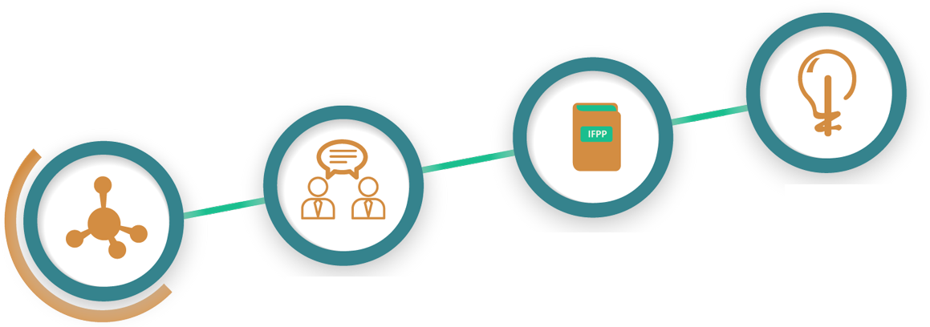
Finding a way forward
Machine translation
SAI
Commercial professional translation
WG
Notes:
Working Group – either by the members of the working group directly, or via ad hoc arrangements.
Commercial professional translation – by professional private sector service providers. The cost of professional translations can be significant, particularly when specialised translators are required. Experience shows that commercial translations do not always have the required high quality.
Translation by SAIs – either using translation or auditor capacity. Although free of charge for INTOSAI, such translations depend on the goodwill and capacity of the organisation offering the service. here are a number of SAIs worldwide which have language departments to translate documents using INTOSAI language combinations. Alternatively, there may be experienced auditors in those SAIs working in one of the INTOSAI official languages, who know the subject matter (and have a good command of English) and who may be willing and have the time to undertake translation of a document.
Machine translation - Computer-based translation technology has become increasingly popular, reliable and accurate in recent years. As such, machine translation will increasingly offer a cheap, quick and dependable alternative to human translators. This would have the advantages of allowing the pronouncement to be available instantly in many languages , be free of charge for the user / INTOSAI, and for the translations to improve each time they are accessed, particularly if users feed back into the process.

Slide 5


Non-official languages
SAIs make the document available for ISSAI website
any pronouncement in the IFPP
translated in entirety
for information only - the original text
authoritative.
Notes:
translations can be made of any pronouncement already in the IFPP;[
the pronouncement must be translated in their entirety; and
translations will be provided for information only, and neither the PSC nor INTOSAl give any guarantee about their quality. In all cases, the original text shall remain authoritative.

Slide 6
The PSC Chair proposal
PSC-SC approve the PSC Chair to
1
2
3
establish pools of SAIs in each INTOSAI language group
monitor the development of machine translation
&
trial machine translation and feedback
continue to post ad hoc translations into non-official INTOSAI
languages on the ISSAI website
Notes:
9100, 9110, 9120, 9130, 9250

Slide 7
Thank you!
PSC Secretariat
psc@tcu.gov.br
eca-psc@eca.europa.eu
Alan Findlay
alan.findlay@eca.europa.eu

