Slide 1
Due process
Maintenance
responsibillity
Classification by PSC Chair
Approval (1) by PSC / CBC / KSC SteerCom
Approval (2) by PSC / CBC / KSC SteerCom
Approval (3) by PSC / CBC / KSC SteerCom
Confirmation by Governing Board
Endorsement by INCOSAI
Monitoring and
regular reviews
Project
Proposal
Exposure
Draft
Endors-ment
version
ISSAI
/
INTOSAI GOV
Initial assessment
Drafting by
project group/
Subcommittee
Public Exposure
(90 days minimum)
(Preliminary
drafts)
All comments published

Slide 2
www.issai.org

PSC SC
CBC SC
KSC SC
Sub com
Sub com
Sub com
Sub com
Sub com
Sub com
Sub com
Sub com
Sub com

Slide 3
The International Standards of Supreme Audit Institutions (ISSAI)
Founding Principles
ISSAI 1 The Lima Declaration
Prerequisites for the functioning of SAIs
ISSAI 10 The Mexico Declaration on SAI Independence
ISSAI 12 Value and benefits of SAIs
ISSAI 20 Principles of Transparency and Accountability
ISSAI 30 Code of Ethics
ISSAI 40 Quality Control for SAIs
Fundamental Auditing Principles
ISSAI 100 Fundamental Principles of Public-Sector Auditing
ISSAI 200 Fundamental Principles of Financial Auditing
ISSAI 300 Fundamental Principles of Performance Auditing
ISSAI 400 Fundamental Principles of Compliance Auditing
Auditing guidelines
General auditing guidelines:
ISSAI 1000-2999 Financial Audit Guidelines
ISSAI 3000-3900 Performance Audit Guidelines
ISSAI 4000-4999 Compliance Audit Guidelines
Specific guidelines:
ISSAI 5000-5099 International Institutions
ISSAI 5100-5199 Environmental Audit
ISSAI 5200-5299 Privatisation
ISSAI 5300-5399 IT-audit
ISSAI 5400-5499 Audit of Public Debt
ISSAI 5500-5599 Guidelines on Audit of Disaster-related Aid
ISSAI 5600-5699 Guidelines on Peer Reviews
INTOSAI Guidance for Good Governance
INTOSAI GOV 9100-9199 Internal Control
INTOSAI GOV 9200-9299 Accounting Standards

Slide 4
International Standards of Supreme Audit Institutions (ISSAI)
Source/maintenance responsibility: | Older INTOSAI documents | Endorsed 2007 | Endorsed 2010 | Endorsement 2013 | Total
Professional Standards Committee - ad hoc groups: - subcommittees: - practice notes to ISAs: | 3 1 - | 2 - 10 | 3 5 27 | 4 - - | 12 6 37
Knowledge Sharing Committee | 12 | 3 | 1 | 6 | 22
Capacity Building Committee | - | - | 1 | - | 1
Total |  |  |  |  | 78

Slide 5
INTOSAI Guidance for Good Governance (INTOSAI GOVs)
Source/maintenance responsibility: | Older INTOSAI documents | Endorsed 2007 | Endorsed 2010 | Endorsement 2013 | T Total
Professional Standards Committee | 4 | 1 | 3 | - | 8
Knowledge Sharing Committee | - | - | - | 2 | 2
Capacity Building Committee | - | - | - | - | -
Total |  |  |  |  | 10

Slide 6
INTOSAI’s professional standards = 78 ISSAIs and 10 INTOSAI GOVs
12
40
16
20

Slide 8
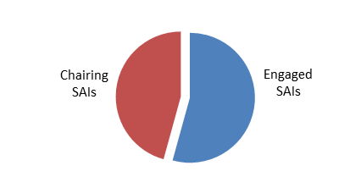
Maintenance of Professional Standards approved by 2013
Estimated annual costs 1,969,000 euros

Slide 9
12
40
16
20

Slide 10
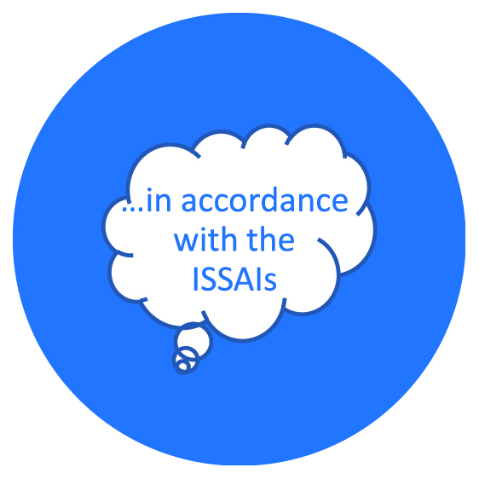

Slide 11
www.issai.org

PSC SC
CBC SC
KSC SC
Sub com
Sub com
Sub com
Sub com
Sub com
Sub com
Sub com
Sub com
Sub com

Slide 12
Due process
Maintenance
responsibillity
Classification by PSC Chair
Approval (1) by PSC / CBC / KSC SteerCom
Approval (2) by PSC / CBC / KSC SteerCom
Approval (3) by PSC / CBC / KSC SteerCom
Confirmation by Governing Board
Endorsement by INCOSAI
Monitoring and
regular reviews
Project
Proposal
Exposure
Draft
Endors-ment
version
ISSAI
/
INTOSAI GOV
Initial assessment
Drafting by
project group/
Subcommittee
Public Exposure
(90 days minimum)
(Preliminary
drafts)
All comments published

Slide 13
Due process
Maintenance
responsibillity
Classification by PSC Chair
Approval (1) by PSC / CBC / KSC SteerCom
Approval (2) by PSC / CBC / KSC SteerCom
Approval (3) by PSC / CBC / KSC SteerCom
Confirmation by Governing Board
Endorsement by INCOSAI
A common forum for the Framework of Professional Standards
Monitoring and
regular reviews
Project
Proposal
Exposure
Draft
Endors-ment
version
ISSAI
/
INTOSAI GOV
Initial assessment
Drafting by
project group/
Subcommittee
Public Exposure
(90 days minimum)
(Preliminary
drafts)
All comments published

Slide 14
- but reemphasize the value circle
Promote capacity development across regions based on standards
Sustainable
professional standard-setting
Professional Standards
(goal 1)
Institutional
Capacity Building
(goal 2)
Model organistation
(goal 4)
Knowledge Sharing/Knowledge Services
(goal 3)
Coordinated development and sharing of knowledge

Slide 15
Tasks of the three Steering Committees:
Approval of professional standards
Roll-out of professional standards
Coordination of WG
PSC SC
CBC SC
KSC SC
Sub com
Sub com
Sub com
Sub com
Sub com
Sub com
Sub com
Sub com
Sub com
Professional standards framework (including competency framework)
Capacity development, implementation and certification
Knowledge sharing , knowledge development and verification

Slide 16
Tasks of the three Steering Committees:
Approval of professional standards
Roll-out of professional standards
Coordination of WG
Approval of professional standards
Roll-out of professional standards
Coordination of WG
Professional standards framework (including competency framework)
Capacity development, implementation and certification
Knowledge sharing , knowledge development and verification

Slide 17
Regional Working Groups
FAC
INCOSAI
General Secretariat
GB
Emerging Issues TF
IJGA
IDI
Suggested membership:
FAC with Goal leaders
Observers/Advisers:
Common Forum Chair
FAS, PAS, CAS chairs
Expert representatives
Management and Coordination of Professional Matters
Strategic level
Goal leader
Strategic Goal 1
Goal leader
Strategic Goal 2
Goal leader
Strategic Goal 3
IT
AR
Coordination
A common forum for the Framework of Professional Standards
PD
IC
EA
IDI
CAS
WG
FAS
Common supporting functions
Providers
TF
PAS
Regions
Community of practise
Community of practise
Content and expertise

Slide 18
Element | INTOSAI | IAASB | IIA | GAO | INTOSAI GOV 9200
Stakeholder input | Very limited | Yes | Yes | Yes | Yes
Oversight | Formally yes (GB) | Yes | Yes | (Yes) | Yes
Deciding on content of standards | Formal competencies in 3 SC (PSC, KSC, CBC) | Board – IAASB 17 members and full-time chair | Board – IIASB Min. 14 members | GAO Input from Advisory Council and GAO audit standard team | Independent selection procedure for standard-setting body
Developing draft standards | Project groups and task forces or subcomittees | Task Force with IAASB member as team leader. Secr assists drafting | Project team w team leader. | GAO audit standards team. | Standards usually developed w input from a task force and experts
Adm support | Limited (PSC secr.) No support to project groups or drafting. | Yes | Yes | Yes | Adequate resources should be available
Financing | In-kind No funding of expenses | Yes | Yes | Yes (employees) | Adequate resources should be available
Implementation | IDI, subcom-mittees, PSC Secr | Yes | Yes | Yes | N/A
Responsiveness | Some degree | … | Yes | Some degree | Yes
Transparancy | Yes | Yes | Yes | Yes | Yes

Slide 19
Leadership
Approval and classification
Development of
draft professional standards
Supporting functions

Slide 20
Leadership
Oversight and final endorsement
Approval and classification
Stakeholder input
Development of
draft professional standards
Supporting functions
Relation to the INTOSAI organisation

Slide 21
Leadership
Oversight and final endorsement
Nomination and appointment
Approval and classification
Stakeholder input
Development of
draft professional standards
Supporting functions
Relation to the INTOSAI organisation

Slide 22
Leadership
Oversight and final endorsement
(goal chairs)
Governing Board
INCOSAI
Nomination and appointment
Nomination and appointment
Approval and classification
Stakeholder input
A common forum for the Framework of Professional Standards
(Advisory group)
Development of
draft professional standards
Sub
Coms
Drafting
team
Project groups
Supporting functions
Relation to the INTOSAI organisation
Common supporting
functions …. to be solved
TBD – INTOSAI Statutes?
TBD – INTOSAI Budget?

Slide 23
Due process
Maintenance
responsibillity
Classification by PSC Chair
Approval (1) by PSC / CBC / KSC SteerCom
Approval (2) by PSC / CBC / KSC SteerCom
Approval (3) by PSC / CBC / KSC SteerCom
Confirmation by Governing Board
Endorsement by INCOSAI
A common forum for the Framework of Professional Standards
Monitoring and
regular reviews
Project
Proposal
Exposure
Draft
Endors-ment
version
ISSAI
/
INTOSAI GOV
Initial assessment
Drafting by
project group/
Subcommittee
Public Exposure
(90 days minimum)
(Preliminary
drafts)
All comments published

Slide 24
CBC
KSC
FAC
GB 2015
GB 2016
INCOSAI
Due process
PSC SteerCom
First draft
Second draft
PSC SteerCom
Final draft
Progress report on clarification of Framework of Professional Standards
Advisory group?
Framework of PS (2007 doc.)
Terms of reference
CFFPS
Com. forum for FPS
Com. forum for FPS
Com. forum for FPS
First draft

Slide 25
Should we adjust the language throughout the document in terms of replacing all references to ’ISSAIs and INTOSAI GOVs’ with references to ‘ISSAIs and other professional standards’?

Slide 26
Approval of exposure drafts
Exposure drafts of the proposed ISSAI or INTOSAI GOV are submitted to the steering committee common forum for approval:
The steering committee common forum approves:
that the exposure draft fulfils the purpose of the project in line with the directions of the approved project proposal and is of high quality;
that any overlaps and inconsistencies in the ISSAI framework in relation to the proposed text have been appropriately addressed, and
that the exposure draft can be submitted for public exposure.
In case of proposed ISSAIs that will form part of the auditing standards issued by INTOSAI, the common forum further approves:
that the exposure draft is fully in accordance with the fundamental principles and concepts of public sector auditing as endorsed in 2013 by INCOSAI through the ISSAI 100
that the proposed requirements are clear and appropriate for the purpose of supporting SAIs in various national settings in their efforts to provide public-sector audits of a high quality
that the proposed requirements provides sufficient safeguards to protect the public confidence in audits conducted in accordance with ISSAI

