Slide 1
Part I: Findings of the Study on the Functionality of the ICS in 6 African countries
Dr. Barbara Dutzler
Good Financial Governance in Africa Programme
PSC Internal Control Standards Meeting
6 June 2017

Slide 2
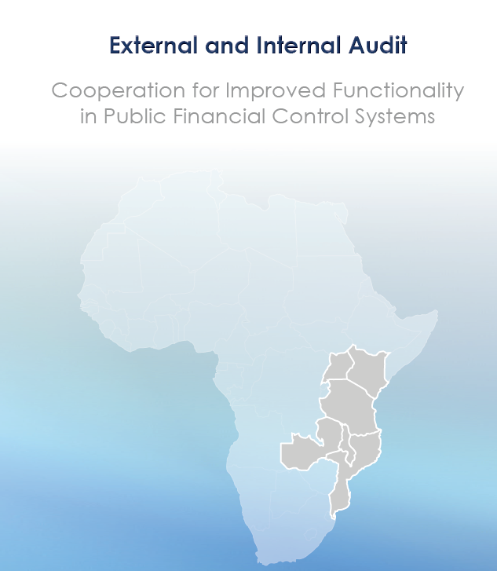
Closeness of Internal and External Audit Standards
Scope for more strategic cooperation
Need for role discussion
Shared view on perspectives
Core findings
Affinities between IA and EA audit standards
Scope for increased and more strategic cooperation
Need for dialogue on roles and responsibility
Asymetric needs for information exchange
Issues of independence and adherence to standards
Avoidance of harmful competition
Need for shared perspective on way forward

Slide 3
Part II:
Approach 3: PFM, SAIs and the
Agenda 2030

Slide 4
AFROSAI Regional Paper for INCOSAI Theme I
SDGs are an opportunity for rethinking the engagement of SAIs in auditing government operations and governance questions.
Public Financial Management
SAIs to rethink review and audit
Catalyst for government performance
and reframe the of PFM systems
To maximize the contribution to achievement of other SDGs.
Notes:
This echoes AFROSAI‘s position on Theme 1 -

Slide 5

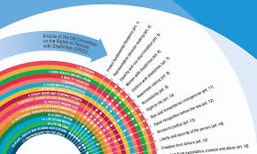

Research results for 23 countries: updated GFG Heatmap
Hypothesis
Well-functioning PFM systems
are fundamental to the
success of the SDGs
Notes:
Yet, this is a statement but with no proven connection that such a link exists.
In our search for defining the role of SAIs in the auditing of SDGs, focusing on goal 16, I believe we have found evidence for such a link. SAIs can make a contribution to SDGs by auditing PFM in a holistic way

Slide 6
The Methodology
Country context factors
SDG achieve-ment
Budgetary outcomes
PFM processes
1. Context:
Economical
Political
Geografical
2. Political Economy
State Capacity
Anti-Corruption
Governance
3 core outcomes:
Fiscal sustainability
Implementation of policy priorities
Service Delivery
Revenue, budget planning, budget execution (procurement, ICS), reporting, accountability

Slide 7
Notes:
The top 12 most common areas of poor performance – and you will note that all procurement indicators belong to this category, they are a concern in about 60% of countries reviewed.
A note on budget credibility: Mr Scartascini noted a distinction between developed and developing countries with regard to public spending decision making. In developed countries, negotiations on spending allocations are carried out prior to actual execution. In developing countries, they occur informally during budget execution. ‘Therefore, in most cases, approved budgets are very different to executed budgets – the budget process is a living system.’ This system of allocation through execution should be of great interest to budgetary and PFM oversight institutions.

Slide 8
Budgetary outcomes remain far from ideal

Slide 9
Good performance in key PFM areas is a necessary
but not sufficient condition to achieve the SDGs.
Countries with many
PFM risk areas
Countries with few
PFM risk areas
Notes:
Grouping countries with a high number of risky PFM areas such as procurement, expenditure arrears, internal audit of payroll, and juxtaposing these with development results such as Human Development Indicators, poverty reduction, school enrolment, infant mortality, maternal mortality, life expectancy, or GINI, it appears there is a relationship: while good PFM is not sufficient to achieve good development results, it is clearly a contributing factor
You may note, comparing the 2 grafs, the differences are not that big, but they are there, and in the direction we expected them. Thus we conclude that Good performance in key PFM areas is a necessary but not sufficient condition to achieve the SDGs.

Slide 10
Internal Control Systems appear as key factor for service delivery
Countries with weak ICS
Countries with well-functioning ICS
Notes:
The same pattern we can see if we juxtappose performance on internal control systems with service delivery. service delivery being measured by pupil-teacher ratios, the relative number of hospital beds, and access to sanitation

Slide 11
Correlations sometimes work both ways
Countries‘ corruption performance is better in environments with low PFM risk
Critical PFM processes work better in countries with better corruption performance
Notes:
Hard to disentangle cause and effect. You simply find environments with both: little corruption and good PFM systems, and lots of corruption and bad PFM systems. You may ask yourselves what causes what. Is it easier to have more efficient PFM systems in a low corruption environment? Probably yes. Is corruption low because government works well? Probably yes. Both go hand in hand.
We can speculate what that means in terms of policy implcations. My answer would be: one should influence that which one can. If two items often occur togther, why not create the conditions for one to appear, the other might follow.

Slide 12

Status quo
  Many entity level mandatory financial audits tie up resources
  PFM risks are not seen holistically – many valid observations at individual Ministry / Department level but little systematic assessment or interpretation
  Results are not well communicated – technical reports, released with delays, little debate in Parliament, recommendations not implemented, no visible change
  The link between underperforming PFM and
  lack of development is not clearly articulated
Notes:
The report also reveals that SAIs are underresourced, ill-staffed, and suffer opposition regarding their work
What you see and what you dont see –

Slide 13








What if SAIs not only understood their respective PFM environments in a holistic way, but also actively participated in shaping and improving it in order to deliver upon Goal 16?
Do SAIs agree on this notion as vision for approach 3, and if yes, what needs to be done to achieve it?
Notes:
Taking the role of SAIs in auditing PFM systems serious, a systematic viewpoint must be applied that attempts to holistically understand the current situation of the PFM system, its strengths, its weaknesses, the core risk areas, and the resulting implications for service delivery and SDGs. Furthermore, existing information must be compiled (as done in the heat maps) and utilized in strategic audit strategy and yearly audit planning. Finally, applying a whole of government approach in which the audits no longer only result in obtaining findings only for single government entities, but in which these results are holistically compiled to determine those core PFM areas that underpin and pose a risk for the non-achievement of development results.

Slide 14

*AFROSAI-E Governing Board
Kenya 8-10 May 2017
lack of a holistic approach
mostly a compliance perspective on financial management resulting from their various individual audit engagements
no institutionalized approach hence a lack of a documented risk analysis or a systemic approach to the audit of PFM systems.
Need to look beyond budgetary figures: budgetary processes, the assumptions driving revenue targets, sustainability of budget,..
Aggregation of results: need to explore role of quality assurance
Auditing PFM systems: SAIs confirm*

Slide 15

On reporting:
AFROSAI-E SAIs agree
there is a need for a common reporting framework
a simple concept that includes guidance on a common understanding of a PFM system
assist with categorizing findings and aggregating and comparing results amongst SAIs.
Aim: to emphasise the value and benefit of SAIs to the lives of citizens as per ISSAI 12.

Slide 16
global integrated reporting movement the new theme in the accounting profession, business practice, and increasingly SAIs.
Not a coincidence.
Integrated Thinking
.. Intending to create value for stakeholders over the short, medium and long term
Integrated
Reporting
.. Effective communication about how strategy, governance, performance and prospects, in the context of external environment, lead to the creation of value.
Notes:
IFAC says: „Technology platforms sit between content suppliers and consumers, and now own the relationship with customers. This is arguably a contributing factor for decreasing levels of trust globally—in institutions, governments, the media, and not-for-profits—and today’s inversion of influence, which sees trusted leaders and organizations as less influential than in the past. Effective communication requires a reinvention of how you share your message and a focus on storytelling that is based on people and individual impact, combined with effective visuals and overall brevity.

Slide 17
From Vision to Reality
Engage
Develop
Apply
  Engage to discuss and refine our understan-ding of PFM systems, core risks and functionalities
Jointly develop a reporting framework based on common understanding
Apply by piloting the framework

Slide 18

Rethinking SAI engagement in PFM systems
Interlinkages are the core of the Agenda 2030. This changes the way we approach policy making, implementation, and reporting
SAIs have a crucial role in advising government on Good Financial Governance matters.
SDGs are entirely voluntary. So is survival.

Slide 19
How to go about it: A matrix approach
Budget Outcomes / Categories | Fiscal Sustainability | Policy Priority Implementation | Service Delivery
Legal Framework | Revenue | Multi-year perspective | Cash management
Compliance | Debt and deficit | Budget credibility | Procurement
Management | ODA | External Audit | Internal controls
Performance |  | Parliamentary oversight | Internal audits
Oversight |  |  | Accounting
… ? |  |  | Reporting

Slide 20
Questions for discussion
Do you agree with the vision of developing a holistic reporting framework on PFM?
How do you engage with other PFM stakeholders e.g. Ministry of Finance?
Do you agree with the proposed matrix approach?
What are suitable steps for development:
  Research: which countries
  Which methods of work (e.g. KSC portal)
  Development workshop for framework
  Piloting: which countries

Slide 21
Thank you for your attention

