Slide 1
ISSAI Implementation Initiative 3i Programme
Results & Lessons Learned
PSC Steering Committee Meeting ,
27- 29 May 2015, Ottawa

Slide 2
Presentation Plan
3i Programme Update
3i Evaluation – Conclusions & Recommendations
3i Lessons Learned & Future Plans

Slide 3
3i Programme Coverage
138 SAIs and 2 sub national audit offices
Region | SAIs
AFROSAI-E | 22
ASOSAI | 20
EUROSAI | 11
PASAI | 15 + 2 Sub-National Audit Offices
CAROSAI | 15
OLACEFS | 19
ARABOSAI | 17
CREFIAF | 19

Slide 4

Implementation Partners
INTOSAI Professional Standards Committee
Subcommittee on Financial Audit
Subcommittee on Performance Audit
Subcommittee on Compliance Audit
INTOSAI Capacity Building Committee
Regional bodies
Participating SAIs
Financing Partners
World Bank, USAID, DFATD Canada, SIDA
E-learning Partner - UNITAR

Slide 5


3i Objective
Current
Situation
ISSAI based
audit practice
Support SAIs in developing countries in
implementing ISSAIs

Slide 6
3i Results Framework
1.Development of Global Public Goods
2.ISSAI Certification Programmes
3.ISSAI Knowledge Network/Community of Practice
4.ISSAI Based Cooperative Audits
5.SAI level ISSAI Implementation Startup

Slide 7
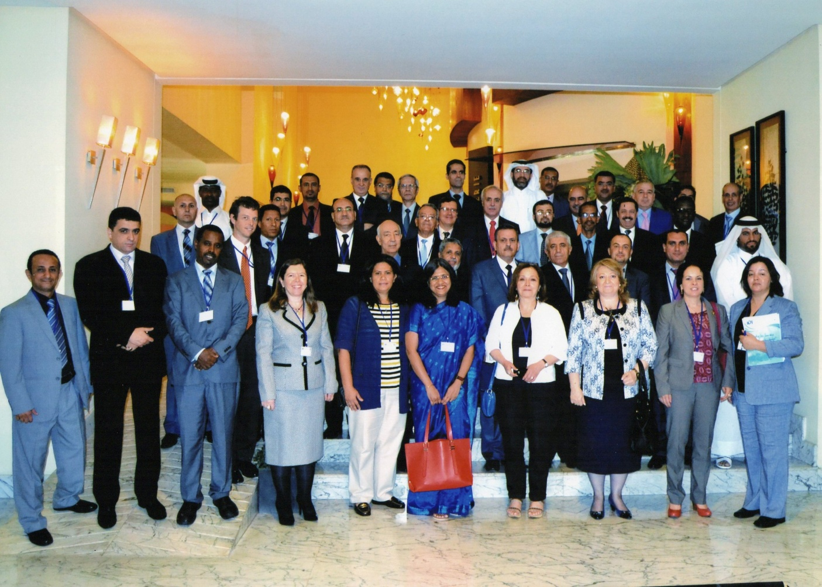
Engaging with SAI Management
3i Management Workshops
  CAROSAI, Paramaribo, Suriname
  AFROSAI-E, Durban, South Africa
  PASAI. Nadi, Fiji
  ASOSAI, Phnom Penh, Cambodia
  EUROSAI, Sarajevo, Bosnia & Herzegovina
  OLACEFS Brasilia, Brazil
  ARABOSAI, Casablanca, Morocco
  CREFIAF, Douala, Cameroon
299 Top Managers from 135 SAIs
111 Statement of Commitments

Slide 8
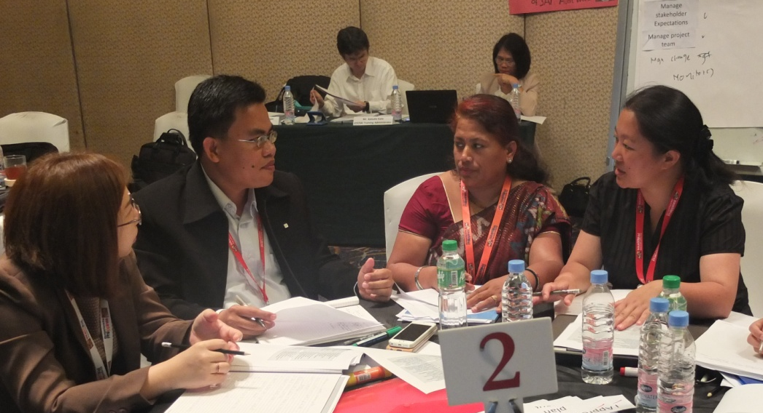
3i Results - IDI Outcomes - GPGs
Use of iCATs by SAIs
Maintenance of iCATS to include level 3 and other feedback
Documented commitment from 111 SAIs in all INTOSAI regions
SAIs in the English speaking regions have carried out iCATs: FA - 31, PA - 31, CA - 26
iCAT review workshops were held to provide support and feedback to SAIs in ASOSAI, CAROSAI and PASAI.
7162 downloads
of iCATs
SAIs committed to
carry out iCATs
ARABOSAI | 17 SAIs
OLACEFS | 20 SAIs
CREFIAF | 18 SAIs

Slide 9
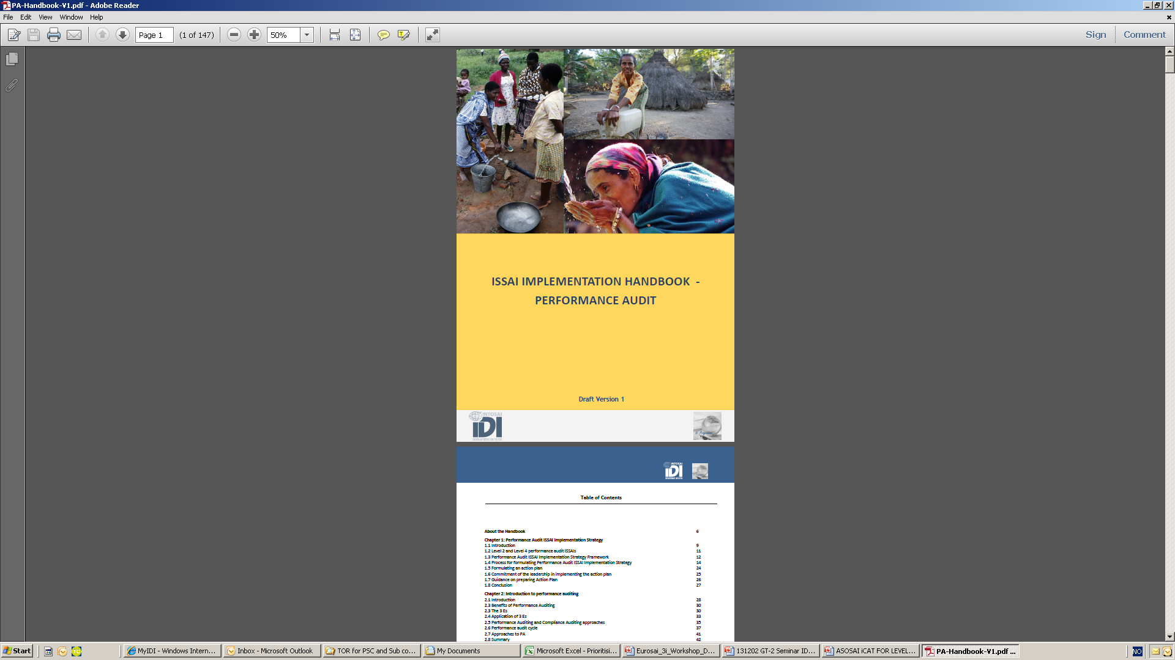
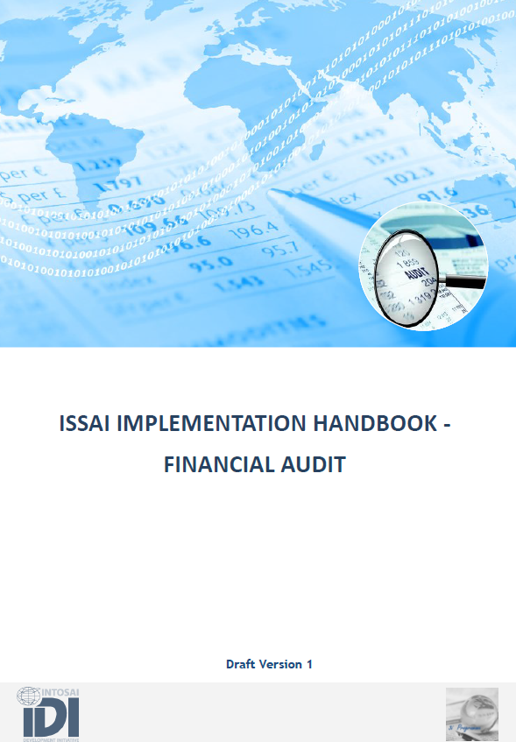
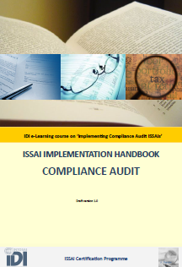
3i Results – IDI Outcomes - GPGs
Use of ISSAI Implementation Handbooks for FA, PA and CA
Used in all three ISSAI Certification Programmes
Used for ISSAI based cooperative audits
Translated into Arabic, Spanish and French
7865 downloads of handbooks

Slide 10
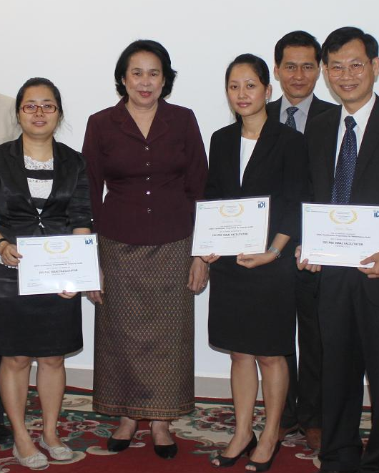

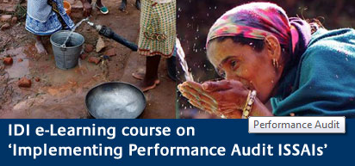
3i Results – IDI Outcomes - ISSAI Facilitators
ISSAI Certification Programmes
IDI-PSC Certified ISSAI Facilitators for FA, PA, CA
5 Regions English | OLACEFS | ARABOSAI | CREFIAF
Completed phase 1 | Completed phase 1 | Ongoing | Start in 2015
2012-2014 | 2014-2015 | 2015-2016 | 2015-2016
198 Certified ISSAI Facilitators | 60 participants, 9 mentors are being certified as ISSAI Facilitators | 93 participants from 16 SAIs | 19 SAIs attended the management workshop

Slide 11
3i Results – IDI Outcomes – Professional Staff & Organisational Capacity
ISSAI Based Cooperative Audits
ASOSAI | PASAI | CAROSAI | AFROSAI-E | OLACEFS
2015: Performance Audit of Disaster Management ( 18 SAIs) | 2015: Compliance Audit of Procurement Performance Audit of Public Debt, 2014 Financial Audit of Foreign Aided Projects, 2013 | Performance Audit of Revenues, 2014 ( 6 SAIs) | Performance Audit of Extractive Industries, 2014 (7 SAIs) | 2015: Performance audit of fight against poverty

Slide 12
3i Results – IDI Outcomes – Professional Staff & Organisational Capacity
Revised Model for ISSAI Based Cooperative Audits
eCourse
Focus on subject matter
Audit Planning Meeting
SAI audit teams
Audit Review Meeting
Support for finalising audit report
Quality Assurance
Audit as per ISSAIs
Focus on audit methodology
Wide stakeholder participation
Support for audit planning

Slide 13

3i Results – IDI Outcomes -
3i Community Portal
15109 visits from 200 countries.
Downloads: iCATs: 7162, handbook: 7865
Communities of practices: 750 registered users
  FA, PA, CA,
  PASAI Cooperative audit,
  iCAT review group,
  CA subcommittee
www.idicommunity.org

Slide 14
SAI Outcomes – ISSAI Implementation
Has the SAI decided to adopt ISSAIs
Undertaken an assessment of compliance ?
Has in place ISSAI compliant manuals and policies
Implemented ISSAIs in practice across the SAI
External review confirms that ISSAIs are implemented in practice
SAIs implement financial, performance and compliance audit ISSAIs
IDI Global Survey
Monitoring sample
SAI PMF
iCATs

Slide 15
SAI Outcomes
Sub-indicators | Baseline 2014
% of SAIs that have decided to adopt respective ISSAIs. | FA: 100 % SAIs CA: 97% SAIs PA: 90% SAIs Monitoring Sample
% of SAIs undertaken an assessment of compliance with standards. (iCATs or SAI PMF) | FA: 17% SAIs CA: 15% SAIs PA: 15% SAIs Monitoring Sample
% SAIs that have ISSAI compliant manuals and policies in place | No baseline available for the 3 areas audit
% SAIs that have generally implemented ISSAIs in practice | FA: 3% SAIs CA: 10% SAIs PA: 7% SAIs (SAI PMF)
IDI Performance &
Accountability Report 2014

Slide 16

3i Evaluation - Conclusions
The feedback from the evaluation team, participants, stakeholders and INTOSAI working groups is that the quality of the tools and the training produced by IDI is of very high quality. The training is highly appreciated, despite being in a new format (an on-line course) for some participants. The tools are well-designed, easy to use and at the same time comprehensive and evidence-based.
However, the hoped for impact of the Program is not to have a suite of well-designed tools that SAIs use regularly; these are outputs. The expected impact, improved quality of audit work and increased compliance with the ISSAIs, has yet to materialize.

Slide 17
3i Evaluation - Conclusions
The results of the Program show that SAIs are beginning to use the competence gained and tools and there are signs that changes to audit processes are being institutionalized, among other through the use of the iCAT as a checklist for quality assurance of individual audits.
It is important to bear in mind that the Program has only been run during two years and to change systems, audit manuals, audit processes, laws and procedures takes time.

Slide 18
3i Evaluation - Conclusions
The IDI has produced all the pre-requisites needed for a SAI to be able to 1) assess the needed changes 2) know how to start the change process and 3) how to measure if change has happened (or increased ISSAI compliance).
This Program is a success and has achieved its outcomes and outputs, and now needs to continue with a new set of activities to help SAIs to increase the quality of their audit work.

Slide 19

3i Evaluation - Recommendations
“improvement in the quality of audit work produced by SAIs as measured by their levels of compliance with the ISSAIs”.”
continuation of ISSAI Certification Programme, more time for ecourses
focus on the support programs such as cooperative audits and iCAT review workshops.
continue to follow up on the action plans (say, every year) to measure progress being made.
Recommendations

Slide 20
3i Evaluation - Recommendations
encourage SAIs to prepare SAI PMF assessments done through peer-reviews every few years to ensure validity of the results.
How to link the iCAT and SAI PMF tools.
Consider whether to include an assessment against level 4 ISSAIs (either linked with the iCAT or not) in the SAI PMF.
Consider including (or referring to how to create) an action plan explicitly stating changes needed for improvement. This could be included in the SAI PMF report itself or could be produced subsequently in a separate document.
Recommendations

Slide 21
Lessons Learned & Future Plans
Start with helping SAIs map their mandate, stakeholder expectations and differentiate audit practices.
define due process, provide for QA, align with SAI PMF, position also as QA tool
Rework level 2 iCAT. Separate interventions on ISSAI 10, 20, 30, 40
Basic content, face to face interventions, certification of competencies, offered on annual basis, participation in INTOSAI efforts
Quality Assurance Programmes at SAI & regional level
More support for ISSAI based cooperative audits & SAI level support
Need to go back to basics.
Improve the iCATs
More emphasis on Level 2
Upgrade ISSAI Certification Programmes
Focus on Quality
Focus on Audit

Slide 22
Global Priorities
SAI Strategy, Performance & Reporting
Support for Implementing ISSAIs ( including certification)
SAI- Stakeholder Relations
Enhancing SAIs role in countering fraud & corruption
Supporting Institutional Capacity Development
Enhancing eLearning capacity
SAI Young Leaders Programe
Future Plans – 2015-2018

Slide 23
In the absence of independent quality assurance reviews, given the formative stages of SAI’s understanding of ‘implementation’ and the SAIs prerogative to not share the results of their self assessments, it is almost impossible to get evidence based data on the actual status of implementation of ISSAIs in SAIs.
What mechanism can we use to get evidence based data on status of ISSAI Implementation ?

