Slide 1

The International Professional Practices Framework
Gerry Cox

Slide 2

Evolution of standards from 1941…
1941 IIA founded
1947 Statement of Responsibilities of the Internal Auditor
1968 Code of Ethics
1978 Standards for the Professional Practice of Internal Auditing
1978 Statements on Internal Auditing Standards
1999 new definition of internal auditing
2000 Code of Ethics (revised)
2002 Professional Practices Framework
2009 International Professional Practices Framework (IPPF)
Notes:
The IIA was founded 75 years ago.
The organization soon turned its attention towards professional standards and ethical principles.
These have been through various iterations over the years.
2009 saw the first version of what we know as the IPPF – the International Professional Practices Framework

Slide 3
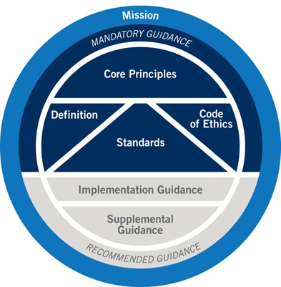
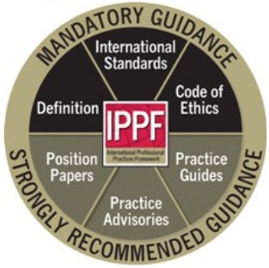
…to 2015 and beyond
IPPF 2009
IPPF 2015
Notes:
The 2009 version has been updated regularly for content but in 2015 it underwent a restructuring with some new elements and new terminology.
At this stage the Standards themselves were not updated. This work is ongoing.

Slide 4
New standards and guidance committee structure 2016
Board of Directors
IPPF Oversight Council
Standards and Implementation Guidance
Executive Committee
Vice Chair(s) – Professional Practices
International Internal Audit Standards Board
Professional Practices Steering Committee
Professional Responsibility and Ethics Committee
Guidance Development Committee
Public Sector Development Committee
FS Development Committee
IT Guidance Committee
Code of Ethics
Supplemental Guidance
Notes:
Before “looking under the bonnet (hood)” of the changes to the IPPF, let’s consider the underpinning structure that supports the standards setting process.
This is also undergoing a change. Most significant is the introduction of sector specific guidance committees for the development of sector specific guidance in
Financial Services
Public Sector
IT
The other two elements to note are the Standards Board and the Oversight Council.
Let’s look at their roles.

Slide 5
The role of the Standards Board
Operates independently
Develops, issues, and maintains the Standards
Comprises 21 members representing IA profession and its stakeholders (includes members from INTOSAI and ACCA)
Overseen by independent council of stakeholders – IPPF Oversight Council (with representatives from OECD, World Bank, INTOSAI, IFAC, and NACD)
Cross-section of geographic areas and sectors
Broad senior experience
Oversees the creation of implementation guidance

Slide 6
The role of the Oversight Council
Chaired by Peter Gleeson NACD
Evaluates the guidance-setting processes
Reviews the standards and guidance work plans and make recommendations on improvements
Reviews the charters of the standards and guidance-setting committees
Reports on the adequacy and appropriateness of the processes employed for the IPPF standards and guidance-setting
Reports to the Board

Slide 7
Standards due diligence
Initiation
IIASB discusses emerging issues and feedback from various sources for potential topics that impact the profession and Standards
Development
IIASB researches and discusses topics, develops potential changes to Standards
Public Exposure
90 days exposure period to get input from the public, including stakeholders and practitioners
Global Ethics Committee reviews proposed changes ensure consistency with Code of Ethics
Review & Approval
IIASB reviews exposure results and makes final decisions on changes
IPPF Oversight Council, an independent body, reviews Standards-setting process

Slide 8
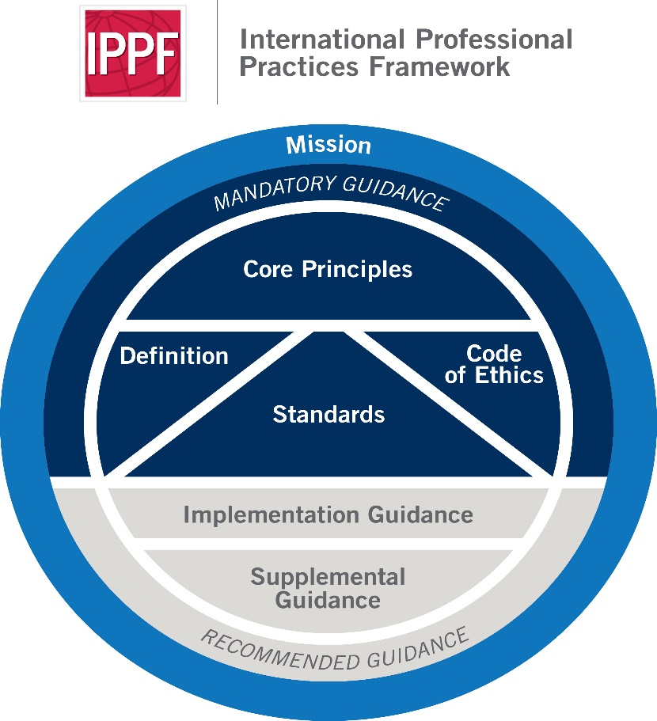
2015 – what’s new?
Mission – NEW
Core Principles – NEW
Definition
Code of Ethics
Standards
Recommended Guidance (Implementation and Supplemental)
Notes:
Launched in July 2015 the new IPPF has a fresh feel and appearance to it.
It introduced a mission for internal auditing and 10 core principles. The mission describes the purpose of internal auditing (as opposed to its definition).
It has always been said that the standards are principles-based but we had never previously defined those principles.
We did away with “strongly recommended” guidance in exchange for “recommended” of two sorts: Implemental and Supplemental Guidance.

Slide 9
Mission of internal audit – NEW
Mission: To enhance and protect organizational value by providing risk-based and objective assurance, advice, and insight.
Notes:
The mission is shorter and pithier than the definition. It defines what internal audit is trying to achieve.

Slide 10
Core principles of internal audit – NEW
Demonstrates integrity
Demonstrates competence and due professional care
Is objective and free from undue influence
Aligns with the strategies, objectives and risks of the organization
Is appropriately positioned and adequately resourced
Demonstrates quality and continuous improvement
Communicates effectively
Provides risk-based assurance
Is insightful, proactive, and future-focused
Promotes organizational improvement
Notes:
The core principles were effectively reverse-engineered from the standards rather than the other way round. They had previously been implicit and are now explicit.
Collectively they articulate what effective internal audit looks like in practice.
The standards have been mapped to the principles to confirm that the list of 10 is complete. There is a very good fit. It may indicate however that in some cases additional standards are required to build further on the principles.

Slide 11
Definition of internal audit
Internal auditing is an independent, objective assurance and consulting activity designed to add value and improve an organization's operations. It helps an organization accomplish its objectives by bringing a systematic, disciplined approach to evaluate and improve the effectiveness of risk management, control, and governance processes.
Notes:
The definition has been around for a good number of years (since 1999) and has been widely cited in legislation, academic literature, organizational manuals and policy papers, and so on.
So to change it would cause some discomfort. Any change would need to be for good reason.
When this was written in the late 90s the addition of “consulting” was considered a very important element. However since then the glamour of consulting has faded a little and it tends to carry some negative connotations. The IIA more commonly talks about “advice and insight” in preference. When the definition is eventually re-worked this is something to be considered.

Slide 12
Professional standards
Attribute Standards:
Purpose, Authority and Responsibility (1000)
Independence and Objectivity (1100)
Proficiency and Due Professional Care (1200)
Quality Assurance and Improvement Program (1300)
Performance Standards:
Managing the Internal Auditing Activity (2000)
Nature of Work (2100)
Engagement Planning (2200)
Performing the Engagement (2300)
Communicating Results (2400)
Monitoring Progress (2500)
Communicating the Acceptance of Risks (2600)
Notes:
The structure of the standards within the IPPF remains the same, divided between attribute standards and performance standards.

Slide 13
Exposure February 1 to April 30, 2016
Two new standards
Alignment of the Standards to the Core Principles
Updates to existing standards
Notes:
Following the revisions to the IPPF The IIA exposed two new standards relating to:
Chief Audit Executive Roles beyond internal auditing, especially relevant where the CAE may be asked to take on roles that blur the three lines of defence (i.e. related to risk management and compliance)
Potentially objectivity-impairing situations where internal audit moves from a consulting role to an assurance one
Various other amendments were proposed, including:
Getting the language right to match the core principles, such as “is insightful, proactive and future-focused”
Revisions to the reporting of quality assurance and improvement program
Enhancing communication between the CAE, the board and senior management
This exposure has just closed.
The Standards and Guidance Committee will review the feedback and propose a final version to come into force at the beginning of 2017.

Slide 14
New Implementation Guidance
1000
Purpose, Authority and Responsibility
2110
Governance
Notes:
1000: This guide supports the implementation of Standard 1000, including the internal audit charter, a formal document that defines the internal audit activity's purpose, authority, and responsibility.
2110: This guide supports the implementation of Standard 2110 for assessing and improving the organization’s governance processes.
More implementation guidance will be released.

Slide 15
New Supplemental Guidance
Practice Guide: Second Line of Defense
Practice Guide: Talent Management
Notes:
1000: This guide supports the implementation of Standard 1000, including the internal audit charter, a formal document that defines the internal audit activity's purpose, authority, and responsibility.
2110: This guide supports the implementation of Standard 2110 for assessing and improving the organization’s governance processes.
More implementation guidance will be released.

Slide 16


