Slide 1

ISSAI Implementation Initiative – 3i Programme
Update on Phase I and Phase II
PSC Steering Committee Meeting
26- 27 May 2016 ,Copenhagen

Slide 2
Presentation Plan
3i Phase I – current status
3i Phase II – future plans

Slide 3
3i Programme – Phase I Coverage
139 SAIs and 2 sub national audit offices
Region | SAIs
AFROSAI-E | 22
ASOSAI | 20
EUROSAI | 11
PASAI | 15 + 2 Sub-National Audit Offices
CAROSAI | 15
OLACEFS | 19
ARABOSAI | 17
CREFIAF | 20

Slide 4
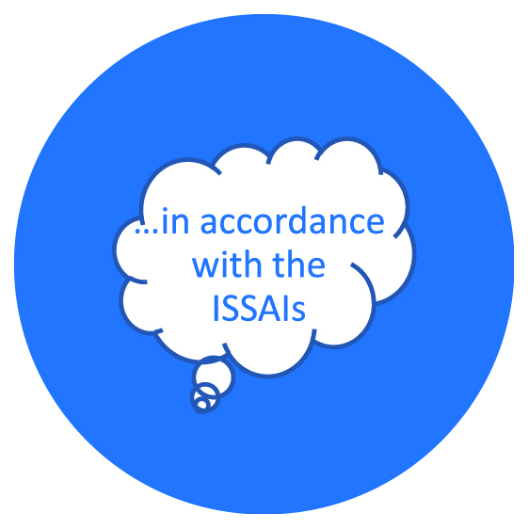

3i Objective
Current
Situation
Support SAIs in
implementing ISSAIs

Slide 5
Partners
SAIs
INTOSAI PSC & subcommittees, CBC, KSC
INTOSAI Regions
Financing partners – World Bank, USAID, DFATD Canada, SIDA, IFAD, DFID

Slide 6
3i Phase I Results Framework
1.Development of Global Public Goods
2.ISSAI Certification Programmes
3.ISSAI Knowledge Network/Community of Practice
4.ISSAI Based Cooperative Audits
5.SAI level ISSAI Implementation Startup

Slide 7
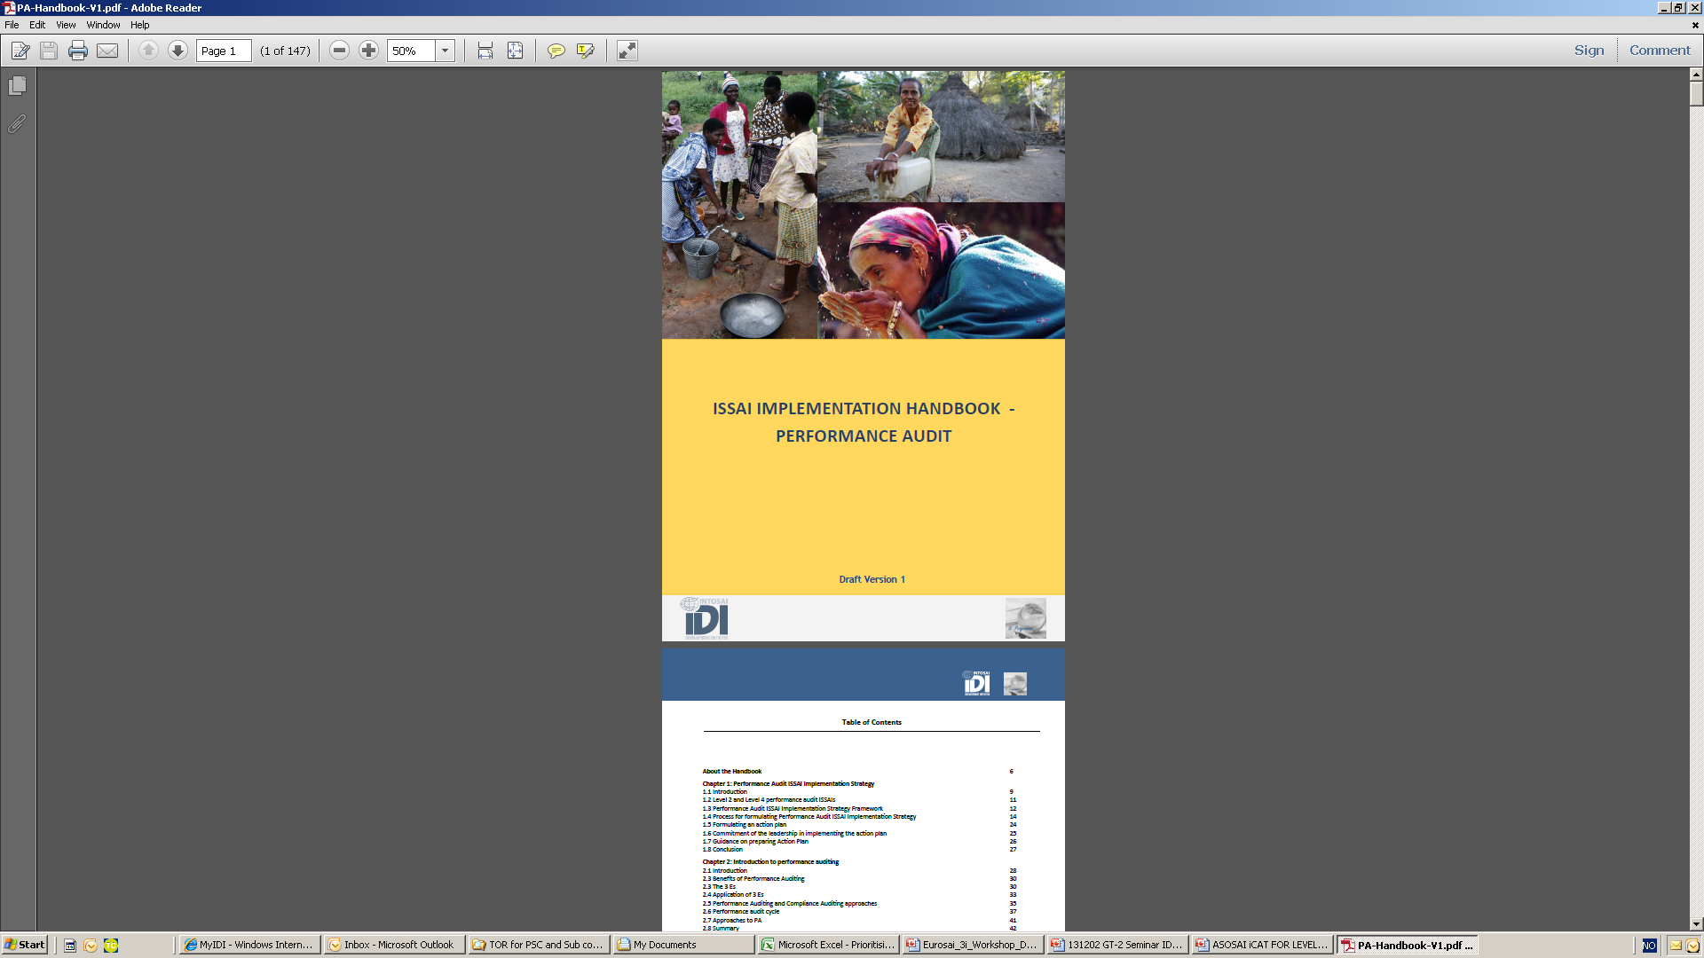
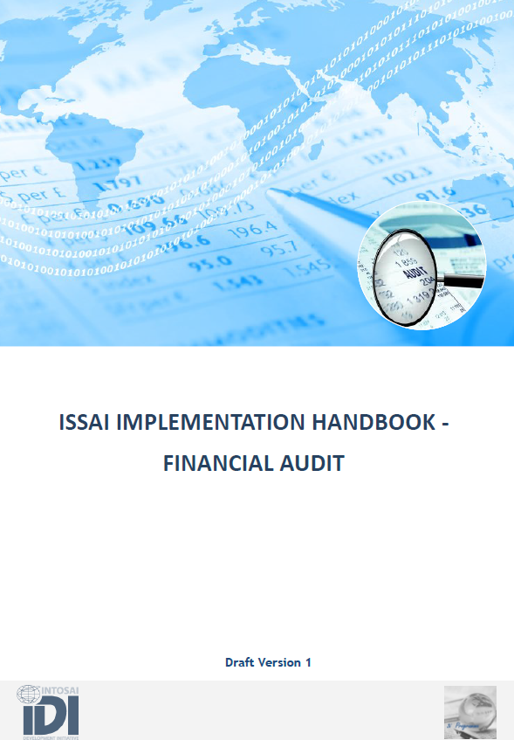
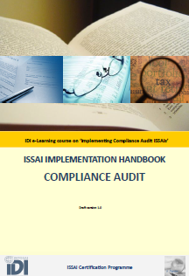
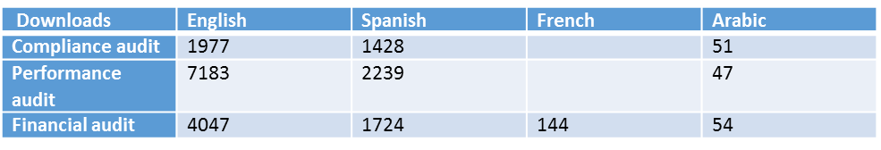
3i Phase I Results – Global Public Goods
Use of ISSAI Implementation Handbooks for FA, PA and CA
Used in all three ISSAI Certification Programmes
Used for ISSAI based cooperative audits
Translated into Arabic, Spanish and French
18908 downloads of handbooks

Slide 8

iCATs Conducted in all regions
EUROSAI
FA- 2
PA- 3
CA-2
ARABOSAI :FA-14
PA-14
CA-15
CAROSAI :
FA-7
PA-6
CA-7
ASOSAI : FA-12
PA-13
CA-10
CREFIAF
FA-14
PA- 14
CA- 19
PASAI :
FA- 9
PA- 9
CA- 8
OLACEFS : FA- 9
PA- 9
CA- 9
AFROSAI-E
FA-1
PA-1
CA-1
Total Number of iCATs received : FA-68 , PA-69 , CA-51

Slide 9
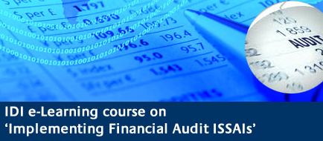
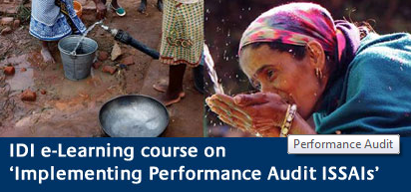
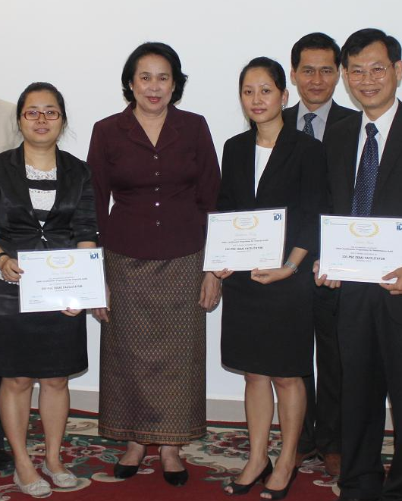
3i Phase I Results
PSC-IDI Certified ISSAI Facilitators for FA, PA, CA
English speaking regions | OLACEFS | ARABOSAI | CREFIAF
2012-2014 | 2014-2015 | 2015-2016 | 2015-2016
198 Certified ISSAI Facilitators and certified mentors | 56 Certified ISSAI Facilitators and 6 Certified ISSAI mentors | 82 participants | 96 participants

Slide 10
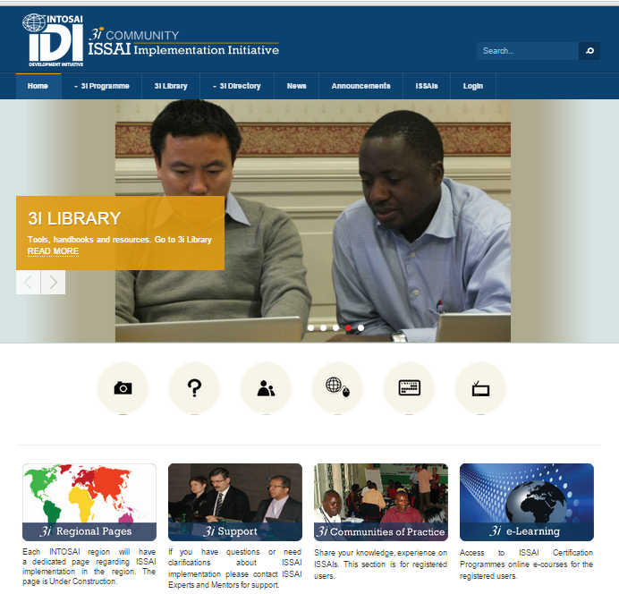
3i Phase 1 Results – 3i community portal
20065 visits from 200 countries since May 2015
Downloads: iCATs: 12503, Handbooks: 18908
Communities of practices: 750 registered users
  FA, PA, CA,
  PASAI Cooperative audit,
  iCAT review group,
  CA subcommittee
www.idicommunity.org

Slide 11
3i Cooperative Audits
ASOSAI : PA Disaster Management
ARABOSAI : CA Procurement, PA fighting corruption, FA
PASAI :
FA externally aided project,
CA Procurement
CAROSAI :
PA Revenue
CREFIAF : PA Gender &
Environment
OLACEFS : PA fighting poverty
AFROSAI-E : PA Extractives,
FA & CA externally aided projects agriculture
Transregional : Auditing Borrowing & Lending Frameworks, IT Audit , SDGs, fighting corruption

Slide 12

Cooperative Audit Support Model
eLearning/ workshop
Focus on subject matter & methodology
Audit Planning Meeting/efacilitation
Mentor support and review
Audit Review Meeting
Support for finalising audit report
Quality Assurance
Independent assurance of audit quality
Design & Deployment on IDI platform
SAI Commitment
Agreement with SAI leadership
Roles & responsibilities
Onsite/online support during audit

Slide 13
SAI Outcomes
Indicators | Baseline 2014
% of SAIs that have decided to adopt respective ISSAIs. | FA: 100 % SAIs CA: 97% SAIs PA: 90% SAIs Monitoring Sample
% of SAIs undertaken an assessment of compliance with standards. (iCATs or SAI PMF) | FA: 17% SAIs CA: 15% SAIs PA: 15% SAIs Monitoring Sample
% SAIs that have ISSAI compliant manuals and policies in place | No baseline available for the 3 areas audit
% SAIs that have generally implemented ISSAIs in practice | FA: 3% SAIs CA: 10% SAIs PA: 7% SAIs (SAI PMF)
IDI Performance &
Accountability Report 2014

Slide 14
3i Programme Phase II

Slide 15
Value & benefits of SAIs
SAI capacity
SAI institutional capacity
SAI organisation systems + professional staff capacity
SAI contribution to Impact
SAI outputs
SAI outcomes
SAI culture + leadership
B
accountability reporting
Internal governance and ethics +
Public confidence in the SAI
A
Independence + legal framework
C
SAI core services
FA standards, process, quality + results
Audits recommendations implemented
PA standards, process, quality + results
Value and benefits delivered by contributing to Sustainable Development Goals (SDG)
SAI Strategic Management Framework
CA standards, process, quality + results
Public confidence in government financial systems
Judgement process + results
Other core services + results
Improved compliance with laws and regulations
D
E
Corporate services
HRM + Professional staff development
Stakeholders engagement in accountability
F
Communication and Stakeholder management
+ results
Country governance, political, social, cultural + public financial management environment

Slide 16
IDI Programme Portfolio 2016-2016
IDI Capacity Development Programme Portfolios
2016-18
1
Strategy, Performance Measurement & reporting
2
SAI engaging with Stakeholders
3
Auditing SDGs
4
ISSAI implementation – Phase II
5
SAI Fighting Corruption
6
SAI Independence
7
SAI Young Leaders
8
Enhance eLearning capacity

Slide 17

3i Phase II-Results Framework
Support for ISSAI Implementation as a work stream
Revision & Maintenance of 3i Products
Strengthen IDI Certification Programmes (Competency Based)
Participate in INTOSAI Certification for Auditors
Quality Assurance Programme
3i Cooperative Audits
3i Community of Practice
Support for Implementation at SAI level

Slide 18
Revision and Maintenance of 3i Products
Guidance on initial mapping
Updating iCATs – remove level 2, clustering requirements, iCATs as QA tools
New version of ISSAI Implementation Handbook for Financial Audit
Updating ISSAI Implementation Handbook for Performance Audit ( equity, assurance)
Updating ISSAI Implementation Handbook for Compliance Audit ( attest engagement, direct reporting engagement, more ‘how to’ guidance)

Slide 19
SAI level support for ISSAI Implementation
Focus on organisational systems and professional staff
ISSAI Awareness & Initial Decisions
Guidance to facilitate basic understanding and key decisions
Initial assessment
SAI PMF
SAI strategy, including ISSAI implementation strategy
SAI Strategic Management Handbook and ISSAI implementation handbooks
Define audit methodology
Implement in Audit practice
iCATs
Blended support for pilots audits
Quality Assurance
iCATs as QA tool
ISSAI Implementation Handbooks
iCATs
Leadership, Advocacy & Change Management

