Slide 1
Certification programs
Gerry Cox
INTOSAI Professional Standards Committee May 2015

Slide 2
Agenda
Overview of The IIA
IIA Certifications
Development
Delivery
Challenges
Keeping it relevant
Future opportunities
Q&A

Slide 3

About The Institute of Internal Auditors

Slide 4
Membership Growth 1980-2014

Slide 5
Vital Statistics
More than 185,000 members from 190 countries
IIA Chapters and Institutes
155 Chapters US, Canada & Caribbean
105 Institutes
CIAs
120,000 CIAs

Slide 6
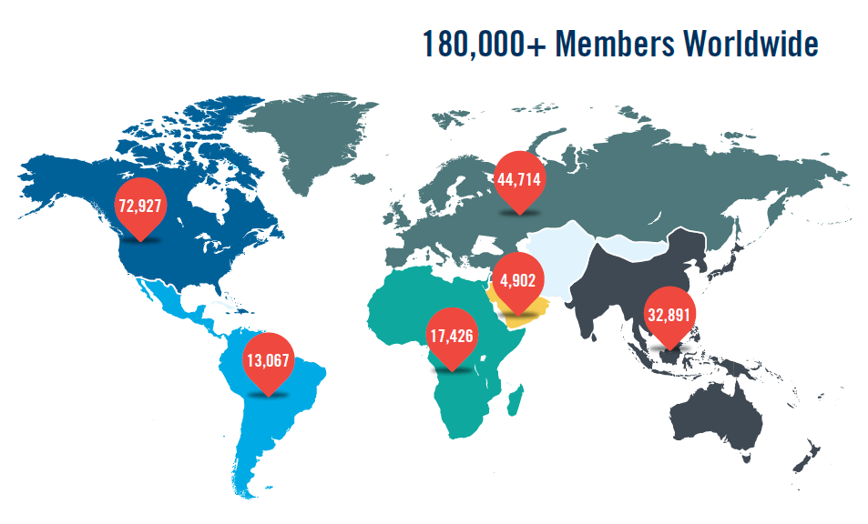
Global picture

Slide 7
IIA Mission
The mission of The Institute of Internal Auditors is to provide dynamic leadership for the global profession of internal auditing

Slide 8
IIA Vision
The IIA will be the global voice of
the internal audit profession: advocating its value, promoting best practice, and providing exceptional service to its members.

Slide 9
The Institute of Internal Auditors
VOLUNTEER ORGANIZATION
More than185,000 MEMBERS IN 190 COUNTRIES
NORTH AMERICAN
BOARD
Canadian Board
Chapter Relations
Learning Solutions
NA Advocacy
Publications Advisory
Regional Conference
BOARD OF DIRECTORS
(MEMBERS-RESEARCH FOUNDATION)
Executive Committee (10)
NA Directors (10)
Institute Directors (10)
Directors at Large (6)
Chairman, Audit Committee (1)
IIA President & CEO (1)
GLOBAL NOMINATING COMMITTEE
GLOBAL COUNCIL
AUDIT COMMITTEE
IPPF OVERSIGHT COUNCIL
RESEARCH FOUNDATION
Vice Chairman (President, RF)
Board of Trustees
Committee of Research &
Education Advisors
EXECUTIVE COMMITTEE
Chairman of the Board
Senior Vice Chairman
Vice Chairmen (5)*
Secretary
Past Chairmen (2)
SENIOR VICE CHAIRMAN
IAAAF/Academic Relations
PAST CHAIRMEN
Global Advocacy (ONA)
NA Board Liaison (NA)
SECRETARY
Global Ethics
VICE CHAIRMAN – FINANCE
(Chairman, GFC)
Global Finance
Investment
PROFESSIONAL CERTIFICATIONS
ADVISORY COUNCIL
Vice Chairman
Professional Certification Board
Exam Development Committee
GLOBAL SERVICES ADVISORY COUNCIL
Vice Chairman
Global Professional Development
Institute Relations
PROFESSIONAL
GUIDANCE
ADVISORY COUNCIL
Vice Chairman
International lnternal Audit Standards Board
Professional Issues
Public Sector
*VC-Global Services, VC-Professional Guidance, VC-Professional Certifications, VC-Research,
VC-Finance

Slide 10
Strategic Plans

Slide 11
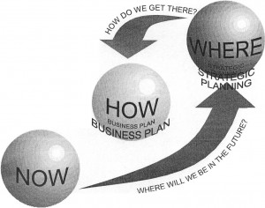

Global Strategic Plan 2012-2016

Slide 12
Global Strategic Plan
The IIA’s Core Purpose
To advance the profession and its value around the world.
The IIA’s Big Audacious Goal
Internal audit professionals will be universally recognized as indispensible to effective governance, risk management, and control.
Notes:
The Core purpose identifies the big picture – why the organization will or should not exist 10 to 30 years into the future. What sense of purpose will motivate members to dedicate their creative energies to The IIA and its efforts over a long period of time?
As you can see on the screen, the core purpose of The IIA is simple: To advance the profession and its value around the world.
The 10- to 15-year envisioned future consists of a single, big audacious goal (BAG) or vision. Because it is “audacious” it represents a significant challenge, and its achievement will require all members, institutes, and committees to embrace it. It helps to set the direction for the succession of future three- to five-year strategic plans.
I believe we all want to embrace the goal that “Internal audit professionals will be universally recognized as indispensible to effective governance, risk management, and control.”

Slide 13
Strategic Goals
Goal A: PROFESSIONALISM
The IIA will be the driving force for the development of
high-performing internal audit professionals, indispensible
to their organizations
Goal B: MEMBERSHIP/VALUE PROPOSITION
The IIA will deliver the value that compels current, future, and former internal auditors to be members
Goal C: ADVOCACY
The IIA will have positively raised the profile of, and demand for, professional internal auditing, globally

Slide 14
Strategic Goals
Goal D: GOVERNANCE
The IIA will have a global operating model in place where all affiliated institutes are aligned on core principles
Goal E: FINANCIAL
IIA Global operations will be self-sufficient financially with adequate reserves to carry out its core purpose and strategic direction

Slide 15
Exam development and maintenance

Slide 16
Global professional certifications
1941
IIA is born
1973
CIA launches
1978
CIA in 55 global sites
1990
CIA in Spanish and French
2000
CGAP launches
2001
CCSA launches
2002
CFSA acquired
2008
Computer based testing
2011
100,000 CIAs
2011
CRMA launches
2014
QIAL launches
2015
Internal Audit Practitioner
2015
BEAC administration
2014
CGAP review starts
2015
CFSA review starts

Slide 17
Growth of certifications by decade

Slide 18
Global professional certifications
80,000 exam parts delivered annually
19 different languages
750 test centers in 140 countries
Computer based and web based
Test center and (coming soon) remote proctoring
Multiple choice
Case studies and essays
Presentation and panel interview
Short answer

Slide 19
Global Certification Portfolio 2015
12 different Programs
Exams available in 19 languages
Computer based testing since 2008
China last country to convert from pencil and paper in 2014
On-line candidate management system
Testing on demand 24/7
Global network of test centers
750 centers
140 countries

Slide 20
Creating a new program
Market analysis – strategic gap
Global job analysis study
Global item writing program
Technical review
Translation and QA
Global pre-testing
Global committee approval
Publication
Continuous monitoring
Retirement

Slide 21
Lessons Learned
Creating exam content is expensive
Generating content
Validating content
Translation
System infrastructure
Subject matter expertise
Staff and IT resources

Slide 22
Challenges
Security
Candidate ID
Exposure of content
False claims to be certified
Keeping content up to date
Maintaining a sufficient pipeline for continuous replenishment
Maintaining reserve item banks as security against exposure

Slide 23
Challenges
Providing supporting materials in local languages
CPE monitoring
Complexities of administration – requires business partners for:
Item bank management
Exam production
Exam delivery
Security
Candidate management
Certificate production

Slide 24
Keeping it relevant
Global job analysis study
Psychometric tools and analysis
Validated reference material on which to base questions
Motivated team of subject matter experts
Continuous flow of new items
Cyclical review of program
Maintaining a global perspective

Slide 25
Future opportunities
Collaborate in development
Collaborate in delivery
Mutual recognition of respective programs

Slide 26
Contact Information

Slide 27
Gerry Cox
gerry.cox@southwestaudit.co.uk
Cyndi Plamondon, VP Certifications
cyndi.plamondon@theiia.org

Slide 28

Questions?

Slide 29


